Slide 1
Potential That Does Not Remain Confidential
ICEL, Sunday March 15, 2015.
Joseph Dimitrov
Notes:
1

Slide 2
1 Peter 2:16
Act as free men, and do not use your freedom as a covering for evil, but use it as bondslaves of God.
Notes:
2

Slide 3
Romans 6:22,
But now having been freed from sin and enslaved to God, you derive your benefit, resulting in sanctification, and the outcome, eternal life.
Notes:
3

Slide 4
Notes:
4

Slide 5
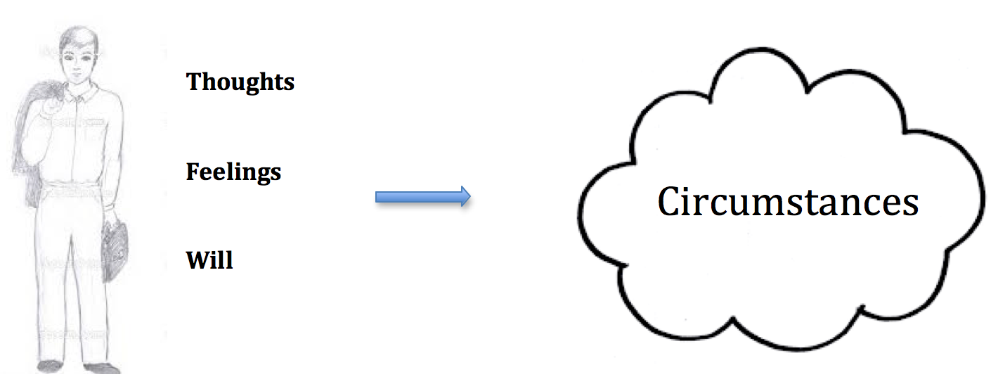
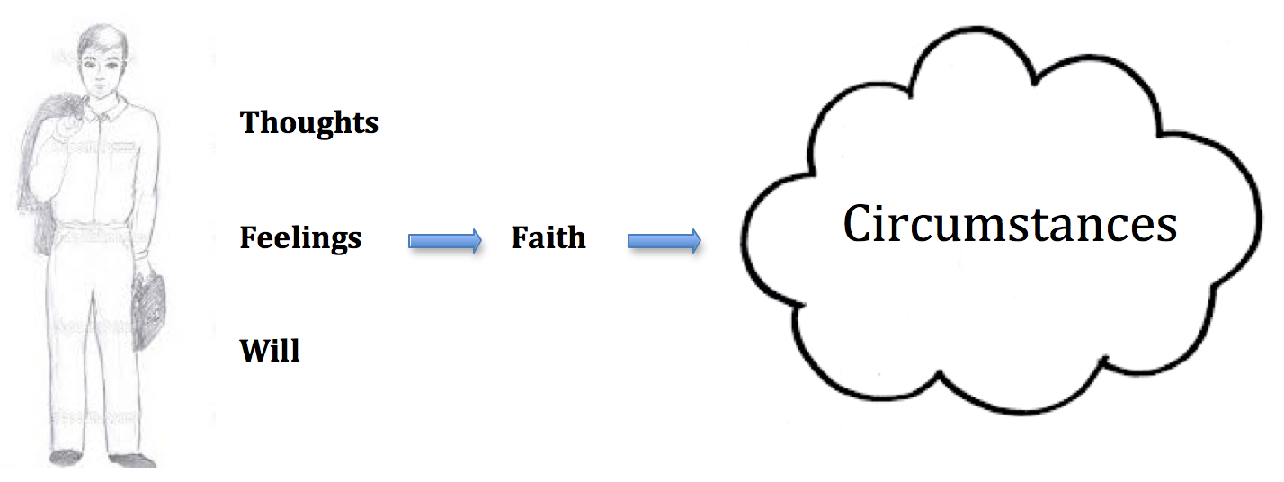
Notes:
5

Slide 6
I. The challenge of our circumstances reveals the placement of our potential

Slide 7
There is no better way to find what you are able to do than to be challenged.

Slide 8
A wrong definition about faith:
“faith is enthusiasm without reason”

Slide 9
Hebrews 11:19
He considered that God is able to raise people even from the dead, from which he also received him back as a type.

Slide 10
Hebrews 11:13
All these died in faith, without receiving the promises, but having seen them and having welcomed them from a distance, and having confessed that they were strangers and exiles on the earth.

Slide 11
II. The challenge of our circumstances reveals the foundation of our potential

Slide 12
A wrong definition about faith:
“faith is blind conviction”

Slide 13
Faith is a state of the spirit that looks to God as One who knows His job.

Slide 14
That
which we do not see
becomes more powerful
to influence us than
what we do see.

