Slide 1
Ron Michener 29 April 2018
Title: The Incarnate Love of God
1John 4:7-12, 19-21 (ESV)
Notes:
1
1

Slide 2
Introduction: Love?
Notes:
2
2

Slide 3
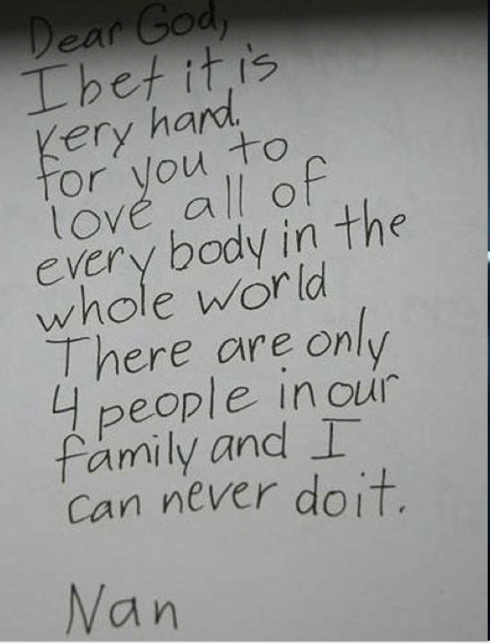
Introduction: Love?
Notes:
3
3

Slide 4
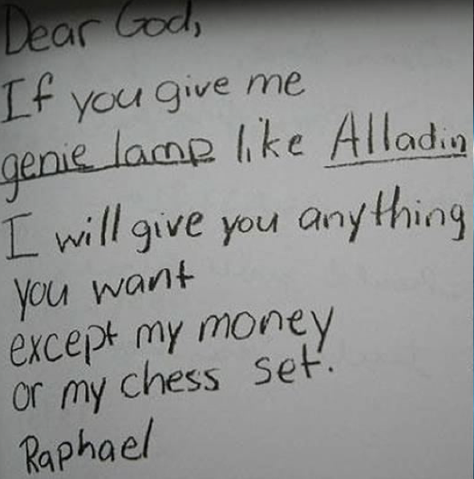
Introduction: Love?
Notes:
4
4

Slide 5
1. Background: Opposition to embodiment
Notes:
5
5

Slide 6
2. God’s love is embodied
1 John 1:1
That which was from the beginning, which we have heard, which we have seen with our eyes, which we looked upon and have touched with our hands, concerning the word of life—
Notes:
6
6

Slide 7
2. God’s love is embodied
John 1:14
And the Word became flesh and dwelt among us, and we have seen his glory, glory as of the only Son from the Father, full of grace and truth.
Notes:
7
7

Slide 8
2. God’s love is embodied
1 John 4:7-10
⁷ Beloved, let us love one another, for love is from God, and whoever loves has been born of God and knows God. ⁸ Anyone who does not love does not know God, because God is love. ⁹ In this the love of God was made manifest among us, that God sent his only Son into the world, so that we might live through him. ¹⁰ In this is love, not that we have loved God but that he loved us and sent his Son to be the propitiation for our sins.
Notes:
8
8

Slide 9
3. Our Love for God is embodied towards others
1 John 3:16-18
¹⁶ By this we know love, that he laid down his life for us, and we ought to lay down our lives for the brothers.
¹⁷ But if anyone has the world's goods and sees his brother in need, yet closes his heart against him, how does God's love abide in him?
¹⁸ Little children, let us not love in word or talk but in deed and in truth.
Notes:
9
9

Slide 10
3. Our Love for God is embodied towards others
1 John 4:11-12, 19-21
¹¹ Beloved, if God so loved us, we also ought to love one another. ¹² No one has ever seen God; if we love one another, God abides in us and his love is perfected in us.
Notes:
10
10

Slide 11
3. Our Love for God is embodied towards others
1 John 4:19-21
¹⁹ We love because he first loved us. ²⁰ If anyone says, “I love God”, and hates his brother, he is a liar; for he who does not love his brother whom he has seen cannot[a] love God whom he has not seen. ²¹ And this commandment we have from him: whoever loves God must also love his brother.
Notes:
11
11

Slide 12
Conclusion and Key idea
God’s embodied love through Jesus animates our embodied love for others.
Notes:
12
12

