Slide 1
‘The transfiguration of Jesus’
ICEL Leuven
3 March 2019
Pieter Boersema

Slide 2
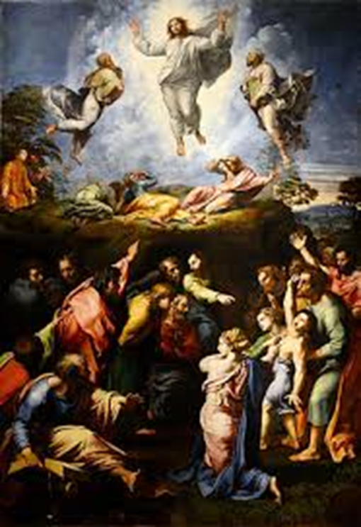
Luke 9: 28 – 31
About eight days after Jesus said this, he took Peter, John and James with him and went up onto a mountain to pray.
As he was praying, the appearance of his face changed, and his clothes became as bright as a flash of lightning.
Two men, Moses and Elijah, appeared in glorious splendor, talking with Jesus.
They spoke about his departure, which he was about to bring to fulfillment at Jerusalem.
Painting: Rafael, 1520

Slide 3
Heaven and Earth (1):
two different domains connected by Jesus
‘About eight days before the Transfiguration Jesus began to teach them that he should suffer and be rejected by the priests, the scribes and church leaders’.
The story of Jesus feeds the Five Thousand (Luke 9: 10-17).
The 5 loaves of bread and two fishes were multiplied by Jesus and the left over was gathered in twelve baskets.
In John 6: 25- 70 we can read that the following day, the people were looking for Jesus again. When they found him Jesus thought that he was ‘the Bread of life’. He is the living bread that came down from heaven (vs 51).
He was more than Moses and more than a prophet.
This message was hard teaching (vs. 60) and many of his disciples turned back and no longer followed him (vs. 66).
Heaven and Earth: wo different dmains connected by Jesus

Slide 4
Heaven and Earth (2):
two different domains connected by Jesus
The people expected a Messiah who was able to act miraculous like healing and feeding, but not a Messiah who gave his live as a redemption for those who believed him as sent by God.
The story of the transfiguration of Jesus, together with Moses (Thora) and Elijah (Prophets) has the same elements.
They spoke about his departure, which he was about to bring to fulfillment at Jerusalem.
As the men were leaving Jesus, Peter said to him, “Master, it is good for us to be here. Let us put up three shelters: one for you, one for Moses and one for Elijah.”
While he was speaking, a cloud appeared and covered them, and they were afraid as they entered the cloud.
God said : “This is my Son, whom I love. Listen to him!”
Heaven and Eath:
two different domains connected by Jesus

Slide 5
The earthly understanding of heavenly decisions
Up till the moment of the resurrection of Jesus at Easter, it was still difficult to understand that Jesus had to die at the cross as an act of redemption (e.g. the disciples from Emmaus).
The people in the time of Jesus live on earth was very much seen in terms of power and the Messiah was the expected king who would defeat the Romans, those who occupied Israel.
The rejection of God by the people on earth, could only be forgiven by an act from heaven. “So that, just as sin reigned in death, so also grace might reign through righteousness to bring eternal life through Jesus Christ our Lord (Rom. 5:21).
The reality of the earthly struggle to accept the mercy from heaven, to follow Jesus by trial and error as humans, is very good explained in the painting ‘the battle between carnival and fasting’ by Pieter Bruegel.

Slide 6
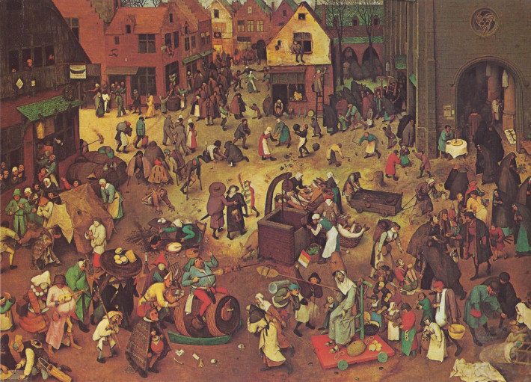
Pieter Bruegel 1559 The battle between Carnival and Fasting

Slide 7
The start of the 40 days of Lent
The word carnival comes from the Latin ‘carnelevarium’ which means the removal of meat.
Because Lent was a period of fasting, carnival therefore represented a last period of feasting and celebration before the spiritual rigors of Lent. A sociological and psychological act.
The painting of Bruegel explains the different aspects.
The left side of the painting stands for the carnival and the right side for the church where the confession is taken.
It is the ‘battle’ between ‘fat versus lean’, but in the middle these two come together in the image of the well: the mirror of yourself.
We see lame, crippled and the blind throughout the painting.
Blue (all over) stands for ‘the other world’, the façade of truth.
Personal conclusion: To follow Jesus is to do good to people in need, to accept your shortcomings, to trust Jesus and to know yourself.

Slide 8
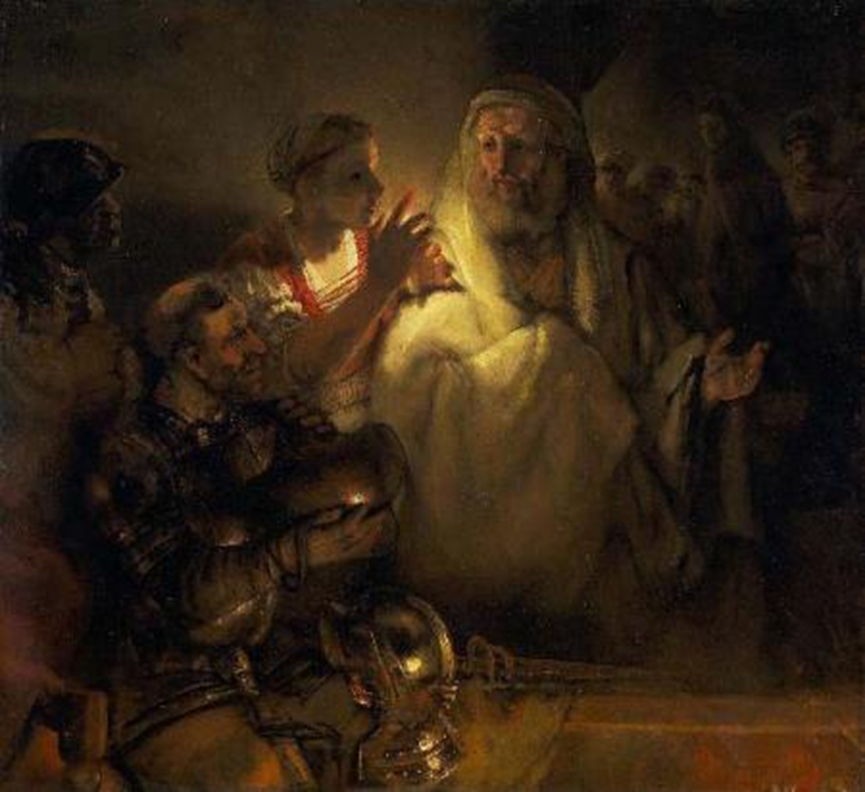
Simon Peter as Rembrandt, 1660
an example for us the denial of Peter
Peter’s confession that Jesus is the Christ (Math. 16:16).
After Jesus predict his death, Peter rebuked him, “this shall never happen to you” (vs. 22).
Peter wants to set up 3 shelters.
The denial and understanding:
“We are redeemed with the precious blood of Christ, a lamb without blemish or defect. He was chosen before the creation of the world, but was revealed in these last times for your sake. Through him you believe in God, who raised him from the dead and glorified him, and so your faith and hope are in God”. 1 Peter 1:19-21
Notes:
8

Slide 9
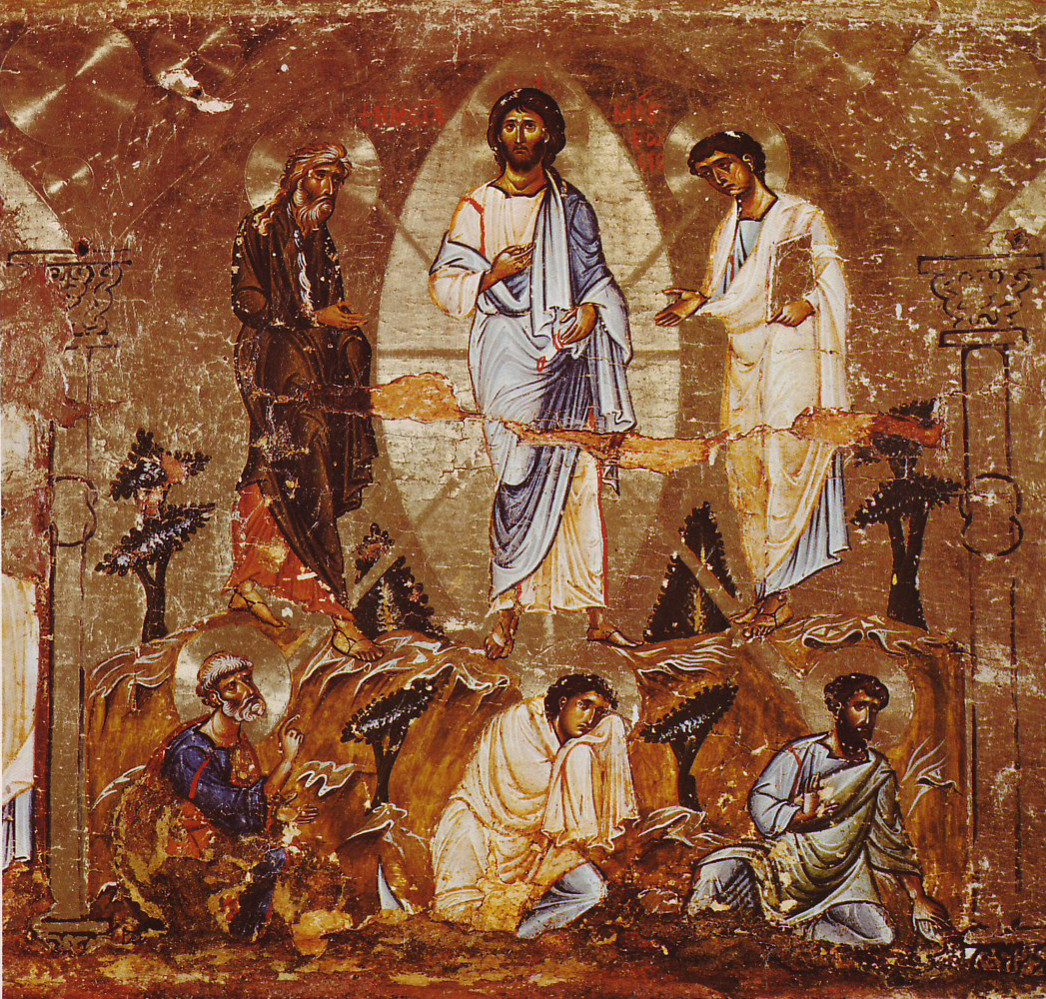
The image of Jesus 12th-century icon of the Transfiguration
the Messiah
We are entering the 40 days before Easter, the remembrance of Jesus Christ crucified, descended to hell and raised from the grave on the third day.
This gift from God we can only accept by confessing our sins.
The bible stories of Simon Peter can be a revelation to us.
Jesus accepted Peter after the resurrection of Jesus.
His invitation to partake at the Holy Communion is the opening to restore your faith in Him.
Notes:
9

