Slide 1
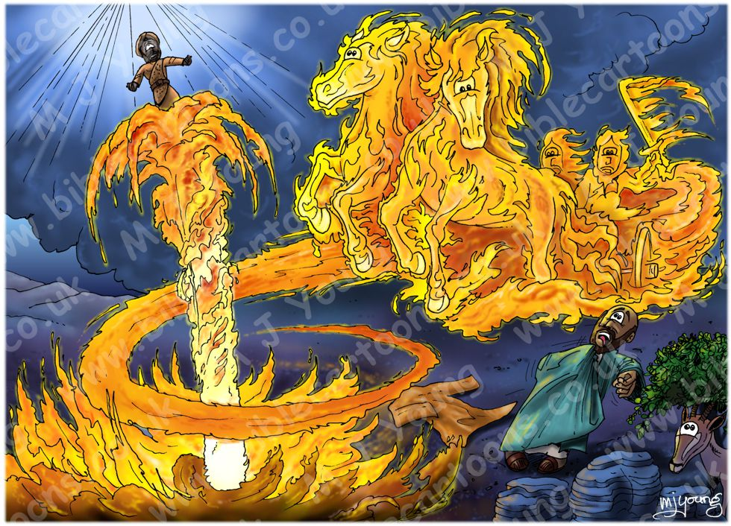
Going away, on your way
2 Kings 2:1-14
ICEL
June 30, 2019
Notes:
https://www.biblecartoons.co.uk/images/568.jpg (accessed 28/08/3029)/

Slide 2
Elijah leaves Elisha
This motif, central to the text, appears in several ways:
Announced at the beginning (v. 1)
Admitted by Elisha and other prophets (vv. 2-5)
Mentioned in dialogue (vv. 9-10)
Described in the narrative (vv. 11-12)

Slide 3
A puzzling story
Unique of its kind in either the Old or New Testament
Contains many features so far not satisfactorily explained
Variously explained in later texts
Merits our reflection on why it is recounted here and what meaning we can take away.

Slide 4
Going away, on your way
Look closely at how the story fits in the book of (2) Kings;
Follow how the story develops;
Ask what it might mean for us in different life situations today.

Slide 5
Fitting the story into Kings
Elijah is introduced, without any description, announcing drought to Ahab, king of Israel (1 Kings 17:1).
Elisha equally abruptly called by Elijah (1 Kings 19:19-21) who throws “his cloak around him.”
Four chapters and several kings (and probably years) later Elijah departs (2 Kings 2: 1-12).
Elijah then takes up the cloak and prophetic work of his master (2 Kings 2:13-13:20)

Slide 6
How the story unfolds
1. Traveling with tension (vv. 1b-6):
Elijah and Elisha were on their way from Gilgal.
² Elijah said to Elisha, "Stay here; the LORD has sent me to Bethel." But Elisha said, "As surely as the LORD lives and as you live, I will not leave you." So they went down to Bethel.
³ The company of the prophets at Bethel came out to Elisha and asked, "Do you know that the LORD is going to take your master from you today?" "Yes, I know," Elisha replied, "so be quiet."
⁴ Then Elijah said to him, "Stay here, Elisha; the LORD has sent me to Jericho." And he replied, "As surely as the LORD lives and as you live, I will not leave you." So they went to Jericho.

Slide 7
How the story unfolds
1. Traveling with tension (vv. 1b-6):
⁵ The company of the prophets at Jericho went up to Elisha and asked him, "Do you know that the LORD is going to take your master from you today?" "Yes, I know," he replied, "so be quiet."
⁶ Then Elijah said to him, "Stay here; the LORD has sent me to the Jordan." And he replied, "As surely as the LORD lives and as you live, I will not leave you." So the two of them walked on.

Slide 8
Final stop and departure
2. Final stop and request (vv. 7-10)
⁷ Fifty men from the company of the prophets went and stood at a distance, facing the place where Elijah and Elisha had stopped at the Jordan.
⁸ Elijah took his cloak, rolled it up and struck the water with it. The water divided to the right and to the left, and the two of them crossed over on dry ground.
⁹ When they had crossed, Elijah said to Elisha, "Tell me, what can I do for you before I am taken from you?" "Let me inherit a double portion of your spirit," Elisha replied.
¹⁰ "You have asked a difficult thing," Elijah said, "yet if you see me when I am taken from you, it will be yours-- otherwise, it will not."

Slide 9
3. Departure and consequences (vv. 11-14):
¹¹ As they were walking along and talking together, suddenly a chariot of fire and horses of fire appeared and separated the two of them, and Elijah went up to heaven in a whirlwind.
¹² Elisha saw this and cried out, "My father! My father! The chariots and horsemen of Israel!" And Elisha saw him no more. Then he took hold of his garment and tore it in two.
¹³ Elisha then picked up Elijah's cloak that had fallen from him and went back and stood on the bank of the Jordan.
¹⁴ He took the cloak that had fallen from Elijah and struck the water with it. "Where now is the LORD, the God of Elijah?" he asked. When he struck the water, it divided to the right and to the left, and he crossed over.

Slide 10
Taking something away
Review the relationship between Elijah and Elisha
How our relationships, past and present, resemble theirs
What to learn from this story

Slide 11
The relationship of Elijah and Elisha

Slide 12
Like or unlike ours?
Whether as learner or teacher

Slide 13
Learning from the story
Be thankful for learner and teacher relationships we have had or now have and value them.
Bring closure to those that have ended.
Trust “the God of Elijah”, our God, to lead us on our way with what we have experienced, for the benefit of others.

Slide 14
Notes:
https://www.restored2yoursoul.com/uploads/2/0/5/4/20545172/relationship-landscape_1.jpg (accessed 28/06/2019)

