Slide 1
Calling

Slide 2
Ephesians 4:1-16 Unity and Maturity in the Body of Christ
1 As a prisoner for the Lord, then, I urge you to live a life worthy of the calling you have received.
2 Be completely humble and gentle; be patient, bearing with one another in love.

Slide 3
3 Make every effort to keep the unity of the Spirit through the bond of peace.
4 There is one body and one Spirit, just as you were called to one hope when you were called;
5 one Lord, one faith, one baptism;
6 one God and Father of all, who is over all and through all and in all.

Slide 4
7 But to each one of us grace has been given as Christ apportioned it.
8 This is why it says:
“When He ascended on high, He took many captives and gave gifts to his people.”
(9 What does “He ascended” mean except that He also descended to the lower, earthly regions?
10 He who descended is the very one who ascended higher than all the heavens, in order to fill the whole universe.)

Slide 5
11 So Christ himself gave the apostles, the prophets, the evangelists, the pastors and teachers,
12 to equip his people for works of service, so that the body of Christ may be built up
13 until we all reach unity in the faith and in the knowledge of the Son of God and become mature, attaining to the whole measure of the fullness of Christ.

Slide 6
14 Then we will no longer be infants, tossed back and forth by the waves, and blown here and there by every wind of teaching and by the cunning and craftiness of people in their deceitful scheming.
15 Instead, speaking the truth in love, we will grow to become in every respect the mature body of him who is the head, that is, Christ.
16 From him the whole body, joined and held together by every supporting ligament, grows and builds itself up in love, as each part does its work.

Slide 7
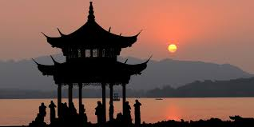
My calling to China

Slide 8
God's calling for me?

Slide 9
Ephesians 4:1-16 Unity and Maturity in the Body of Christ
1 As a prisoner for the Lord, then, I urge you to live a life worthy of the calling you have received.
2 Be completely humble and gentle; be patient, bearing with one another in love.

Slide 10
14 Then we will no longer be infants, tossed back and forth by the waves, and blown here and there by every wind of teaching and by the cunning and craftiness of people in their deceitful scheming.
15 Instead, speaking the truth in love, we will grow to become in every respect the mature body of him who is the head, that is, Christ.
16 From him the whole body, joined and held together by every supporting ligament, grows and builds itself up in love, as each part does its work.

Slide 11
“Growing Mindset”
IQ / character
is not fixed
“Mistakes”
are opportunities
to learn
Don’t be afraid
of new challenges

Slide 12
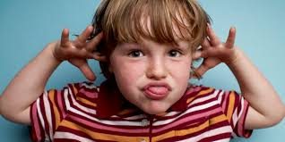
Positive Discipline (Jane Nelsen)
A misbehaving child is a discouraged child.
A sense of not belonging
Not feeling significant

Slide 13
My own struggles
* “feeling significant”

Slide 14
My own struggles
* “belonging”

Slide 15
Discovering your calling

Slide 16
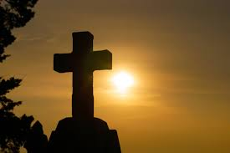
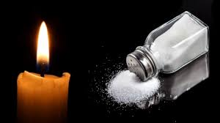
Discovering your calling
-Meditation: Ask God!

Slide 17
Song: Image
You have made me in Your image
And You saw that it was good
So help me Lord to live this image
And walk in Your ways as I should
And though I know I will do wrong
When I'm weak, You always will be strong!

Slide 18
Volunteer work / donations / News letters
- Shabai's news letters / questions
E-mail: elisabethchina@gmail.com

