Slide 2
1 Cor 1:10-18
FIRST THINGS FIRST:
Thoughts on undividedness

Slide 3
Epiphany season
² The people who walk in darkness will see a great light
Isaiah 9
¹⁷ From then on Jesus began to preach
Matthew 4
⁴ The one thing I ask of the Lord— the thing I seek most—
Psalm 27
¹⁰ be united in the same mind and the same purpose
1 Corinthians 1

Slide 4
About division
1 Cor. 1:10-18
¹⁰ Now I appeal to you, brothers and sisters, by the name of our Lord Jesus Christ, that all of you be in agreement and that there be no divisions among you, but that you be united in the same mind and the same purpose. ¹¹ For it has been reported to me by Chloe’s people that there are quarrels among you, my brothers and sisters. ¹² What I mean is that each of you says, “I belong to Paul,” or “I belong to Apollos,” or “I belong to Cephas,” or “I belong to Christ.” ¹³ Has Christ been divided? Was Paul crucified for you? Or were you baptized in the name of Paul? ¹⁴ I thank God that I baptized none of you except Crispus and Gaius, ¹⁵ so that no one can say that you were baptized in my name. ¹⁶ (I did baptize also the household of Stephanas; beyond that, I do not know whether I baptized anyone else.) ¹⁷ For Christ did not send me to baptize but to proclaim the gospel, and not with eloquent wisdom, so that the cross of Christ might not be emptied of its power. ¹⁸ For the message about the cross is foolishness to those who are perishing, but to us who are being saved it is the power of God. (NRSV)

Slide 5
About division
1 Cor. 1:10-18
¹⁰ Now I appeal to you, brothers and sisters, by the name of our Lord Jesus Christ, that all of you be in agreement and that there be no divisions among you, but that you be united in the same mind and the same purpose.
¹¹ For it has been reported to me by Chloe’s people that there are quarrels among you, my brothers and sisters. ¹² What I mean is that each of you says, “I belong to Paul,” or “I belong to Apollos,” or “I belong to Cephas,” or “I belong to Christ.”
¹³ Has Christ been divided? Was Paul crucified for you? Or were you baptized in the name of Paul? ¹⁴ I thank God that I baptized none of you except Crispus and Gaius, ¹⁵ so that no one can say that you were baptized in my name. ¹⁶ (I did baptize also the household of Stephanas; beyond that, I do not know whether I baptized anyone else.)
¹⁷ For Christ did not send me to baptize but to proclaim the gospel, and not with eloquent wisdom, so that the cross of Christ might not be emptied of its power. ¹⁸ For the message about the cross is foolishness to those who are perishing, but to us who are being saved it is the power of God. (NRSV)
APPEAL
OBSERVATION
DEBATE
REFOCUS

Slide 6
Unity
What it shouldn’t look like
False belonging
‘Has Christ been divided?’ (vs. 13)

Slide 7
Unity

Slide 8
Unity
What it shouldn’t look like
False belonging
Non-essentials
‘Or were you baptized in the name of Paul?’ (vs. 13)

Slide 9
Unity

Slide 10
Unity
What it shouldn’t look like
What it should be like
False belonging
Same mind
Non-essentials

Slide 11
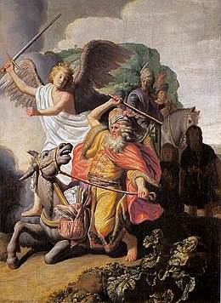
Unity

Slide 12
Unity
What it shouldn’t look like
What it should be like
False belonging
Same mind
Non-essentials
Same purpose

Slide 13
Unity

Slide 14
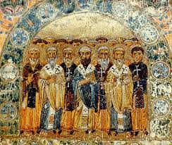
Unity
³² All the believers were united in heart and mind. And they felt that what they owned was not their own, so they shared everything they had. (Acts 4, NLT)

