Slide 1
Hosanna !
Jesus’ triumphal entry in Jerusalem (John 12:12-16)

Slide 2
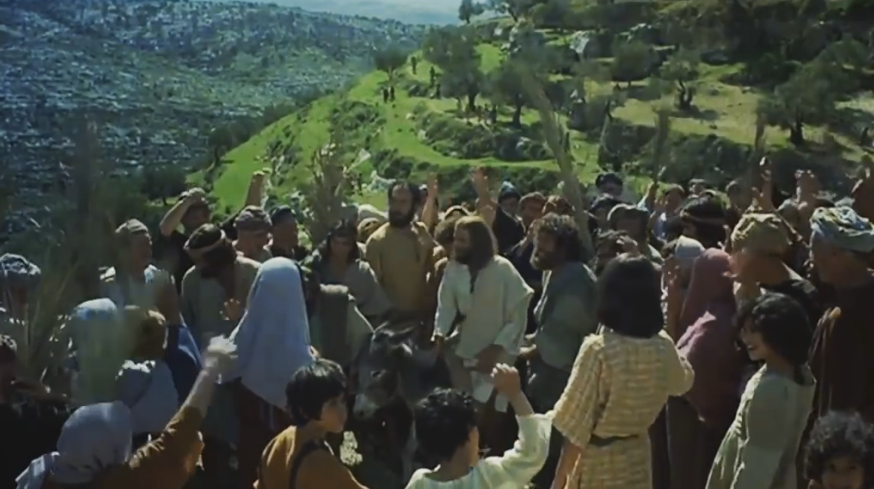

Slide 3
¹² The next day the large crowd that had come to the feast heard that Jesus was coming to Jerusalem.

Slide 4
¹³ So they took branches of palm trees and went out to meet him, crying out, “Hosanna! Blessed is he who comes in the name of the Lord, even the King of Israel!”

Slide 5
¹⁴ And Jesus found a young donkey and sat on it, just as it is written,
¹⁵ “Fear not, daughter of Zion;
behold, your king is coming,
sitting on a donkey's colt!”

Slide 6
¹⁶ His disciples did not understand these things at first, but when Jesus was glorified, then they remembered that these things had been written about him and had been done to him.

Slide 7
¹⁶ His disciples did not understand these things at first, but when Jesus was glorified, then they remembered that these things had been written about him and had been done to him.
Psalm 118 !

Slide 8
Matthew 21:42
Jesus said to them, “Have you never read in the Scriptures: “‘The stone that the builders rejected has become the cornerstone; this was the Lord's doing, and it is marvelous in our eyes’?

Slide 9
Psalm 118:14

Slide 10
¹⁷ I shall not die, but I shall live,
and recount the deeds of the LORD.
¹⁸ The LORD has disciplined me severely,
but he has not given me over to death.

Slide 11
¹⁹ Open to me the gates of righteousness,
that I may enter through them
and give thanks to the LORD.
²⁰ This is the gate of the LORD;
the righteous shall enter through it.

Slide 12
²¹ I thank you that you have answered me
and have become my salvation.

Slide 13
Psalm 118:21

Slide 14
Psalm 118:25

Slide 15
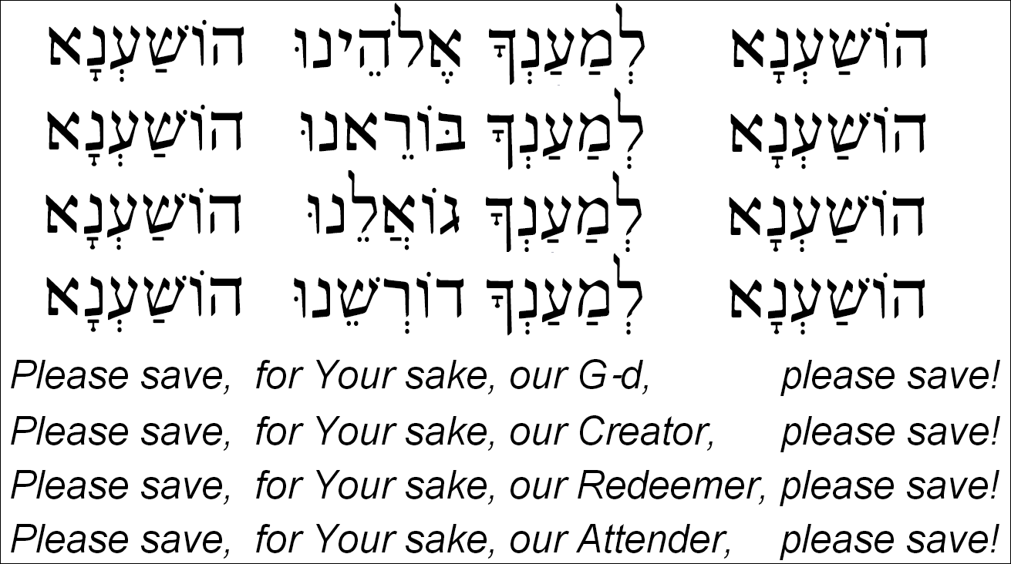
Hoshana prayers at Succot

Slide 16
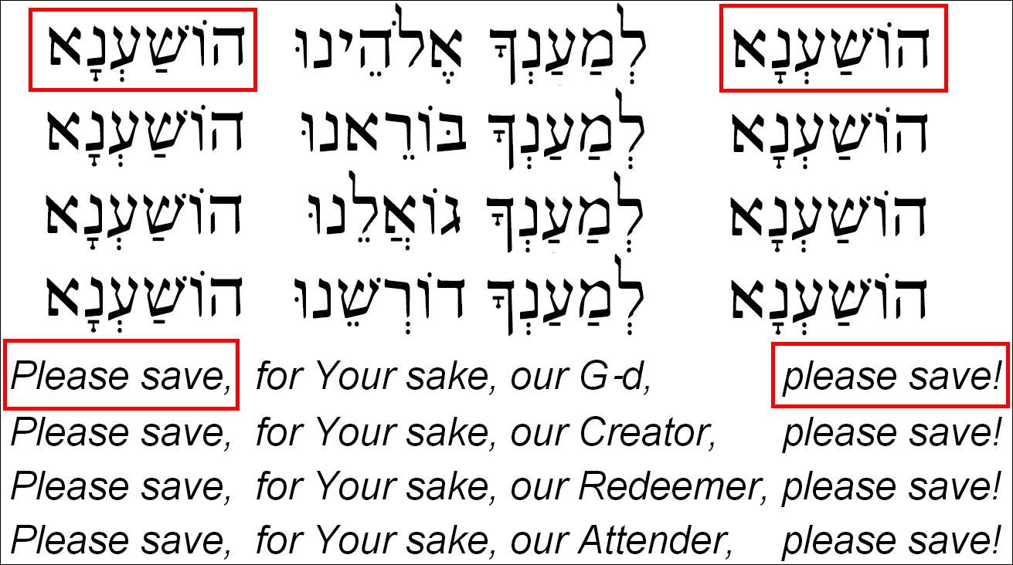

Slide 17
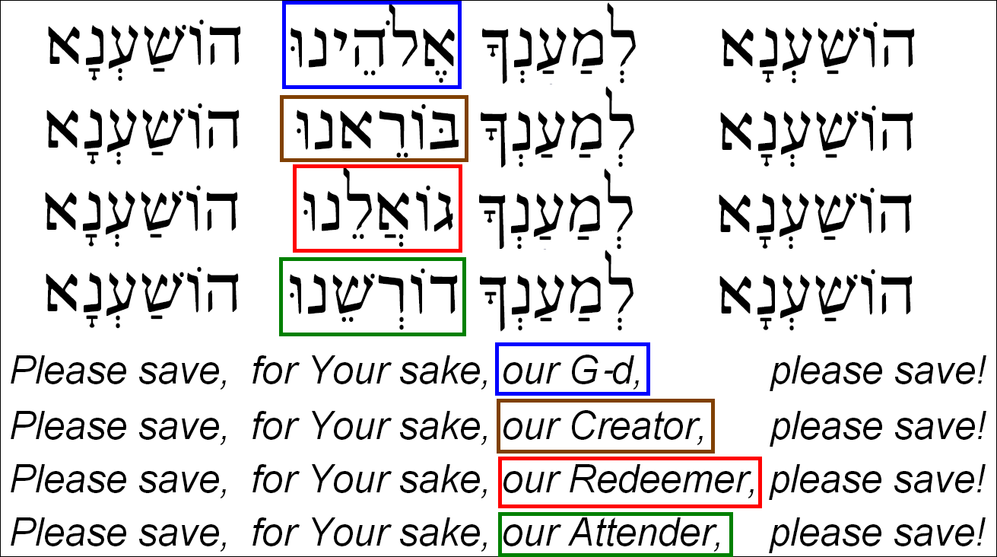

Slide 18
From Hoshana ritual for Succot

Slide 19
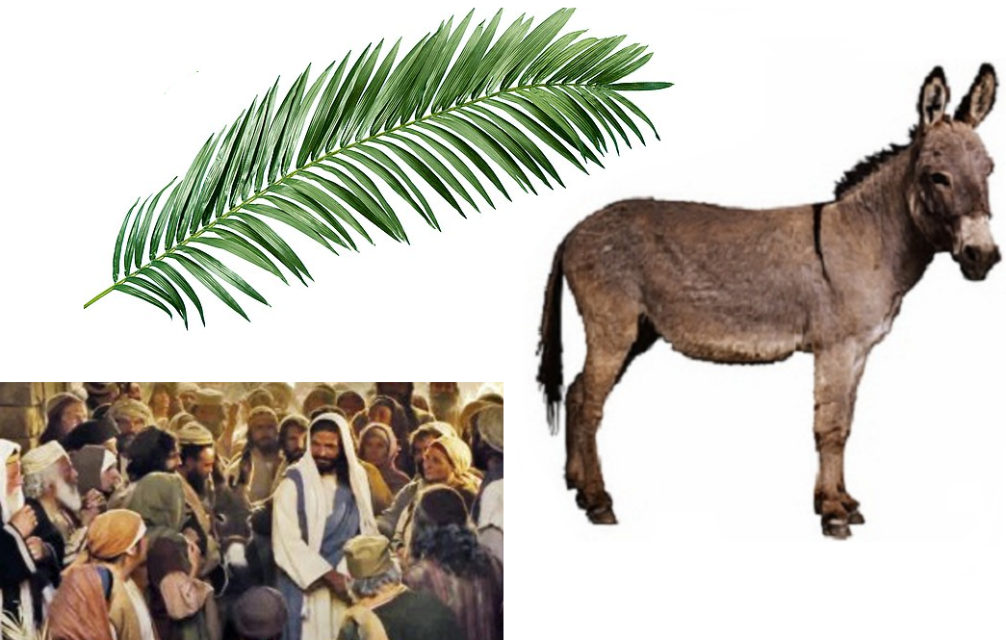

Slide 20
Luke 19:39–40
And some of the Pharisees in the crowd said to him, “Teacher, rebuke your disciples.”
He answered, “I tell you, if these were silent, the very stones would cry out.”

