Slide 1
"Zeal for your house will consume me"
John 2:13-22

Slide 2
The Passover of the Jews was at hand,
and Jesus went up to Jerusalem.

Slide 3
Pilgrim song: Psalm 84
¹ How lovely is your dwelling place,
LORD Almighty!
² My soul yearns, even faints,
for the courts of the LORD;
my heart and my flesh cry out
for the living God.

Slide 4
³ Even the sparrow has found a home,
and the swallow a nest for herself,
where she may have her young—
a place near your altar,
LORD Almighty,
my King and my God.

Slide 5
⁴ Blessed are those
who dwell in your house;
they are ever praising you.
⁵ Blessed are those
whose strength is in you,
whose hearts are set on pilgrimage.

Slide 6
In the temple he found those
who were selling oxen
and sheep and pigeons,
and the money-changers
sitting there.

Slide 8
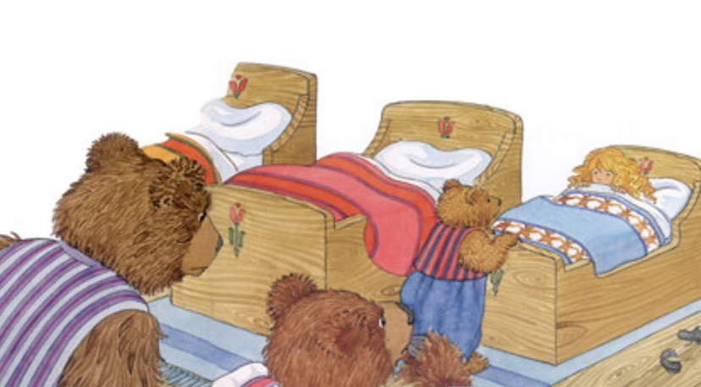

Slide 9
And making a whip of cords,
he drove them all out of the temple,
with the sheep and oxen.

Slide 10
And he poured out the coins
of the money-changers
and overturned their tables.

Slide 11
And he told those who sold the pigeons,
“Take these things away;
do not make my Father's house
a house of trade.”

Slide 12
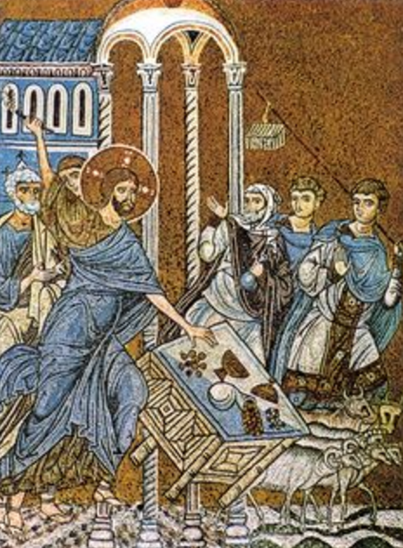

Slide 13
His disciples remembered
that it was written,
“Zeal for your house
will consume me.”

Slide 14
So the Jews said to him,
“What sign do you show us
for doing these things?”

Slide 15
Jesus answered them,
“Destroy this temple,
and in three days I will raise it up.”

Slide 16
The Jews then said,
“It has taken forty-six years
to build this temple,
and will you raise it up
in three days?”

Slide 17
But he was speaking
about the temple of his body.

Slide 18
When therefore he was raised
from the dead,
his disciples remembered
that he had said this,
and they believed the Scripture
and the word that Jesus had spoken.

