Slide 3
Matthew 21:8-10 (New International Version)
⁸ A very large crowd spread their cloaks on the road, while others cut branches from the trees and spread them on the road.
⁹ The crowds that went ahead of him and those that followed shouted,
‘Hosanna to the Son of David!’
‘Blessed is he who comes in the name of the Lord!’
‘Hosanna in the highest heaven!’
¹⁰ When Jesus entered Jerusalem, the whole city was stirred and asked, ‘Who is this?’

Slide 4
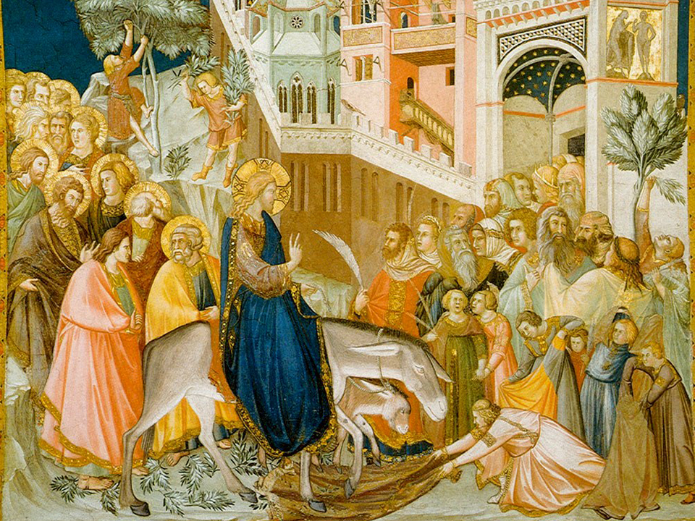

Slide 6
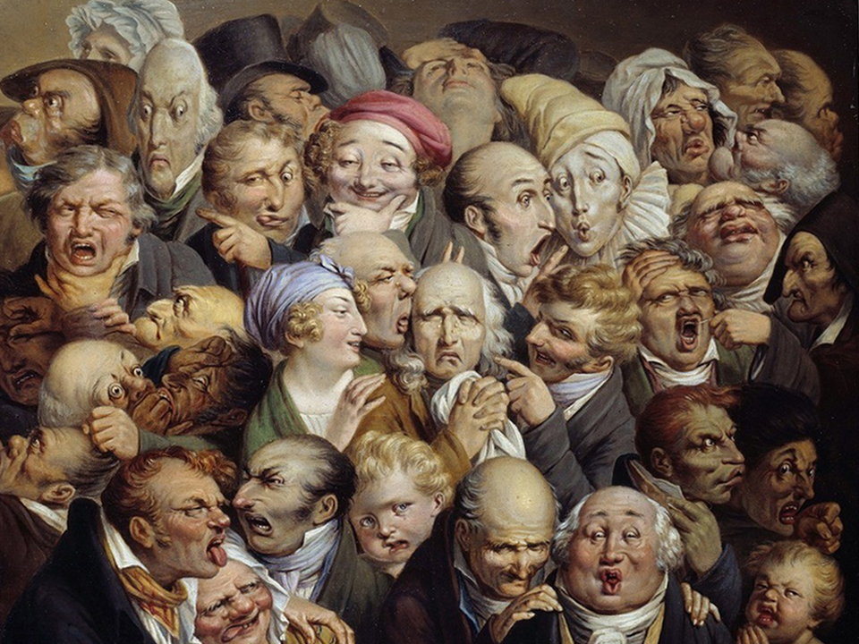

Slide 8
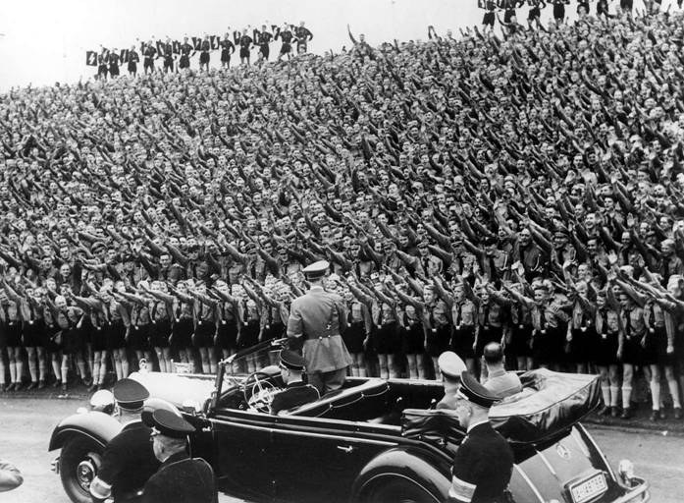

Slide 10
