Slide 1
Finding Peace in the Empty Tomb Responses to the Resurrection…
John 20:1-23

Slide 2
“If Jesus rose from the dead, then you have to accept all that he said; if he didn't rise from the dead, then why worry about any of what he said? The issue on which everything hangs is not whether or not you like his teaching but whether or not he rose from the dead.”
― Timothy Keller, The Reason for God: Belief in an Age of Skepticism

Slide 3
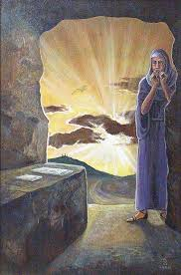
Mary’s Response
Early on the first day of the week, while it was still dark, Mary Magdalene went to the tomb and saw that the stone had been removed from the entrance. 2 So she came running to Simon Peter and the other disciple, the one Jesus loved, and said, “They have taken the Lord out of the tomb, and we don’t know where they have put him!”
The New International Version. (2011). (Jn 20:1–2).

Slide 4
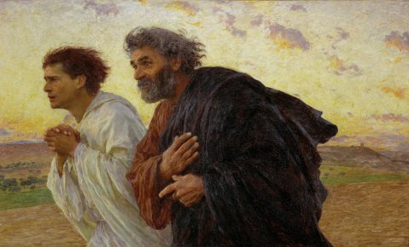
Peter and John’s Response
3 So Peter and the other disciple started for the tomb. 4 Both were running, but the other disciple outran Peter and reached the tomb first.
The New International Version. (2011)
(Jn 20:3–5).

Slide 5
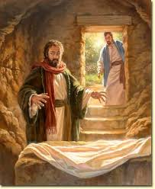
Peter and John’s Response
5 He bent over and looked in at the strips of linen lying there but did not go in. 6 Then Simon Peter came along behind him and went straight into the tomb. He saw the strips of linen lying there, 7 as well as the cloth that had been wrapped around Jesus’ head. The cloth was still lying in its place, separate from the linen. 8 Finally the other disciple, who had reached the tomb first, also went inside. He saw and believed.
The New International Version. (2011). (Jn 20:5–8)

Slide 6
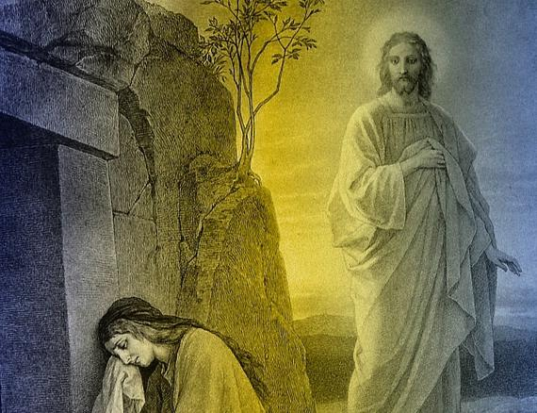
Jesus meets Mary
11 Now Mary stood outside the tomb crying. As she wept, she bent over to look into the tomb 12 and saw two angels in white, seated where Jesus’ body had been, one at the head and the other at the foot.
13 They asked her, “Woman, why are you crying?”
“They have taken my Lord away,” she said, “and I don’t know where they have put him.” 14 At this, she turned around and saw Jesus standing there, but she did not realize that it was Jesus.
The New International Version. (2011). (Jn 20:11–14)

Slide 7
Jesus meets Mary
15 He asked her, “Woman, why are you crying? Who is it you are looking for?”
Thinking he was the gardener, she said, “Sir, if you have carried him away, tell me where you have put him, and I will get him.”
16 Jesus said to her, “Mary.”
She turned toward him and cried out in Aramaic, “Rabboni!” (which means “Teacher”).
The New International Version. (2011). (Jn 20:15–18)

Slide 8
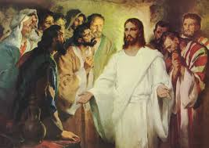
Jesus and the Disciples
19 On the evening of that first day of the week, when the disciples were together, with the doors locked for fear of the Jewish leaders, Jesus came and stood among them and said, “Peace be with you!” 20 After he said this, he showed them his hands and side. The disciples were overjoyed when they saw the Lord.
The New International Version. (2011). (Jn 20:19–20).

Slide 9
Jesus and the Disciples
21 Again Jesus said, “Peace be with you! As the Father has sent me, I am sending you.” 22 And with that he breathed on them and said, “Receive the Holy Spirit. 23 If you forgive anyone’s sins, their sins are forgiven; if you do not forgive them, they are not forgiven.”
The New International Version. (2011).
(Jn 20:21-23).

Slide 10
"Believing in Jesus' resurrection is hard not merely because it's difficult to get our minds around the idea of a person going through death and out into a new sort of bodily existence the other side... It's hard because we are asked to grasp or be grasped by the fact that a new reality, a new mode of existence, has been introduced to the world. This is at the heart of the ongoing revolution: that a new way of being human has been launched, a way that starts with forgiveness, “
N.T Wright, The Day The Revolution Began, PG. 385.

Slide 11
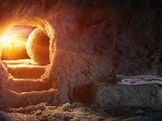
Peace be with you…..
Celebrate the empty tomb by allowing Christ to show you His love for you….

