Slide 1
The Parable of the Workers in the Vineyard
Matthew 20:1-16
Notes:
I want to start by thanking all of you for being there for our family and for all of the help and prayers while we made out transition here - we are looking forward to getting to know all of you and seeking Gods direction for the ministry here in Leuven.
This weeks scripture is from Matthew 20 –it is the parable of the vineyard. Within it I believe are truths that are timely for the church today.
Truth is an interesting notion. One that is based on our own experience and what we have seen and obeserved in life. Yet truth is unchangeable by definition – it is learned and tested by our life’s experience. But sometimes our version of truth isn’t clear. It is not completely seen or understood. When I was 16 I got glasses inconjunction with getting my drivers license I had no idea my eyes were so bad until corrective lenses were used to change how I saw things. When glasses were put on I could see the trees and the leaves on the trees in complete clarity. The definition and brightness was astonishing. How I saw clouds in the sky were very different. The features I could see on peoples face were different. Everything had changed. In a sense Jesus used parables to try to get people to look at things differently.
A parable is a story that communcates spiritual truth. Often Jesus used parables to give a picture of what the coming kingdom of heaven will be like. He used story form to help communicate truth that might challenge the preconceptions that his audience may have had. In this case it his disciples that were being challenged – so the context of the pararble – when and who it was directed to was very important.

Slide 2
Context
Jesus was teaching an audience with a Jewish backgroud
The parable was a response to Jesus Interaction with the Rich Young Ruler
The parable was directed toward His disciples
The parable was a response to Peter about the Kingdom of Heaven
Upon hearing hearing the interaction between Jesus and the rich young man Peter responds,
“We have left everything to follow you! What will there be for us?”
Notes:
Jesus was teaching a group of people primaily with a Jewish background
He was preaching eternal life and the kingdom that was to come. The rich young ruler asks what “good” thing must I do to enter eternal life?
Jesus says don’t kill, don’t steal, don’t commite adultry – he quotes the 10 commandments.
Jesus asks him why he asks about what he should do and why he doesn’t seek out the father – then he would know what he needs to do.
The young man misses the point Jesus is making. He reframes the question – he must have had something
Inside that he knew was wrong – that was lacking so he asks:
“What do I lack…”
Jesus looks into his heart and says – sell all of your possessions and follow me….
The young man left looking sad.
The disciples there watching the interaction. We don’t know what the rich young ruler ultimately did – however the point is that his material posession were getting in the way of his heart truly following God. Jesus knew this.
Peter – in a way that only peter could do responds. He says - we have left everything to follow you! What will be there for us!

Slide 3
Jesus’ Response to Peter
Matthew 19:29-30
“And everyone who has left houses or brothers or sisters or father or mother or children or fields for my sake will receive a hundred times as much and will inherit eternal life. But many who are first will be last and many who are last will be first.”
Notes:
Now you have to love Peter’s zeal. Peter’s question is comparing his sacrifice to that of those who were not willing to sacrifice themselves.
He is asking what many of us to when we are called to serve – what is in it for me!
How Jesus answers this questions leads us to the parable at hand today.
Read Matthew 19:29-30
Jesus in his answer to peter introduces a picture of the kingdom of heaven – a picture of life in eternity that is going to challenge the disciples in their paradigm of the kingdom that is coming – and is at hand.
He mentions that yes those who sacrifice will be rewarded. But anytime there is a BUT in scripture we need to understand that something is being highlighted and emphasized.
Jesus states that many who are first will be last and those who are last will be first. The idea of position and status as it is in the world is going to be different in the kingdom to come. He is saying your expectations of what is to come needs to change.
The Parable of the Workers in the Vineyard is a teaching moment for the disciples meant to get them to understand that life in the kingdom is much different than they think – it differs from the kingdom of the world.

Slide 4
The Ministry of Jesus – “The God Revolution” N.T. Wright
“The resurrection completes the inauguration of God's kingdom. . . . It is the decisive event demonstrating that God's kingdom really has been launched on earth as it is in heaven.“
N.T. Wright
Notes:
NT Wright has written many books on the issue of the kindome of heaven – God’s kingdom to be more specific. His most recent book challenges the notion of what many of us percieves is heaven – something that is in the future – and the kingdom of God,
Jesus was the Messiah.
His “job” was to bring all of creation back in to relationship with God
Ultimately the death and resurrection of Jesus was a final redemptive act ushering in the Kingdom of God.
Read Quote…..
Jesus taught his disciples and Jewish leaders more about the dynamic of the Kingdom of God than anything else
The disciples would be the ones after the resurrection that would build the church – God’s vehicle for ushering in the kingdom of God.
The kingdom of heaven is upon us now…. Not a heaven that we are to wait for – but we are to prepare heaven on earth for the return of messiah.
With this in mind lets read the parable found in Matthew 20.

Slide 5
Matthew 20:1-6
“For the kingdom of heaven is like a landowner who went out early in the morning to hire men to work in his vineyard. He agreed to pay them a denarius for the day and sent him in to his vineyard.
About the third hour he went out and saw others standing in the marketplace doing nothing. He told the, “You also go and work in my vineyard, and I will pay you whatever is right.” So they went.
He went out again about the sixth hour and the ninth hour and did the same thing. About the 11th hour he went out and found still others standing around. He asked them, “Why have you been standing here all day doing nothing?”

Slide 6
Matthew 20:7-10
“Because no one has hired us,” they answered.
He said to them, “You also go and work in my vineyard.”
When evening came the owner of the vineyard said to his foreman, “Call the workers and pay them their wages, beginning with the last ones hired and going on to the first.”
The workers who were hired about the eleventh hour came and each one received a denarius. So when those came who were hired first, they expected to receive more. But each one also received a denarius.

Slide 7
Matthew 20:11-16
When they received it, they began to grumble against the landowner. “These men who were hired last worked only one hour,” they said, “and you have made them equal to us who have borne the burden of the work and the heat of the day.”
But he answered one of them, “Friend, I am not being unfair to you. Didn’t you agree to work for a denarius? Take your pay and go. I want to give the man who was last hired the same as I gave you. Don’t I have the right to do what I want with my own money? Or are you envious because I am generous.”
“So the last will be first, and the first will be last.”
Notes:
Much can be said on the content of this parable. God is the landowner and we are the workers in the market place.
Note that God is in pursuit of workers. That there is plenty to do. He comes back several times throughout the day to find people to engage in His work.
Also note that the workers that were there were all paid the same amount. The point of the work was not the wage – it was engaging in work for the landowner. In the kingdom the focus is on relationship with the Father – not the wage that is paid the worker. This is a picture of the grace that the Father extends to all of us.
We need to keep in mind Romans 3:23 “for all have sinned “ and Romans 6:23 “ the wages of sin is death – but the gift of God is eternal life.”
In the kingdom we all stand at the same priviledged position before the father – and that is forgiven and valued enough by the Father that He sent His son to make that possible. It is a priviledge to be asked to serve and work in the kingdom.

Slide 8
There is Work to be Done in the Kingdom
“Our task as image-bearing, God-loving, Christ-shaped, Spirit-filled Christians, following Christ and shaping our world, is to announce redemption to a world that has discovered its fallenness, to announce healing to a world that has discovered its brokenness, to proclaim love and trust to a world that knows only exploitation, fear and suspicion...The gospel of Jesus points us and indeed urges us to be at the leading edge of the whole culture, articulating in story and music and art and philosophy and education and poetry and politics and theology and even--heaven help us--Biblical studies, a worldview that will mount the historically-rooted Christian challenge to both modernity and postmodernity, leading the way...with joy and humor and gentleness and good judgment and true wisdom. I believe if we face the question, "if not now, then when?" if we are grasped by this vision we may also hear the question, "if not us, then who?" And if the gospel of Jesus is not the key to this task, then what is?” ― N.T. Wright, The Challenge of Jesus: Rediscovering Who Jesus Was and Is
Notes:
With that in mind there are three simple points I want to focus on from the parable that I think are very timely for the Chruch as a whole and the world within which we life.
The first is that there is work to be done in the kingdom. In the parable Jesus points a picture of people in the marketplace who are not doing anything.
Paul in his letters to the early church warns of the danger of not being engaged in work. That idle time is dangerous. In the bok of proverbs there are scores of verses about not being engaged in work and what can happen as a result – you can become your own worst enemy.
As beleivers we must understand that there is a heaven – but is is not something we have to wait for that is only a place beyond what we know as life now. When we become believers we enter in to a relationship with God through Jesus and literally enter eternity itself. As a believer – we – the church – are tasked with building the kingdom of heaven here on earth for the coming return of Jesus.
There is work to be done in the kingdom.
Read the quote…..
We are to be a light to the word right where god has placed us. In what ever Job God has called us we are to be a light there – to be excellent and on the cutting edge there. To gain respect of the community and how we live and interact with those whom we live and work is how we become change agents in our commuity. They weill see Christ in us.
There is work to be done and no one who is called in to ralationship with the father is exept.

Slide 9
Age or Background don’t matter
³⁶ When he saw the crowds, he had compassion for them, because they were harassed and helpless, like sheep without a shepherd. ³⁷ Then he said to his disciples, “The harvest is plentiful, but the laborers are few; ³⁸ therefore pray earnestly to the Lord of the harvest to send out laborers into his harvest.”
Matthew 9:36-38
Notes:
In the parable Jesus returns to the marketplace sever times. Many of us are called and come to faith at different seasons of life. Some of us grew up in the church, others of us came later in life or strayed in our younger lives. Some of us have carried the burdon of sin and have a past that we don’t want others to know about. In the Kingdom we are all the same – the grace is the same for all of us. We are all forgiven and God will give us a task that will use the experiences that we have been through to bring mor people to Him –
Read the verse….
Sometimes there are preconceptions of what a person that can be used by God looks like. The person who can deliver a message up front or one who can lead in worship. We tend to think that these are the people that God can use. The reality is much different.
Tell the story of Irene at Cedaray….
Of the abortion clinic ministry in Ukraine …..
God can use All to help him in building the kingdom. His grace is sufficient.

Slide 10
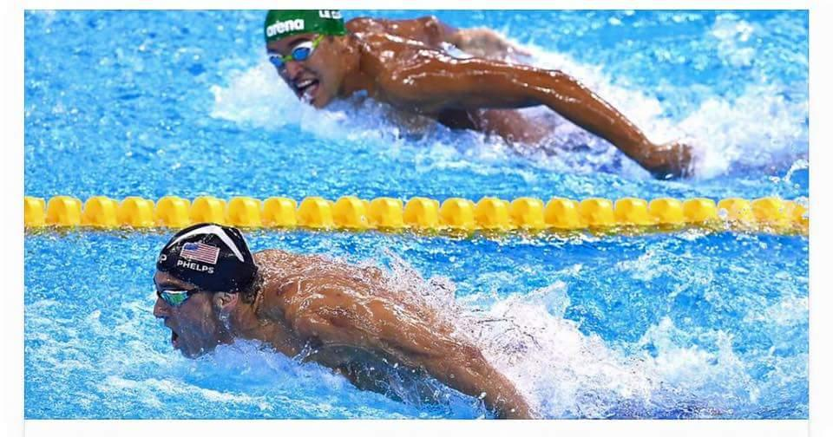
Don’t Compare
Notes:
This is my favorite picture of the last olympics. Michael Phelps is the most decorated olympian in history. I believe he has 28 medals and 23 are gold. In the swimming world – he is a winner. But this picture tells a story – the guy in second position in this race is using his energy to look rat what Phelps is doing - Phelps on the other had is focused on the goal. To finish the race as fast as he can. He is not comparing himself to others he is competing with – he is rather focused on the goal. He knows he has put in the time training – creating the disciplines in his life to compete a a very high level.
The caption for this is “Winners focus on winning, losers focus on the winners.” The message is don’t compare yourself to other.”

Slide 11
Don’t Compare
²⁴ Do you not know that in a race all the runners run, but only one gets the prize? Run in such a way as to get the prize. ²⁵ Everyone who competes in the games goes into strict training. They do it to get a crown that will not last, but we do it to get a crown that will last forever.
1 Corinthians 9:24 – 25
Notes:
Paul exhorts the early church in Corinth to run the race in a way that you will win it.
So often in the church we have the tentancy to compare ourself with others. The danger with this is when we do this it oftem becomes destructive relationally within the body.
I am not saying that we should not look at good examples with the church or not celebrate testimonies. I am saying we should not compare our gifts and passions with other. Rather we need to encourage our brothers and sisters to use to gifts and talents to be a light in the community. To explore how God has wired us in a way that we celebrate our differences and together seek God how he wants to use us.
Much else beyond that can become gossip and comparing that can drain the energy from the body and make us ineffective in our ministry.

Slide 12
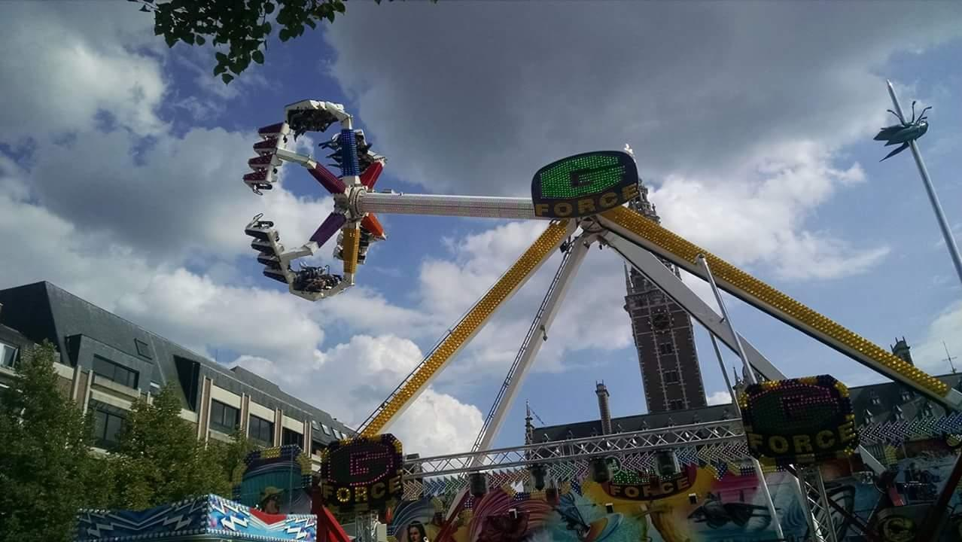
Notes:
Finally I will end with this picture before we pray.
Most of you know what this is a picture of. It is the G Force ride at the Kermis. I took the picture because Kathryn is trying to talk me in to going on the ride with her. To be honest – I really want to ride it. I used to love those rides. But as I have gotten older the rides are more daunting.
But I was noticing last week when we were walking around ther were really 2 kinds of people at the Kermis. There were those who were riding the rides and those who were watching.
Go and watch the G Force riders. Watch the trepidation as they get on the ride –the screaming and laughing while on the rides – but mostly look at the look of joy and satisfaction on their faces as they exit the ride. Then compare it to those who are simply watching the ride. These is a big difference. Those who took a chance and rode the ride found joy and exhileration – much more so than those of us who were just watching.
Serving and working in the kingdom involves risk taking and being uncomfortable. Often we are thrust in to the unknown – but when we take the step of faith and engage – we are given joy that only comes from relying on the Father and serving Him.
It is truly more blessed to give than to receive.
Lets Pray.

