Slide 1
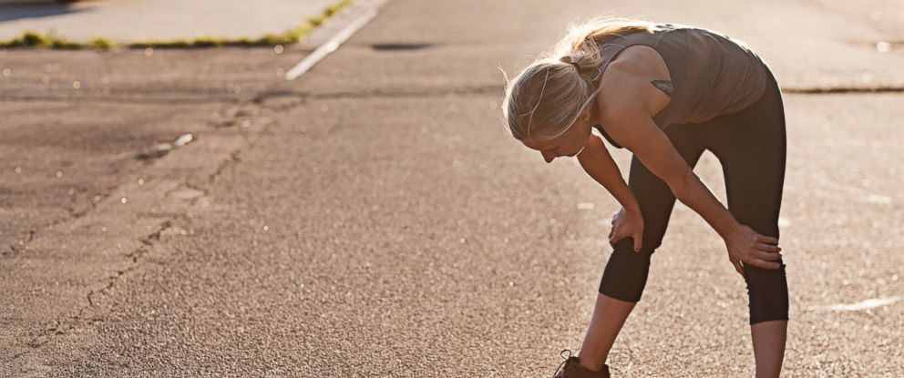
Winning the Race
(Before the Finish Line)
Colossians 2:13-15

Slide 2
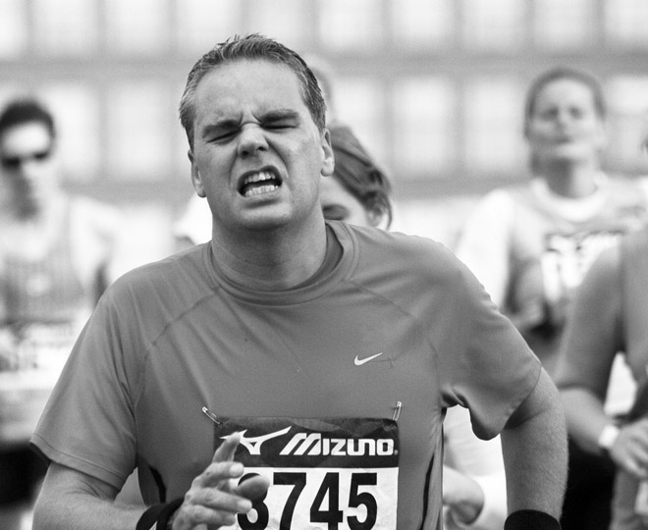

Slide 3
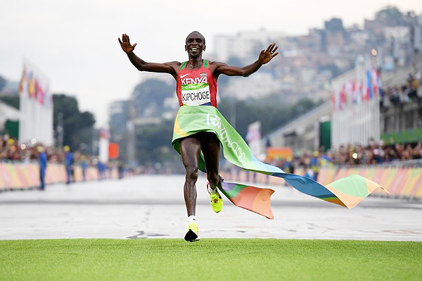

Slide 4
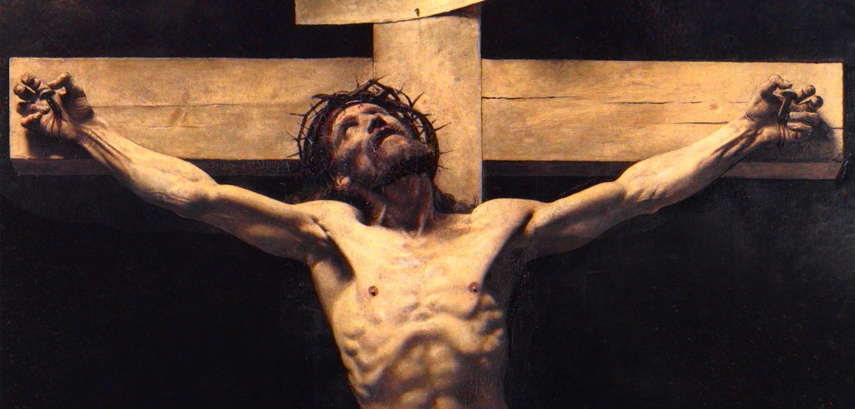
What Does the Cross Mean to YOU?

Slide 5
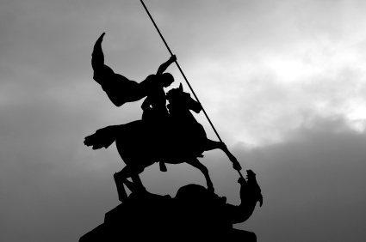
He made peace with everything in heaven and on earth by means of Christ’s blood on the cross. Colossians 1:20b

Slide 6
Peace Because Our MORTAL ENEMY Has Been Defeated

Slide 7
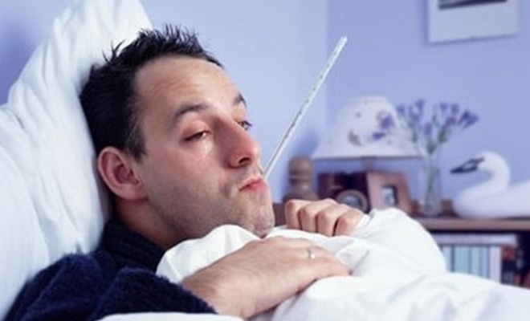
It’s WORSE than You Thought

Slide 8
You were dead because of your sins and because your sinful nature was not yet cut away. Then God made you alive with Christ… Colossians 2:13a

Slide 9
For the wages of sin is death…
Romans 6:23

Slide 10
…only by dying could
he break the power of the devil, who had the power of death. Hebrews 2:14

Slide 11
I am the Living One; I was dead, and now look, I am alive for ever and ever! And I hold the keys of death and Hades. Revelation 1:18

Slide 12
DEATH is Destroyed

Slide 13
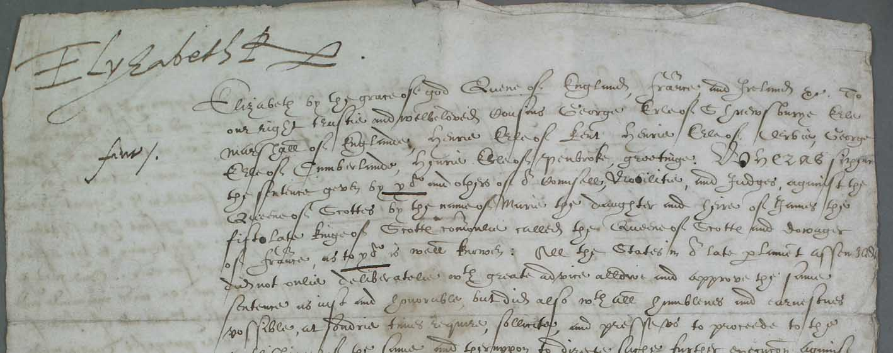
The Death Warrant Has Been SCRAPPED

Slide 14
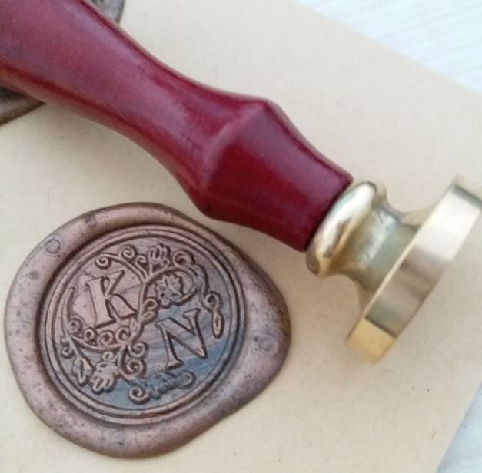
Then God made you alive with Christ, for he forgave all our sins. He canceled the record of the charges against us and took it away by nailing it to the cross. Colossians 2:13b-14

Slide 15
Once you were dead because of your disobedience and your many sins. You used to live in sin, just like the rest of the world, obeying the devil—the commander of the powers in the unseen world. He is the spirit at work in the hearts of those who refuse to obey God. All of us used to live that way, following the passionate desires and inclinations of our sinful nature. Ephesians 2:1-3a

Slide 16
He will lay both of his hands on the goat’s head and confess over it all the wickedness, rebellion, and sins of the people of Israel. In this way, he will transfer the people’s sins to the head of the goat. Then a man specially chosen for the task will drive the goat into the wilderness. As the goat goes into the wilderness, it will carry all the people’s sins upon itself into a desolate land. Leviticus 16:21-22

Slide 17
SIN
is Dismissed

Slide 18
The Deal is DONE

Slide 19
In this way, he disarmed the spiritual rulers and authorities. He shamed them publicly by his victory over them on the cross. Colossians 2:15

Slide 20
But even the archangel Michael, when he was disputing with the devil about the body of Moses, did not himself dare to condemn him for slander but said, "The Lord rebuke you!" Jude 1:9

Slide 21
The God of peace will soon crush Satan under your feet. Romans 16:20

Slide 22
