Slide 3
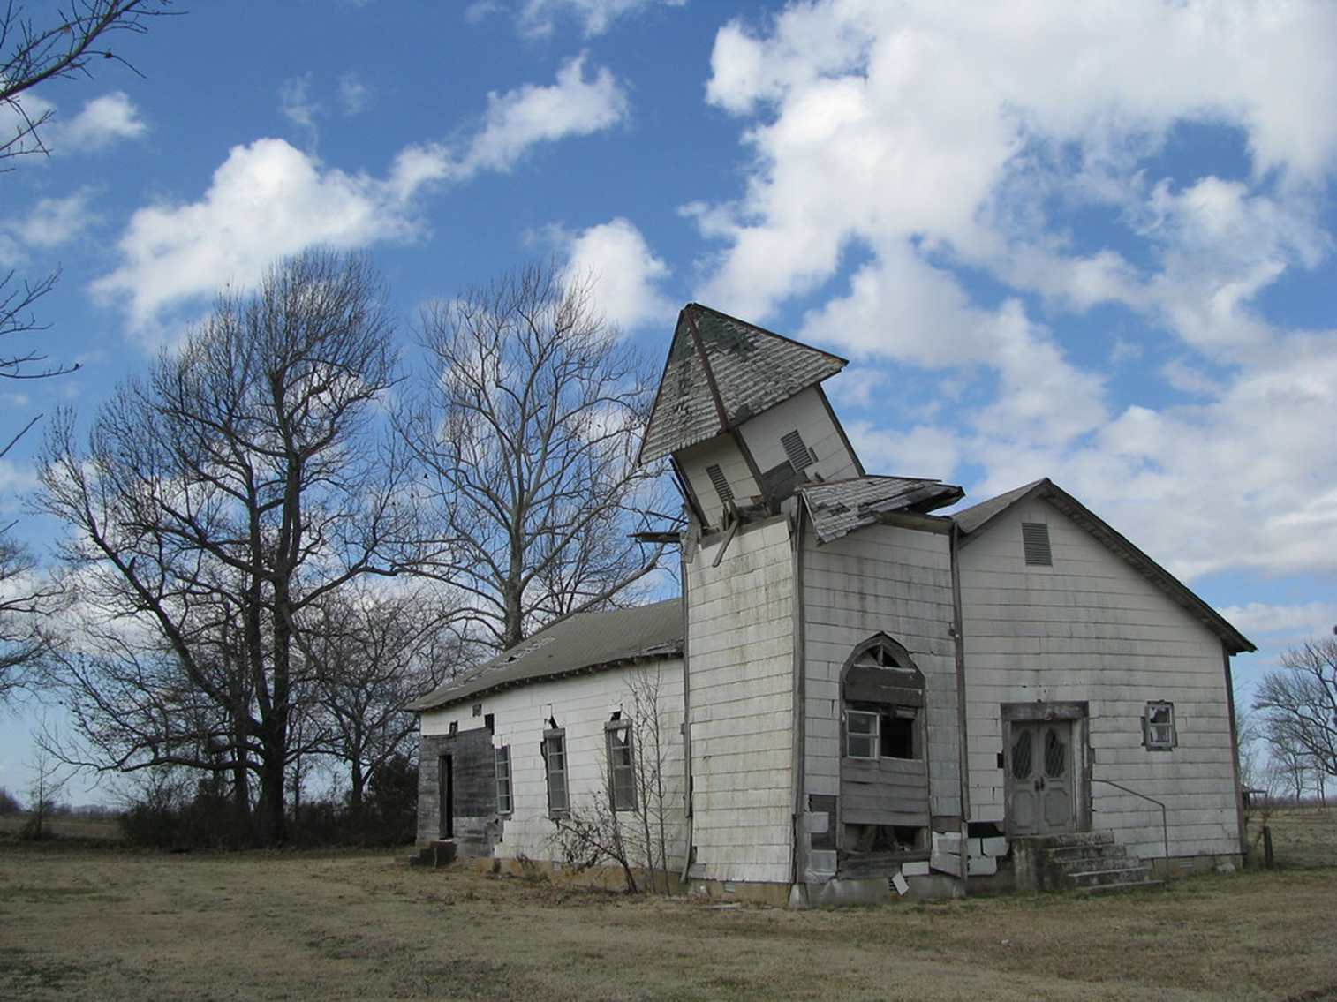
The Church as WE Sees It

Slide 4
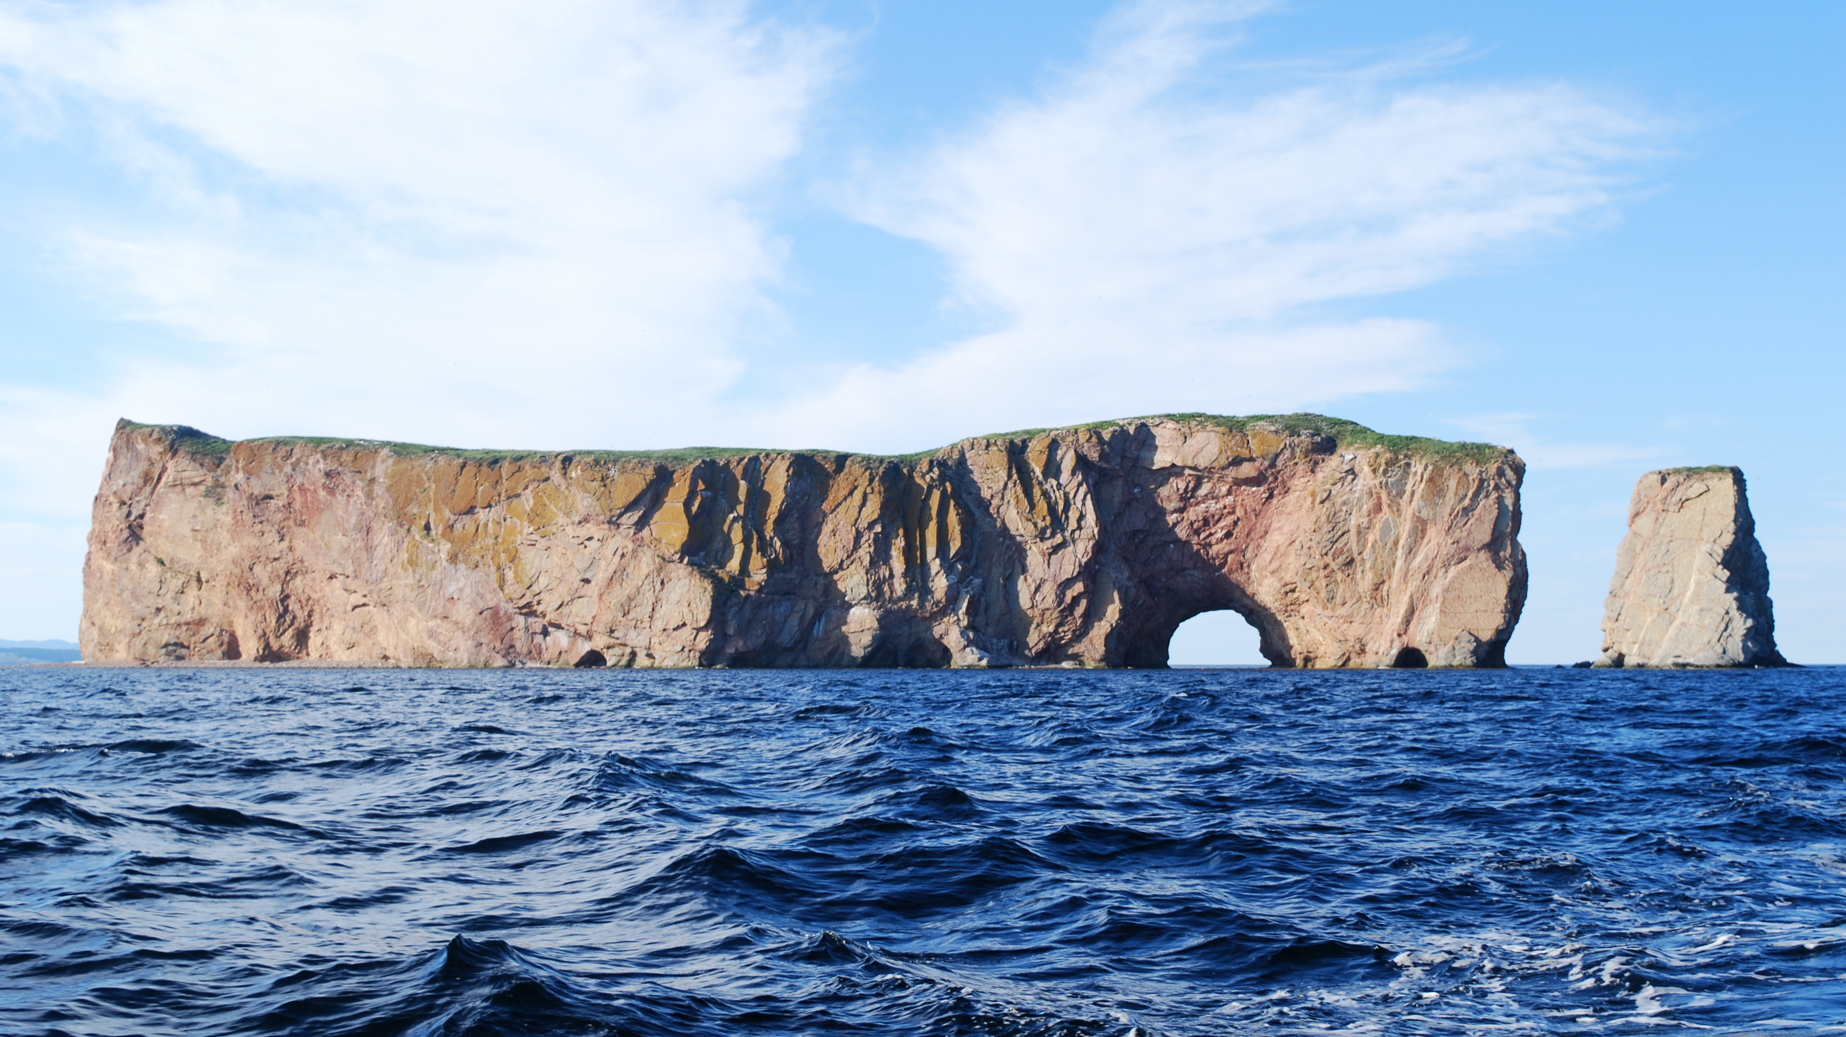
I will build my church, and the gates of Hades will not overcome it. Matthew 16:18b

Slide 5
And I tell you that you are Peter, and on this rock I will build my church, and the gates of Hades will not overcome it. Matthew 16:18b

Slide 6
Brothers and sisters, think of what you were when you were called. Not many of you were wise by human standards; not many were influential; not many were of noble birth. 1 Corinthians 1:26

Slide 7
…my conceit just began peeling off… It gets you out of your solitary conceit.
C. S. Lewis

Slide 8
But God chose the foolish things of the world to shame the wise; God chose the weak things of the world to shame the strong. God chose the lowly things of this world and the despised things—and the things that are not—to nullify the things that are, so that no one may boast before him.
1Corinthians 1:27-29

Slide 9
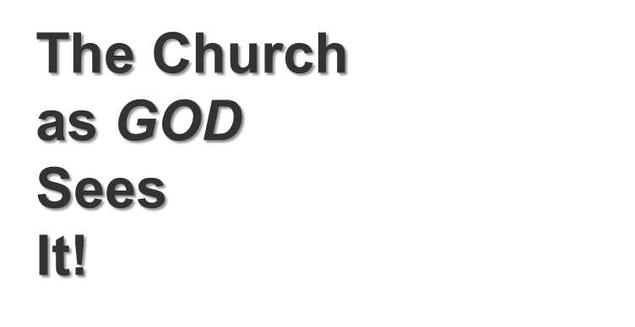

Slide 10
I will build my church, and the gates of Hades will not overcome it. Matthew 16:18b

Slide 11
“But what about you?” he asked. “Who do you say I am?”
Simon Peter answered, “You are the Messiah, the Son of the living God.”
Matthew 16:15-16

Slide 12
Blessed are you, Simon son of Jonah, for this was not revealed to you by flesh and blood, but by my Father in heaven. Matthew 16:17

Slide 14
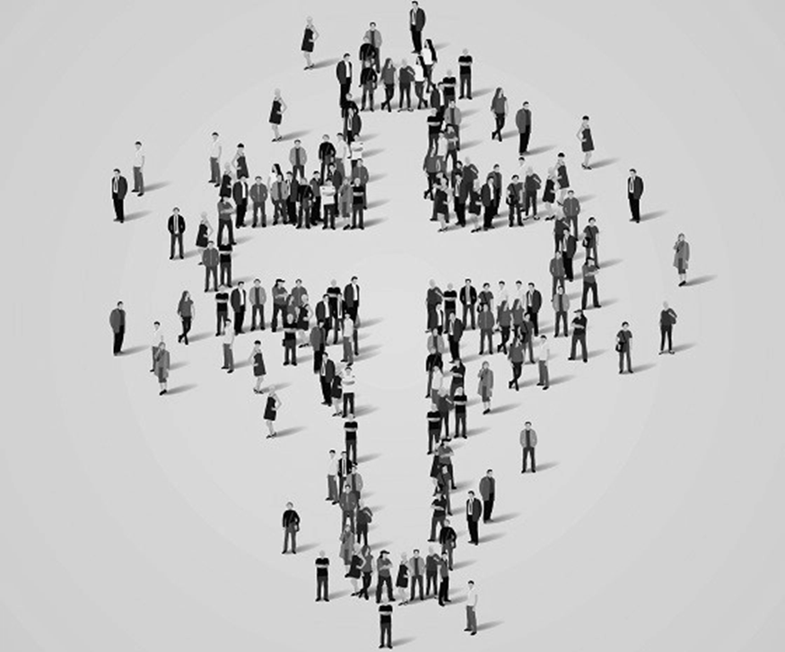
…the administration of this mystery, which for ages past was kept hidden in God, who created all things. His intent was that
now, through the church,
the manifold wisdom of God should be made known to the rulers and authorities in the heavenly realms, according to his eternal purpose that he accomplished in Christ Jesus our Lord. Ephesians 3:8-11

Slide 15
Brian Stewart
Award-winning Journalist
Senior Correspondent

Slide 16
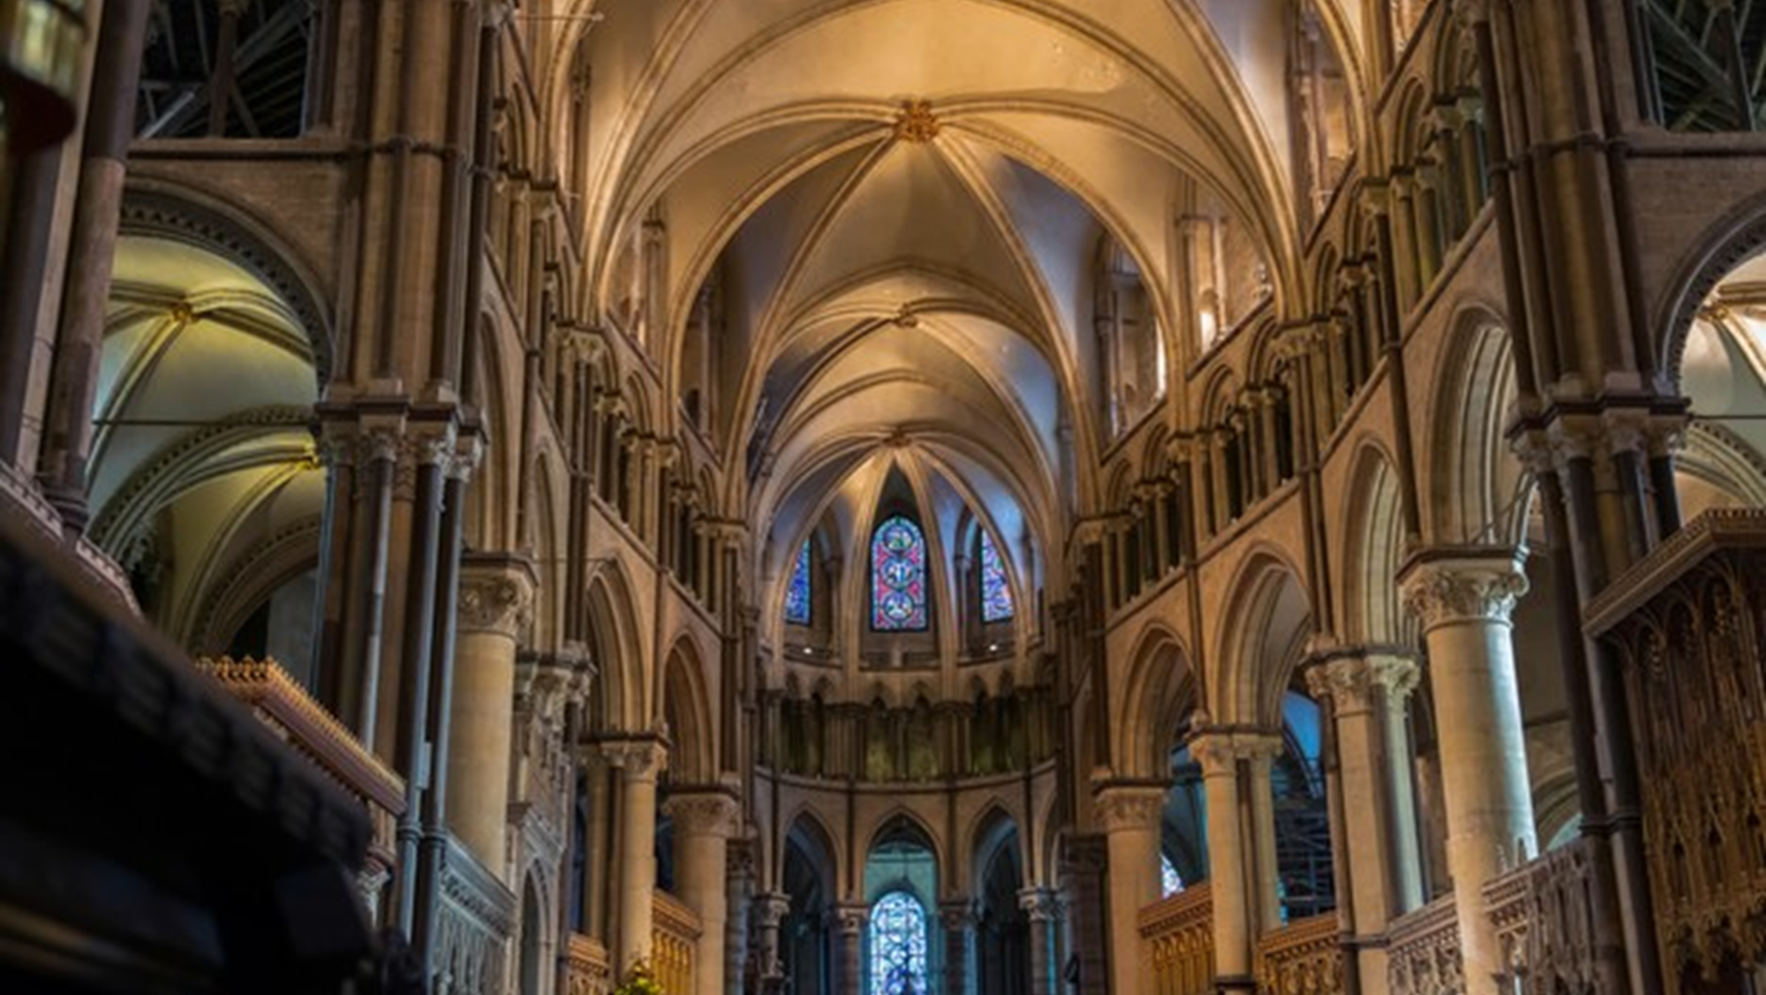
The Church as ESSENTIAL…

Slide 17
I will build my church, and the gates of Hades will not overcome it. Matthew 16:18b

Slide 18
As you come to him, the living Stone—rejected by humans but chosen by God and precious to him—you also, like living stones, are being built into a spiritual house to be a holy priesthood, offering spiritual sacrifices acceptable to God through Jesus Christ. 1 Peter 2:4-5

Slide 19
In him the whole building is joined together and rises to become a holy temple in the Lord. And in him you too are being built together to become a dwelling in which God lives by his Spirit. Ephesians 2:21-22

Slide 20
Apart from the church, salvation is impossible.
Martin Luther

