Slide 1
Acts 10:1-48 (New International Version)
¹ At Caesarea there was a man named Cornelius, a centurion in what was known as the Italian Regiment.
² He and all his family were devout and God-fearing; he gave generously to those in need and prayed to God regularly.
³ One day at about three in the afternoon he had a vision. He distinctly saw an angel of God, who came to him and said, ‘Cornelius!’

Slide 2
Acts 10:1-48 (New International Version)
⁴ Cornelius stared at him in fear. ‘What is it, Lord?’ he asked.
The angel answered, ‘Your prayers and gifts to the poor have come up as a memorial offering before God.
⁵ Now send men to Joppa to bring back a man named Simon who is called Peter.
⁶ He is staying with Simon the tanner, whose house is by the sea.’

Slide 3
Acts 10:1-48 (New International Version)
⁷ When the angel who spoke to him had gone, Cornelius called two of his servants and a devout soldier who was one of his attendants.
⁸ He told them everything that had happened and sent them to Joppa.

Slide 4
Acts 10:1-48 (New International Version)
⁹ About noon the following day as they were on their journey and approaching the city, Peter went up on the roof to pray.
¹⁰ He became hungry and wanted something to eat, and while the meal was being prepared, he fell into a trance.
¹¹ He saw heaven opened and something like a large sheet being let down to earth by its four corners.
¹² It contained all kinds of four-footed animals, as well as reptiles and birds.

Slide 5
Acts 10:1-48 (New International Version)
¹³ Then a voice told him, ‘Get up, Peter. Kill and eat.’
¹⁴ ‘Surely not, Lord!’ Peter replied. ‘I have never eaten anything impure or unclean.’
¹⁵ The voice spoke to him a second time, ‘Do not call anything impure that God has made clean.’
¹⁶ This happened three times, and immediately the sheet was taken back to heaven.

Slide 6
Acts 10:1-48 (New International Version)
¹⁷ While Peter was wondering about the meaning of the vision, the men sent by Cornelius found out where Simon’s house was and stopped at the gate.
¹⁸ They called out, asking if Simon who was known as Peter was staying there.
¹⁹ While Peter was still thinking about the vision, the Spirit said to him, ‘Simon, three men are looking for you.
²⁰ So get up and go downstairs. Do not hesitate to go with them, for I have sent them.’

Slide 7
Acts 10:1-48 (New International Version)
²¹ Peter went down and said to the men, ‘I’m the one you’re looking for. Why have you come?’
²² The men replied, ‘We have come from Cornelius the centurion. He is a righteous and God-fearing man, who is respected by all the Jewish people. A holy angel told him to ask you to come to his house so that he could hear what you have to say.’
²³ Then Peter invited the men into the house to be his guests.

Slide 8
Acts 10:1-48 (New International Version)
The next day Peter started out with them, and some of the believers from Joppa went along.
²⁴ The following day he arrived in Caesarea. Cornelius was expecting them and had called together his relatives and close friends.
²⁵ As Peter entered the house, Cornelius met him and fell at his feet in reverence.
²⁶ But Peter made him get up. ‘Stand up,’ he said, ‘I am only a man myself.’

Slide 9
Acts 10:1-48 (New International Version)
²⁷ While talking with him, Peter went inside and found a large gathering of people.
²⁸ He said to them: ‘You are well aware that it is against our law for a Jew to associate with or visit a Gentile. But God has shown me that I should not call anyone impure or unclean.
²⁹ So when I was sent for, I came without raising any objection. May I ask why you sent for me?’

Slide 10
Acts 10:1-48 (New International Version)
³⁰ Cornelius answered: ‘Three days ago I was in my house praying at this hour, at three in the afternoon. Suddenly a man in shining clothes stood before me ³¹ and said, “Cornelius, God has heard your prayer and remembered your gifts to the poor.
³² Send to Joppa for Simon who is called Peter. He is a guest in the home of Simon the tanner, who lives by the sea.”

Slide 11
Acts 10:1-48 (New International Version)
³³ So I sent for you immediately, and it was good of you to come. Now we are all here in the presence of God to listen to everything the Lord has commanded you to tell us.’
³⁴ Then Peter began to speak: ‘I now realise how true it is that God does not show favouritism ³⁵ but accepts from every nation the one who fears him and does what is right.

Slide 12
Acts 10:1-48 (New International Version)
³⁶ You know the message God sent to the people of Israel, announcing the good news of peace through Jesus Christ, who is Lord of all.
³⁷ You know what has happened throughout the province of Judea, beginning in Galilee after the baptism that John preached – ³⁸ how God anointed Jesus of Nazareth with the Holy Spirit and power, and how he went around doing good and healing all who were under the power of the devil, because God was with him.

Slide 13
Acts 10:1-48 (New International Version)
³⁹ ‘We are witnesses of everything he did in the country of the Jews and in Jerusalem. They killed him by hanging him on a cross, ⁴⁰ but God raised him from the dead on the third day and caused him to be seen.
⁴¹ He was not seen by all the people, but by witnesses whom God had already chosen – by us who ate and drank with him after he rose from the dead.

Slide 14
Acts 10:1-48 (New International Version)
⁴² He commanded us to preach to the people and to testify that he is the one whom God appointed as judge of the living and the dead.
⁴³ All the prophets testify about him that everyone who believes in him receives forgiveness of sins through his name.’
⁴⁴ While Peter was still speaking these words, the Holy Spirit came on all who heard the message.

Slide 15
Acts 10:1-48 (New International Version)
⁴⁵ The circumcised believers who had come with Peter were astonished that the gift of the Holy Spirit had been poured out even on Gentiles.
⁴⁶ For they heard them speaking in tongues and praising God.
Then Peter said, ⁴⁷ ‘Surely no one can stand in the way of their being baptised with water. They have received the Holy Spirit just as we have.’
⁴⁸ So he ordered that they be baptised in the name of Jesus Christ. Then they asked Peter to stay with them for a few days.

Slide 17
Hello From Ribeiro Lin Family

Slide 18
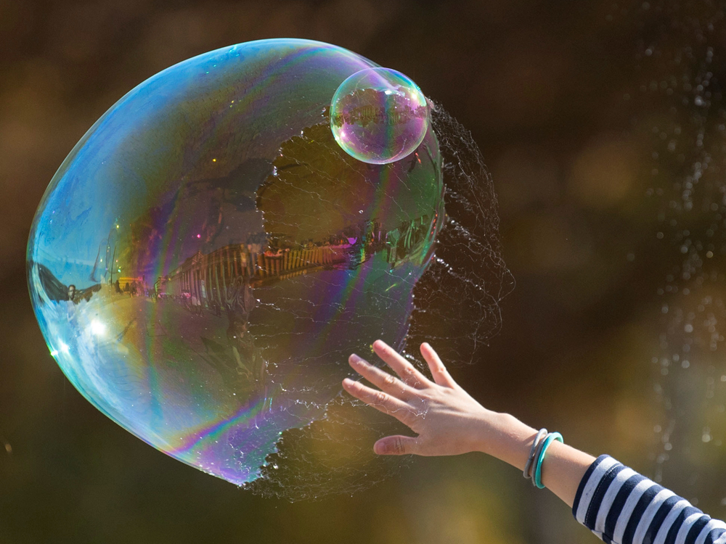
Saved From the Bubble

Slide 19
Book of Acts
At Pentecost (chapter 2), people from different races could hear the Word of God in their own language. God was revealing that what was once exclusive for Jews became accessible to all.

Slide 20
From a Jewish Liturgical Prayer Book
“Blessed are you O God, King of the Universe, who has not made me a Gentile nor a slave, neither woman.”

Slide 21
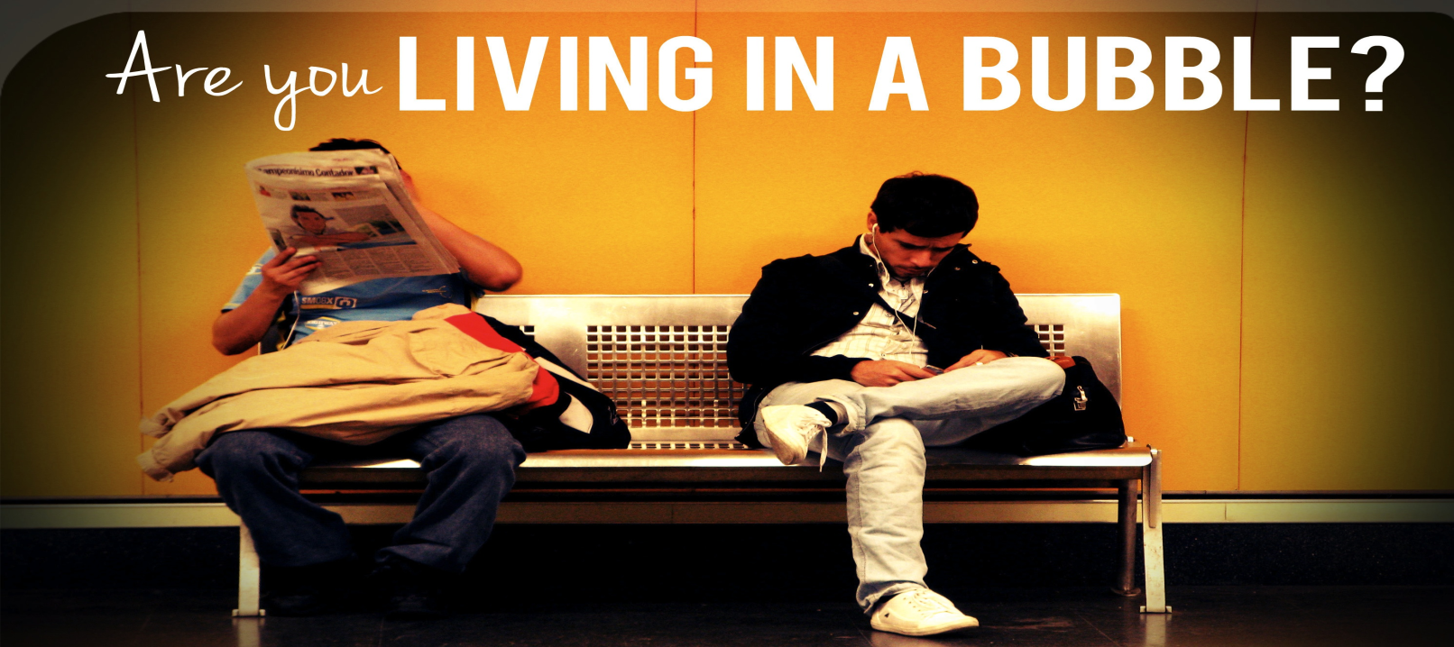

Slide 22
Technology reinforcing a bubble

Slide 23
In Caesarea

Slide 24
“At Caesarea there was a man named Cornelius, a centurion in what was known as the Italian Regiment” Acts 10:1

Slide 25
“One day at about three in the afternoon he had a vision. He distinctly saw an angel of God, who came to him and said, “Cornelius!”
Cornelius stared at him in fear. “What is it, Lord?” he asked.
The angel answered, “Your prayers and gifts to the poor have come up as a memorial offering before God. Now send men to Joppa to bring back a man named Simon who is called Peter (Acts 10:3-5)

Slide 26
Why the angel did not speak directly to Cornelius about Jesus? A long and inefficient process? Why does he have to listen to the gospel from another human being?

Slide 27
When Peter shares the gospel with Cornelius, something new happens: a Jewish fisherman begins a dialogue with a Roman soldier in Caesarea!

Slide 28
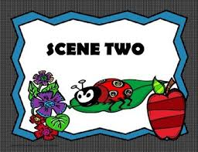
“Food” in Joppa

Slide 29
In the last story (chapter 9), Peter responded courageously to the death of Dorcas and by the power of God, there was resurrection. But to overcome Peter's prejudice against the Gentiles… it's harder than to raise the dead. How will he respond to the challenge of racial and religious discrimination?

Slide 30
God gives him a vision of a large sheet being let down to earth containing all kinds of four footed animals, reptiles.

Slide 31
“Get up, Peter, Kill these animals and eat.”
“NO!!!”
“Do not call anything impure that God has made clean.”

Slide 32
Animals in vision are a metaphor for human beings: Peter is being prepared for the accept Cornelius’ invitation to visit him.
When he finishes receiving the vision – Cornelius’ servants knock on the door.

Slide 33
Peter encounters Cornelius

Slide 35
A Galilean Fisherman and a Roman Centurion
Peter begins by listening, not preaching;
A double conversion
Cornelius must listen to the story of Jesus to receive salvation and the Holy Spirit. But Peter is also converted to an even profound understanding of the gospel.

Slide 36
Peter’s two statements
“God has shown me that I should not call any man impure or unclean” (v. 28);
“I now realize how true it is that God does not show favoritism” (v. 34).

Slide 37
Why is the encounter between Peter and Cornelius a turning point in salvation history?

Slide 38
Four Implications

Slide 39
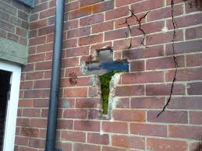
1) It reveals Christ, the reconciler, who brings down the walls of hostility

Slide 40
Ephesians 2:14-18: ¹⁴ For he himself is our peace, who has made the two groups one and has destroyed the barrier, the dividing wall of hostility, ¹⁵ by setting aside in his flesh the law with its commands and regulations. His purpose was to create in himself one new humanity out of the two, thus making peace, ¹⁶ and in one body to reconcile both of them to God through the cross, by which he put to death their hostility. ¹⁷ He came and preached peace to you who were far away and peace to those who were near. ¹⁸ For through him we both have access to the Father by one Spirit.

Slide 41
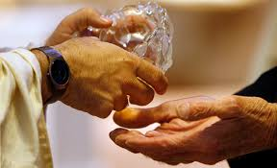
2) The relational (encounter) approach to our conversion

Slide 42
Cornelius could have met directly, but God chose a different path. At this meeting, both are transformed. The way God uses to convert us to Him are relationships.

Slide 43
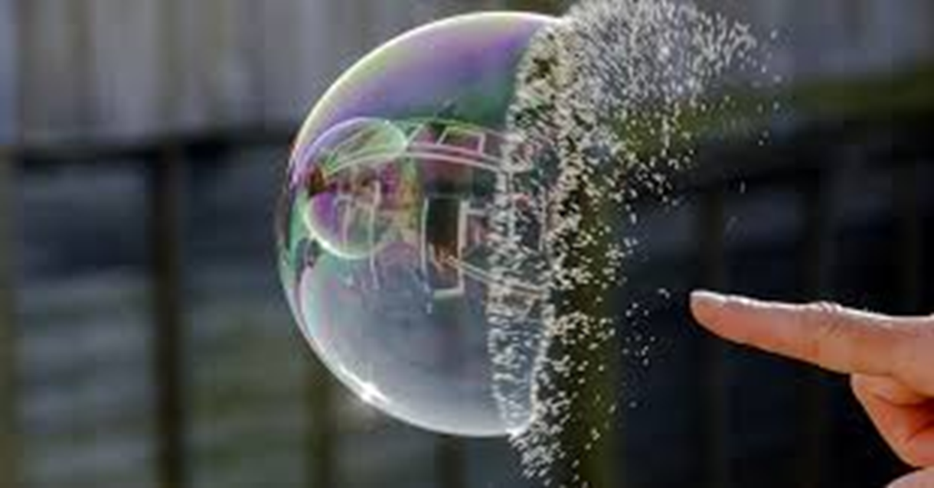
3) It explodes Peter’s bubble and his prejudice against the Gentiles.

Slide 44
We don’t need many certainties but a few, central convictions.
Our hearts are wounded, they fear. When there is fear, we create barriers.
Prejudice is an expression of insecurity or feelings of inferiority or superiority. But if one has truly understood God’s grace, such a position is impossible.

Slide 45
4) The church is open to all peoples, because God loves a diverse community.

