Slide 1
Fulness of life restored
Luke 8: 26-39
The first missionary to the gentiles

Slide 3
Bartolomeu Dias (P) – first European to sail around the Cape of Good Hope

Slide 4
First man on the moon (the one taking this picture of Buzz Aldrin)

Slide 5
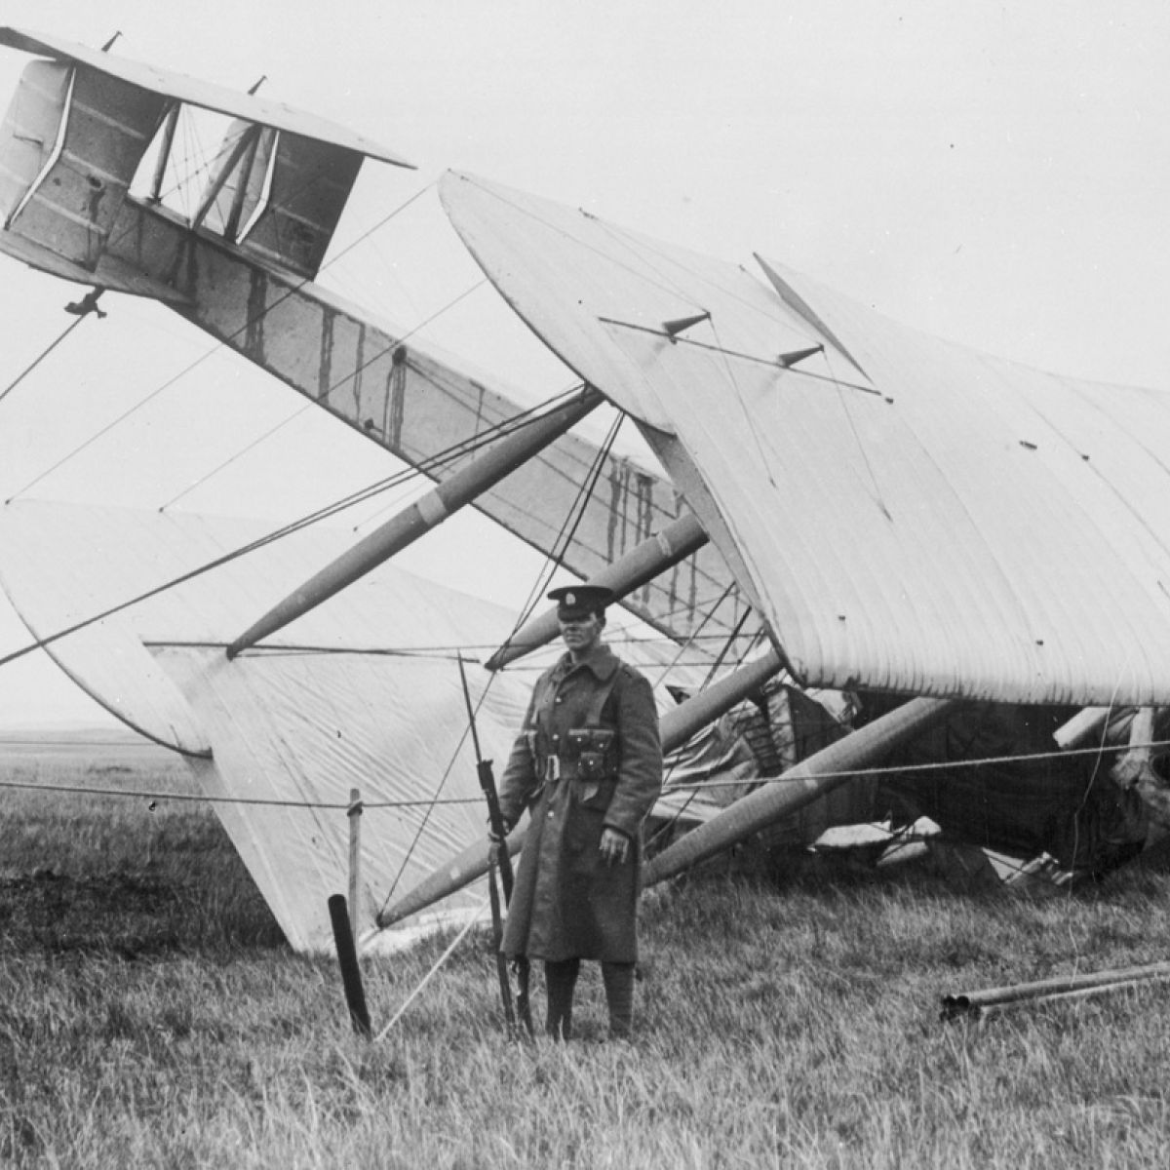

Slide 6
Who was the first missionary to the Gentiles ?

Slide 7
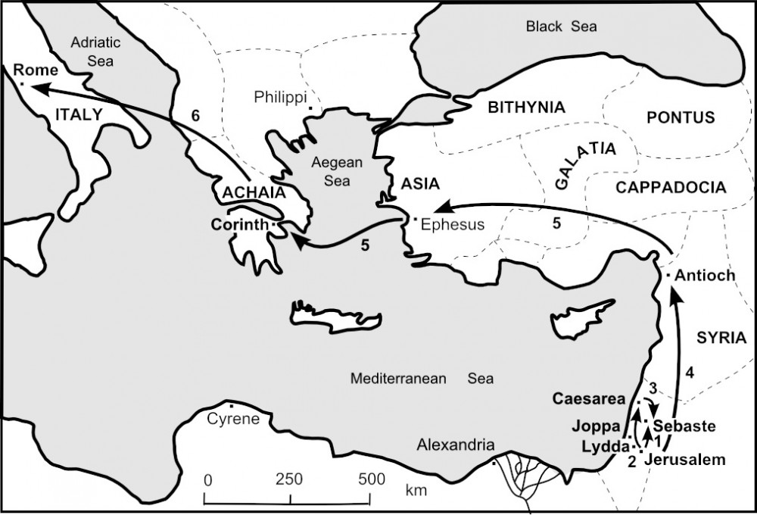
Peter’s journeys

Slide 8
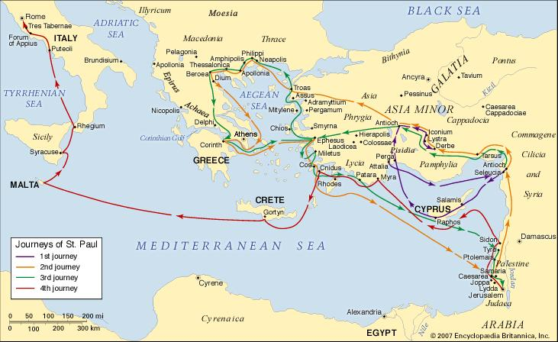
Paul’s journeys

Slide 10
Luke 8, 26-39 (New International Version)
²⁶ They sailed to the region of the Gerasenes, which is across the lake from Galilee.

Slide 11
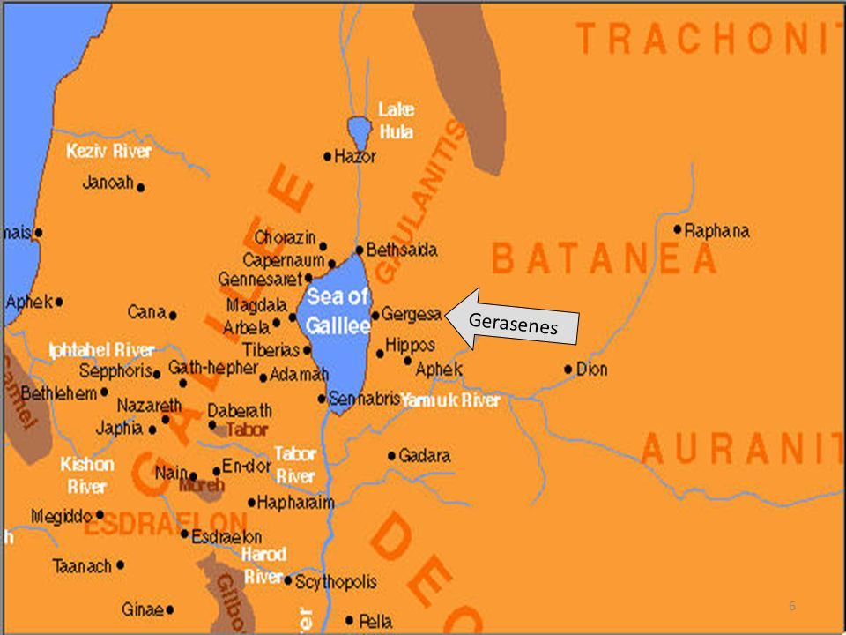

Slide 12
Luke 8, 26-39 (New International Version)
²⁷ When Jesus stepped ashore, he was met by a demon-possessed man from the town. For a long time this man had not worn clothes or lived in a house, but had lived in the tombs.
²⁸ When he saw Jesus, he cried out and fell at his feet, shouting at the top of his voice, “What do you want with me, Jesus, Son of the Most High God? I beg you, don’t torture me!”

Slide 13
Luke 8, 26-39 (New International Version)
²⁹ For Jesus had commanded the impure spirit to come out of the man. Many times it had seized him, and though he was chained hand and foot and kept under guard, he had broken his chains and had been driven by the demon into solitary places.
³⁰ Jesus asked him, “What is your name?”
“Legion,” he replied, because many demons had gone into him.

Slide 14
Luke 8, 26-39 (New International Version)
³¹ And they begged Jesus repeatedly not to order them to go into the Abyss.
³² A large herd of pigs was feeding there on the hillside. The demons begged Jesus to let them go into the pigs, and he gave them permission.
³³ When the demons came out of the man, they went into the pigs, and the herd rushed down the steep bank into the lake and was drowned.

Slide 15
Luke 8, 26-39 (New International Version)
³⁴ When those tending the pigs saw what had happened, they ran off and reported this in the town and countryside, ³⁵ and the people went out to see what had happened. When they came to Jesus, they found the man from whom the demons had gone out, sitting at Jesus’ feet, dressed and in his right mind; and they were afraid.

Slide 16
Luke 8, 26-39 (New International Version)
³⁶ Those who had seen it told the people how the demon-possessed man had been cured.
³⁷ Then all the people of the region of the Gerasenes asked Jesus to leave them, because they were overcome with fear. So he got into the boat and left.

Slide 17
Luke 8, 26-39 (New International Version)
³⁸ The man from whom the demons had gone out begged to go with him, but Jesus sent him away, saying, ³⁹ “Return home and tell how much God has done for you.” So the man went away and told all over town how much Jesus had done for him.

Slide 18
Extreme and sad case
Spiritual darkness in today’s society ?
The demons acknowledge Jesus’ authority
Sad and bizarre scenery: mentally ill, wild, uncivilized, naked man, outcast to society, living in a tomb …
But with some hilarious elements highlighting rivalries between (legalistic) Jews, pagans and Roman occupiers.

Slide 19
A serious message
Preceding events:
Jesus has power to physically heal
Healing of a leper
Healing of a paralyzed man
Raising the son of a widow
Jesus has power over the natural elements
Calming the storm when crossing the sea of Galilee
Here
Jesus has power over demons, over dark spiritual powers

Slide 20
But with a serious message
Preceding events:
Jesus has power to physically heal
Jesus has power over the natural elements
Here
Jesus has power over demons, over dark spiritual powers
Leading to the legitimate question …

Slide 21
“Who is this ?“
Luke 8, 25 In fear and amazement they asked one another, “Who is this? He commands even the winds and the water, and they obey him.”
Luke 9, 18, 20 He (Jesus) asked them, “Who do the crowds say I am?” (…) “But what about you?” he asked. “Who do you say I am?”

Slide 22
“Who is this ?“
Luke 9, 20 Peter answered, “God’s Messiah.”
Philippians 2:9-11 ⁹ Therefore God exalted him to the highest place and gave him the name that is above every name,¹⁰ that at the name of Jesus every knee should bow, in heaven and on earth and under the earth,¹¹ and every tongue acknowledge that Jesus Christ is Lord, to the glory of God the Father.

Slide 23
Who is He to us ?
In a world that tries to turn us away from Jesus, we are safe in the power that Jesus brings, the power of love, and fulness of life.
The demon possessed man was given back the fulness of his life.
Romans 8: 38-39
³⁸ For I am convinced that neither death nor life, neither angels nor demons, neither the present nor the future, nor any powers, ³⁹ neither height nor depth, nor anything else in all creation, will be able to separate us from the love of God that is in Christ Jesus our Lord.

Slide 24
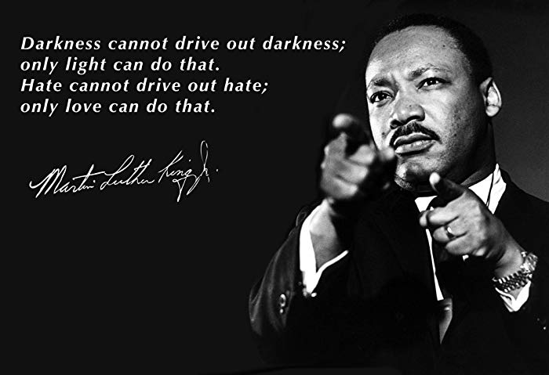

Slide 25
The life of the demon possessed man was fully restored and he became the first missionary to the gentiles.
God also reserved a special mission to a, once demon possessed, woman …
… Mary Magdalene.

Slide 26
Luke 8:1-3
¹ After this, Jesus traveled about from one town and village to another, proclaiming the good news of the kingdom of God. The Twelve were with him, ² and also some women who had been cured of evil spirits and diseases: Mary (called Magdalene) from whom seven demons had come out; ³ Joanna the wife of Chuza, the manager of Herod’s household; Susanna; and many others. These women were helping to support them out of their own means.
Mark 16:9
⁹ When Jesus rose early on the first day of the week, he appeared first to Mary Magdalene, out of whom he had driven seven demons.

Slide 27
Jesus is Lord over everything.
We are protected by his love.
He offers us rest, against any negative power.

