Slide 1
The promised King, Shepherd, Saviour
God uses the insignificant in his great plan for
mankind
Micah 5:2-5a

Slide 2
Prophet Micah
Lived in the 8th-7th century BC
Southern Kingdom of Judah
Contemporary of Isaiah
Burdened by the sin of God’s covenant people
Predictions of many troubles to come
… but also eventual deliverance and peace

Slide 3
Micah 5: 2-5a (New International Version)
² “But you, Bethlehem Ephrathah, though you are small among the clans of Judah, out of you will come for me one who will be ruler over Israel, whose origins are from of old, from ancient times.”
³ Therefore Israel will be abandoned until the time when she who is in labour bears a son, and the rest of his brothers return to join the Israelites.

Slide 4
Micah 5: 2-5a (New International Version)
⁴ He will stand and shepherd his flock in the strength of the Lord, in the majesty of the name of the Lord his God. And they will live securely, for then his greatness will reach to the ends of the earth.
⁵ And he will be our peace when the Assyrians invade our land and march through our fortresses.

Slide 5
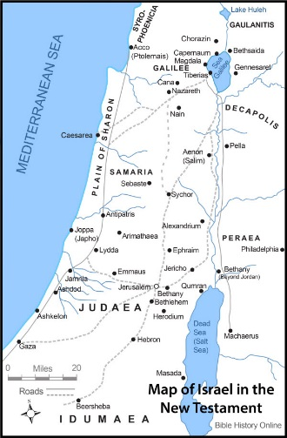
1. God uses the insignificant in his great plan for mankind
² “But you, Bethlehem Ephrathah,
though you are small among the clans of Judah,
out of you will come for me
one who will be ruler over Israel,
whose origins are from of old,
from ancient times.”

Slide 6
1. God uses insignificant places, ordinary people and unusual circumstances
Insignificant place yet with a rich history
Rachel: life and death
Ruth: redemption and hope
David: kingship
2 Samuel 7:12-16
I will raise up your offspring after you, who shall come forth from your body and I will establish his kingdom. He shall build a house for my name and I will establish the throne of his kingdom forever.… And your house and your kingdom shall be made sure for ever before me; your throne shall be established forever.

Slide 7
1. God uses insignificant places, ordinary people and unusual circumstances
Insignificant place yet with a rich history
Rachel: life and death
Ruth: redemption and hope
David: kingship
Micah: Bethlehem will be the place where the Messiah will be born
Known by chief priest and scribes (Mathew 2:5)
Understood by the people (John 7:42)

Slide 8
1. God uses insignificant places, ordinary people and unusual circumstances
David
4 unusual women in Jesus’ genealogy
Tamar
Rahab
Ruth
Bathsheba
Mary and Joseph – Nazareth! (John 1:46)
Shepherds

Slide 9
1. God uses the insignificant in his great plan for mankind
Why did He choose the ordinary to becomes extraordinary ?
1 Corinthians 1:27-31
²⁷ But God chose the foolish things of the world to shame the wise; God chose the weak things of the world to shame the strong. ²⁸ God chose the lowly things of this world and the despised things—and the things that are not—to nullify the things that are, ²⁹ so that no one may boast before him. ³⁰ It is because of him that you are in Christ Jesus, who has become for us wisdom from God—that is, our righteousness, holiness and redemption. ³¹ Therefore, as it is written: “Let the one who boasts boast in the Lord.”

Slide 10
2. God uses the insignificant in his great plan for mankind
³ Therefore Israel will be abandoned
until the time when she who is in labour bears a son,
and the rest of his brothers return
to join the Israelites.
Prediction of great trouble and distress: occupation by the Assyrians, captivity in Babylon
But no ultimate abandoning: promise of the Messiah and salvation will be offered to all of Israel
And more: salvation will be offered to all, Jews and Gentiles

Slide 11
2. God uses the insignificant in his great plan for mankind
⁴ He will stand and shepherd his flock
in the strength of the Lord,
in the majesty of the name of the Lord his God.
And they will live securely, for then his greatness
will reach to the ends of the earth.
Present age:
A protecting shepherd, receiving strength from the Father
Future perspective: The earth will be filled with God’s glory when the Messiah will return to establish his Kingdom and peace

Slide 12
2. God uses the insignificant in his great plan for mankind
⁵ And he will be our peace
when the Assyrians invade our land
and march through our fortresses.
Micah 4:3: political peace (very similar to Isaiah 2:2-4)
But more:
Ephesians 2:14, Isaiah 9:6: Jesus is our peace, the Prince of Peace, through Him we can have peace with God

Slide 13
What about us ?
God uses the insignificant, that no one may boast
He does not look at the outward appearance but at your heart. No-one is insignificant in God’s eyes.
God confirms his faithfulness to us through keeping his promise made more than 700 years.
He is King, Shepherd and Saviour to all who accept him. And he wants to also use you!
His greatness will reach to the ends of the earth and he will establish peace, in our hearts, with God.

