Slide 1
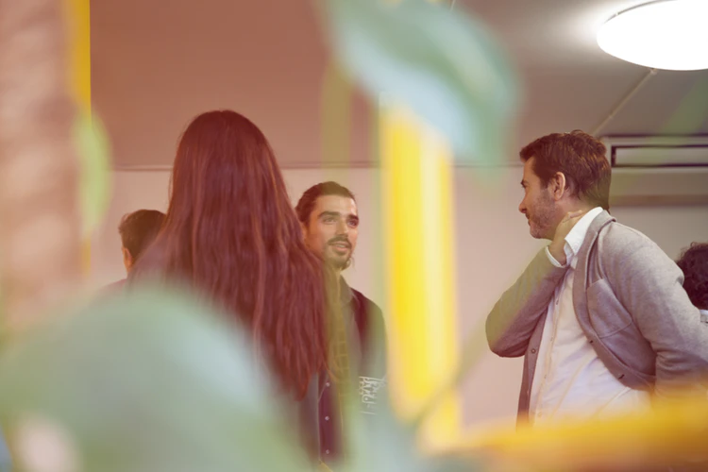

Slide 2
Luke 1:26 In the sixth month the angel Gabriel was sent by God to a town in Galilee called Nazareth, 27 to a virgin engaged to a man whose name was Joseph, of the house of David. The virgin’s name was Mary. 28 And he came to her and said, “Greetings, favored one! The Lord is with you.” 29 But she was much perplexed by his words and pondered what sort of greeting this might be. 30 The angel said to her, “Do not be afraid, Mary, for you have found favor with God. 31 And now, you will conceive in your womb and bear a son, and you will name him Jesus. 32 He will be great, and will be called the Son of the Most High, and the Lord God will give to him the throne of his ancestor David. 33 He will reign over the house of Jacob forever, and of his kingdom there will be no end.”

Slide 3
34 Mary said to the angel, “How can this be, since I am a virgin?” 35 The angel said to her, “The Holy Spirit will come upon you, and the power of the Most High will overshadow you; therefore the child to be born will be holy; he will be called Son of God. 36 And now, your relative Elizabeth in her old age has also conceived a son; and this is the sixth month for her who was said to be barren. 37 For nothing will be impossible with God.” 38 Then Mary said, “Here am I, the servant of the Lord; let it be with me according to your word.” Then the angel departed from her.

Slide 4
39 In those days Mary set out and went with haste to a Judean town in the hill country, 40 where she entered the house of Zechariah and greeted Elizabeth. 41 When Elizabeth heard Mary’s greeting, the child leaped in her womb. And Elizabeth was filled with the Holy Spirit 42 and exclaimed with a loud cry, “Blessed are you among women, and blessed is the fruit of your womb. 43 And why has this happened to me, that the mother of my Lord comes to me? 44 For as soon as I heard the sound of your greeting, the child in my womb leaped for joy. 45 And blessed is she who believed that there would be a fulfillment of what was spoken to her by the Lord.”

Slide 5
Big Idea
When we let Jesus rule in
our lives, we experience the goodness of God.

Slide 6
Big Idea
When we let Jesus rule in
our lives, we experience the goodness of God.

Slide 7
Big Idea
When we let Jesus rule in
our lives, we experience the goodness of God.
👂🤔👌

Slide 8
👂
Letting Jesus Rule • Hearing the Word
26 In the sixth month the angel Gabriel was sent by God to a town in Galilee called Nazareth, 27 to a virgin engaged to a man whose name was Joseph, of the house of David. The virgin’s name was Mary. 28 And he came to her and said, “Greetings, favored one! The Lord is with you.”
Notes:
Message for you: The Lord is with you! The Lord looks with favor upon you!
The Lord is with me?
David was favored. Abraham was favored. The Lord was with them.
But I am only a young girl from Nazareth!

Slide 9
🤔
Letting Jesus Rule • Pondering the Word
29 But she was much perplexed by his words and pondered what sort of greeting this might be.
Notes:
Remember David’s sermon 2 weeks ago? - God uses ordinary people, places, objects to do miracles!

Slide 10
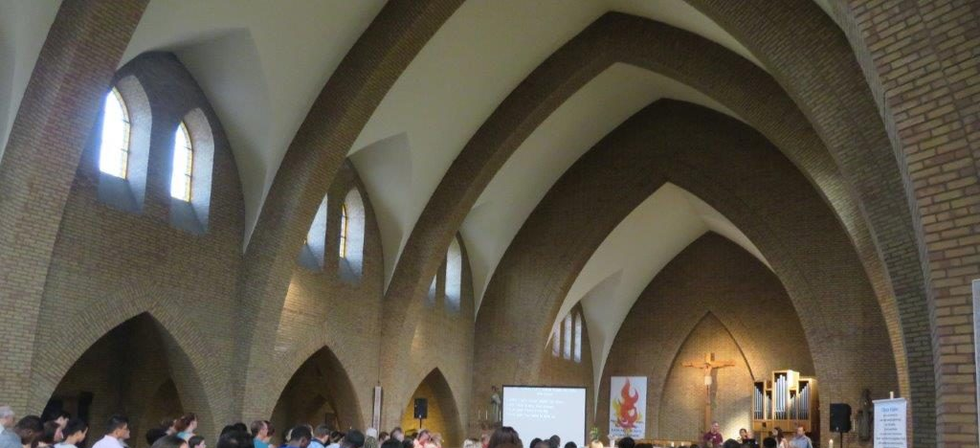
🤔

Slide 11
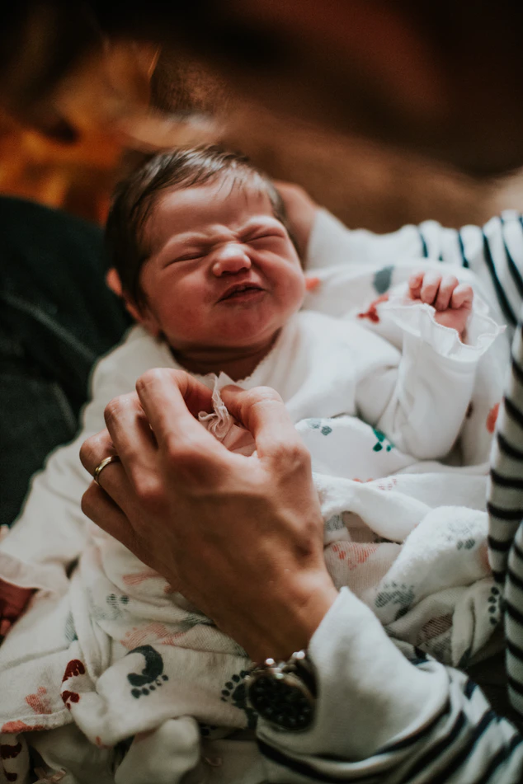
🤔

Slide 12
🤔
Letting Jesus Rule • Pondering the Word
It’s OK to ponder.

Slide 13
🤔
Letting Jesus Rule • Pondering the Word
Job 7:19 How long will you not look away from me,
nor leave me alone till I swallow my spit?
If I sin, what do I do to you, you watcher of mankind?
Why have you made me your mark?
Why have I become a burden to you?
Matt 27:46 And about three o’clock Jesus cried with a loud voice, “Eli, Eli, lema sabachthani?” that is, “My God, my God, why have you forsaken me?”

Slide 14
🤔

Slide 15
🤔

Slide 16
👂
Letting Jesus Rule • Hearing the Word
30 The angel said to her, “Do not be afraid, Mary, for you have found favor with God. 31 And now, you will conceive in your womb and bear a son, and you will name him Jesus. 32 He will be great, and will be called the Son of the Most High, and the Lord God will give to him the throne of his ancestor David. 33 He will reign over the house of Jacob forever, and of his kingdom there will be no end.”

Slide 18
🤔
Letting Jesus Rule • Pondering the Word
34 Mary said to the angel, “How can this be, since I am a virgin?”

Slide 19
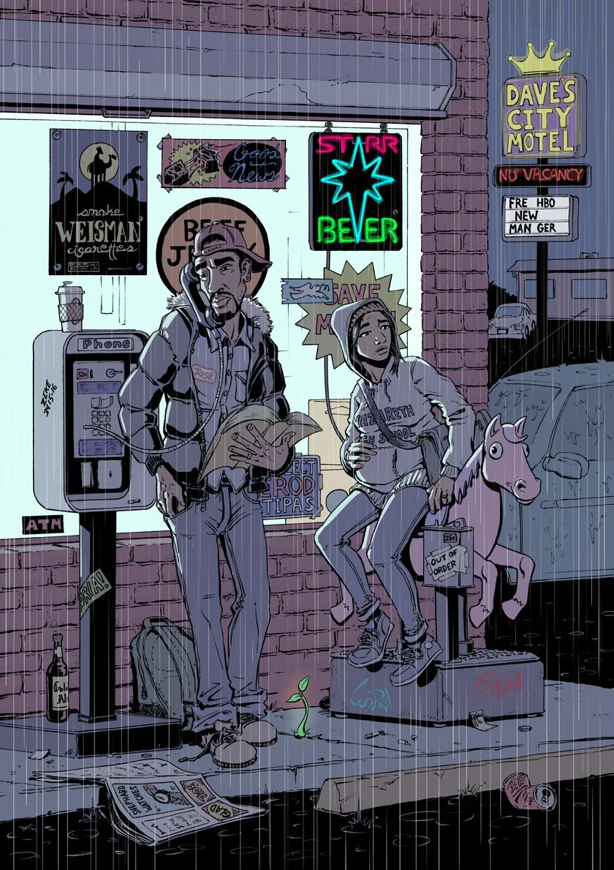

Slide 20
👂
Letting Jesus Rule • Hearing the Word
35 The angel said to her, “The Holy Spirit will come upon you, and the power of the Most High will overshadow you; therefore the child to be born will be holy; he will be called Son of God. 36 And now, your relative Elizabeth in her old age has also conceived a son; and this is the sixth month for her who was said to be barren. 37 For nothing will be impossible with God.”

Slide 21
👌
Letting Jesus Rule • Living the Word
38 Then Mary said, “Here am I, the servant of the Lord; let it be with me according to your word.” Then the angel departed from her.

Slide 22
👌
Letting Jesus Rule • Living the Word
Pondering is not enough.
Letting Jesus rule is a an action.

Slide 23
👌
Letting Jesus Rule • Living the Word

Slide 24
👌
Letting Jesus Rule • Living the Word

Slide 25
👌
Letting Jesus Rule • Living the Word

Slide 26
👌
Letting Jesus Rule • Living the Word

Slide 27
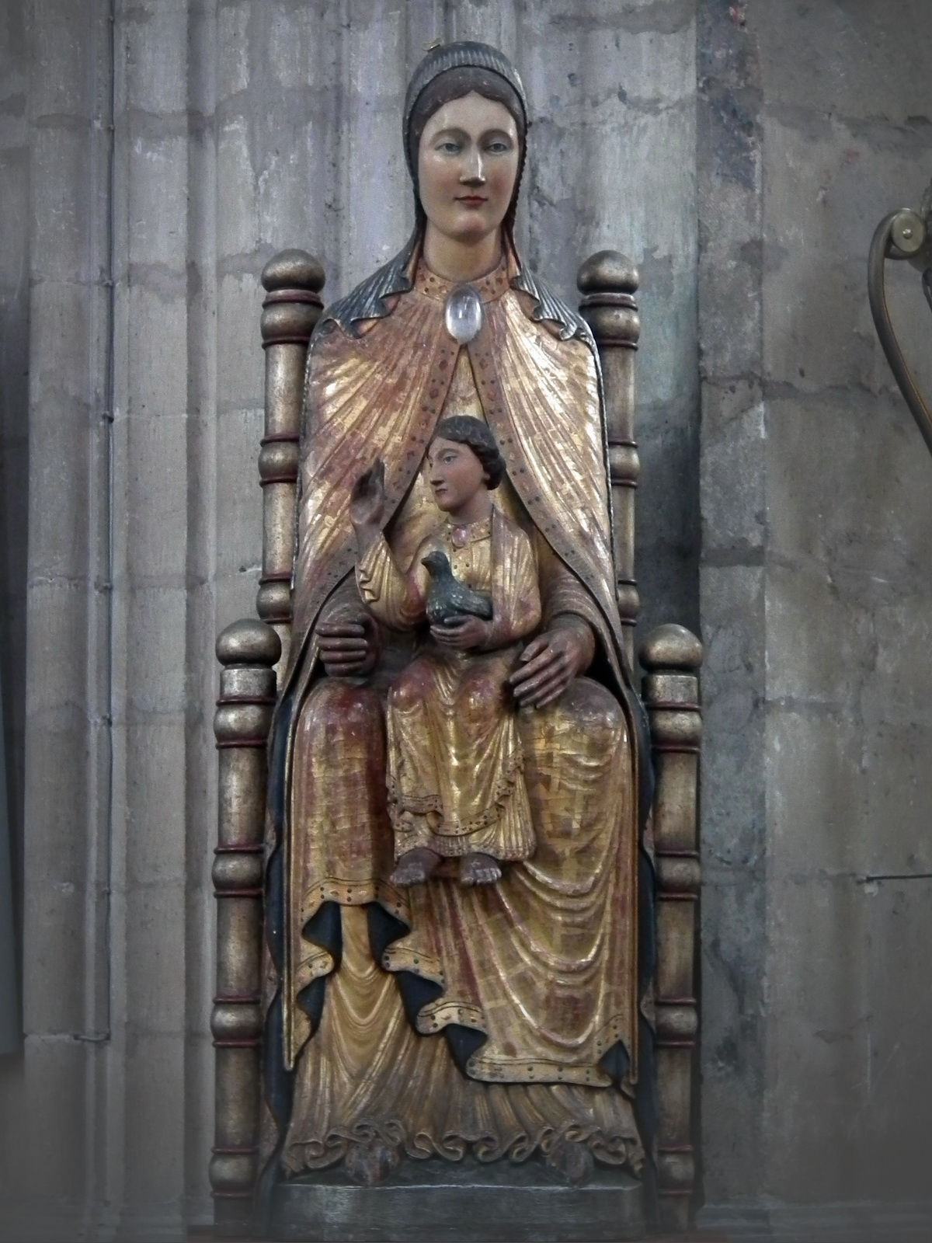
👌

Slide 28
👌
Letting Jesus Rule • Living the Word

Slide 29
👌
Letting Jesus Rule • Living the Word

Slide 30
When we let Jesus rule in
our lives, we experience the goodness of God.

Slide 31
39 In those days Mary set out and went with haste to a Judean town in the hill country, 40 where she entered the house of Zechariah and greeted Elizabeth.

Slide 32
Experiencing the Goodness of God
41 When Elizabeth heard Mary’s greeting, the child leaped in her womb. And Elizabeth was filled with the Holy Spirit 42 and exclaimed with a loud cry, “Blessed are you among women, and blessed is the fruit of your womb. 43 And why has this happened to me, that the mother of my Lord comes to me? 44 For as soon as I heard the sound of your greeting, the child in my womb leaped for joy. 45 And blessed is she who believed that there would be a fulfillment of what was spoken to her by the Lord.”

Slide 33
Experiencing the Goodness of God
My soul magnifies the Lord,
and my spirit rejoices in God my Savior,
for he has looked with favor on the lowliness of his servant.
Surely, from now on all generations will call me blessed;
for the Mighty One has done great things for me,
and holy is his name.

Slide 34
Experiencing the Goodness of God
His mercy is for those who fear him
from generation to generation.
He has shown strength with his arm;
he has scattered the proud in the thoughts of their hearts.
He has brought down the powerful from their thrones,
and lifted up the lowly;
he has filled the hungry with good things,
and sent the rich away empty.
He has helped his servant Israel,
in remembrance of his mercy,
according to the promise he made to our ancestors,
to Abraham and to his descendants forever.

