Slide 1
The Cross, a strange symbol
Good Friday
19 April 2019
BGG

Slide 2
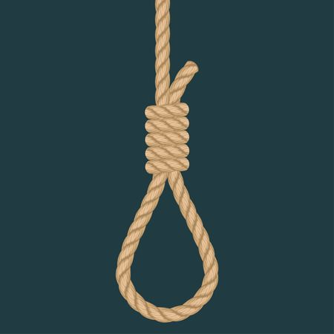
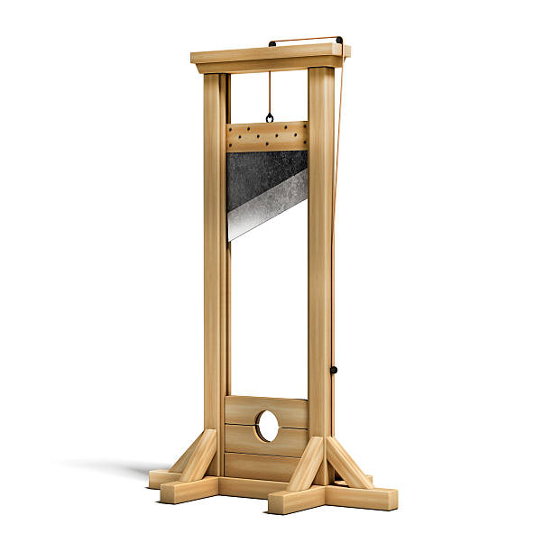
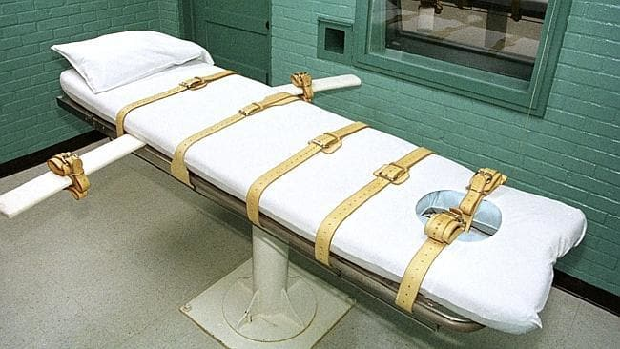
The Cross, a strange symbol
an instrument of execution

Slide 3
Why a cross?
Instrument of torture and death

Slide 4
Jesus was special
His claim: to die for our sins
staggering!

Slide 5
Everything hinges on how we react
A load of rubbish
A great teacher

Slide 6
re 2) A great teacher
i) miracles
ii) powerful sense of justice
iii) claim to be the Son of God:>

Slide 7
re 2) A great teacher
a crackpot?
actually what he claimed to be!

Slide 8
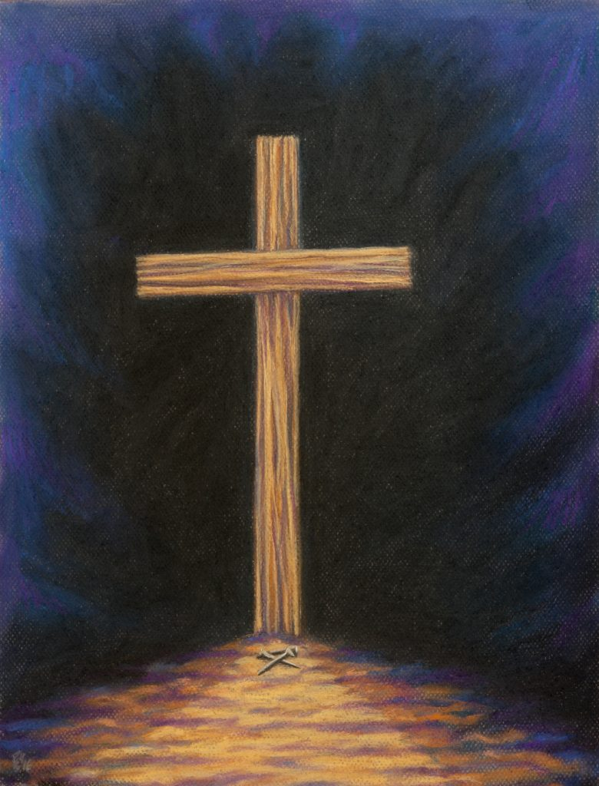
symbol of redemption
symbol of execution

Slide 9
for those who have been believers for years…
Risk of smugness…
we’re ok because we are saved!
blasé; even proud
worn down; we’ve heard it all before

Slide 10
remember
“this is my body, which is broken for you”

