Slide 1
Loving Others
or
The Sermon on the Mount
17 February 2019
Notes:
Last week David Courey painted some vivid metaphors for us -- We are mirrors or shattered mirrors that don’t quite reflect a perfect image of God. And yet God the father loves us despite that imperfection; Jesus willingly die for us despite that imperfection; and the Holy Spirit fills us despite our imperfections. That’s how we understand God’s love for us. Eric gave us a hint two weeks ago that it is the image of God in us that connects us to both God and others.

Slide 2
Notes:
Then came the idea that we should not attempt to stand still while others, including God, orbit around us. But we were warned NOT to pursue this model.

Slide 3
Matthew 5:48
Therefore, just as
your heavenly Father
is complete
in showing love to everyone,
so also you must be complete.
Notes:
You could add together all of the Sermon on the Mount and summarize it in this one statement --
Jesus warns his listeners that he did not come to destry the law but to fulfill it. That is not a hope-giving statement. If it is possible to fulfill the law, then each of us is accountable for NOT doing it. I mean -- do you get awards for driving the speed limit? Nope. Do you get recognition from your employer for being on time to work? Nope. When you meet the expectation, then you’ve only done the absolute minimum. You get praise for going above and beyond. But have you ever met this expectation for more than a month? A week? A day? Yeah -- this is extremely difficult. WHY?

Slide 4
Notes:
So one possible outcome is that we so focus on our ideal behavior that we are consumed with reputation -- ours and the reputations of others.
But this is a trap that leads to the pits of judgementalism and perfectionism. We can’t, by our own sheer effort, be complete in love.

Slide 5
Notes:
Because the Christian life is not meant to be lived in a solitary existence. It is meant to be lived in a complex interworking of community. At first this sounds like it makes things more difficult. People are not easy. We let each other down. We wound each other. We have complicated histories. It might be easier to just be responsible for ourselves. ALONE. But, this is one place where Western philosophy has crept into our thinking and warped the gospel. The entire point of the sermon on the mount is about how we relate to other people. It is entirely about being connected in the context of a community.

Slide 6
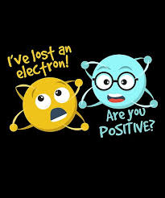
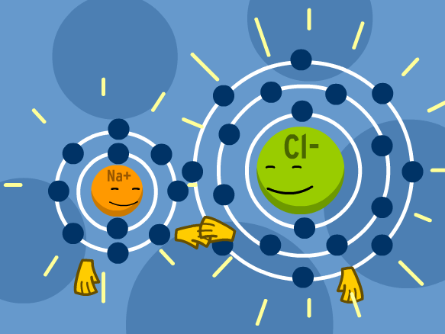
Notes:
There are several people here this morning who understand this much more clearly than I do. However there are several different kinds of bonds that atoms can form to make molecules. In most every circumstance the individual atoms continue to possess their essential identity but together with other atoms, a molecule is formed. This image is a bit more like community. It captures the idea for me at least that when we embrace who we are, we can join with others to build a community.

Slide 7
Notes:
As a community gathers more and more members, the possibilities grow. Still speaking in molecular terms, these groupings can produce consequences that the individual atoms could not dream of on their own. To take a very simple example Hydrogen and Oxygen exist in the conditions of this world as gases. But when they join together, they exist as a liquid.
We, as individual Christians have a structure to our lives. And Jesus lets his followers know in the Sermon on the Mount that the expectation is high. But we are not alone. We are connected to God and to each other.

Slide 8
Notes:
The idea is not that we guard an immaculate reputation. Instead it is about living each moment as the best moment of your life. This is always something we share with real people in real time.
Just as we cannot make any relationship a means to an end, we should not make certain behaviors the means to an end either.
What do I mean by this? Last week we were challenged to appreciate relationships as an end in themselves. To be a friend, a spouse, to love God -- just for the sake of the relationship. That is one way we reflect God’s image. When we make a relationship about anything else, we’re using the other person.

Slide 9
First make things right with your brother or sister and then come back and offer your gift. Matt 5:24
Notes:
So too with our behavior. When we use our behavior to manage our reputation -- like shapewear for the body, reputation for the character -- it is false. It is a distortion. We are not kind because then people will know we’re good Christians. We are not quick to make things right with others because it is better for our emotional health.

Slide 10
First make things right with your brother or sister and then come back and offer your gift. Matt 5:24
But I say to you that every man who looks at a woman lustfully has already committed adultery.
Matt 5:28
But I say to you, love your enemies and pray for those who harass you. . . Matt 5:44
give to the poor in secret Matt 6:4
Notes:
We are not motivated avoid lust because it makes us impure.
We do not offer kindness to those who bully us because it highlights how very wrong they are.
We do not give to others so that we can be thought of as generous.
And the list goes on -- for three chapters.
We do these things, yes. But they are not a means to an end. We don’t behave so that our character may be seen in the best light or that our reputation may be good.

Slide 11
Notes:
When I ask you about the best moment of your life -- you tell me about another person. You tell me about sharing an experience and some emotions together.

Slide 12
“....I made known to them your name, and I will continue to make it known, that the love with which you have loved me may be in them, and I in them.” Jesus
John 17:26
Notes:
We are called to demonstrate love for each other. Not to complete a checklist of perfect behaviors. Not so that our image is enhanced. We demonstrate love and forgiveness because that grows out of God’s love for us. As we spend time connected - bonded to Christ and to other Christians then that bond enables us to love.
Remember that Hydrogen and Oxygen are not naturally liquid under the pressure of this world but when they are bonded they are able to exist as water? When we are bonded in the love of God to God and to other Christians, then we become capable of expressing God’s love under the pressure of this world. Not because we’re using that behavior to get to something. But through the bond with God and his people, our capacity shifts.
Notice with me please that the love which Jesus wants us to express is located, originated in the love shared between God - father son and spirit.
As we carry the image of God, as we are connected with each other, our capacity shifts. Now that we are bonded with God we can express love in ways that are otherwise inconceivable in this world. Forgiving those who wound us, demonstrating kindness, offering respect, seeking reconciliation. All of these only become truly, consistently possible when we reflect the image of God being renewed in us.

