Slide 1
The risen Christ brings new life
ICEL, Leuven
April 19, 2015
Pieter Boersema

Slide 2
1. Introduction: Who is Jesus?
We live in the time between Easter and Ascension Day.
Who is Jesus after his resurrection from the grave?
The question is not if Jesus exists; more than 500 people have seen him (1 Corinthians 15).
  Jesus in Islam: the prophet Isa
  Jesus in Hinduism: an avatar of a god
  Jesus in Buddhism: a good teacher
The question: Is Jesus a good man or is he God?

Slide 3
2. Jesus’ teaching during these 40 days
What was Jesus teaching?
Jesus is not only repeating the Gospels but he brings the Scriptures together:
His suffering, crucifixion and resurrection from the grave had been foretold.
Jesus is the fulfillment of what is written in the Torah, the Prophets and the Psalms.
Scripture revelation today means: from Genesis, Exodus, the Prophets, the N.T. Church and at the end the book of Revelation.

Slide 4
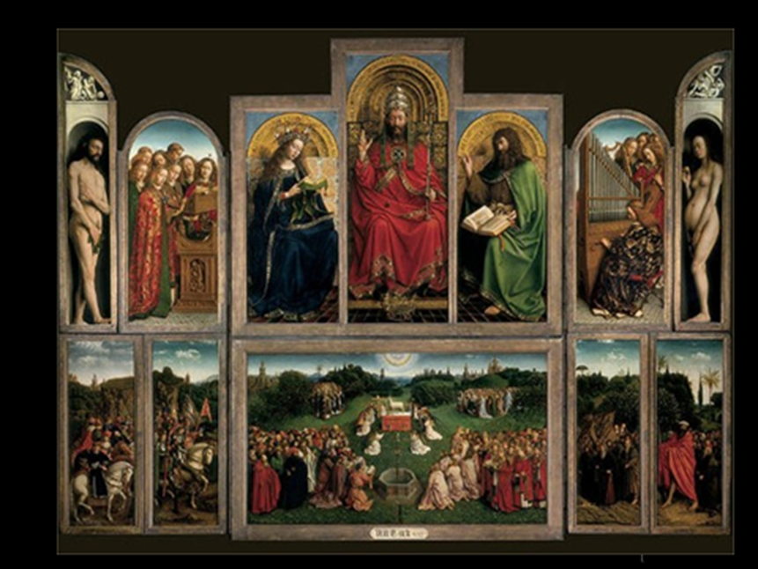
The Lamb of God, van Eyck 1432

Slide 5
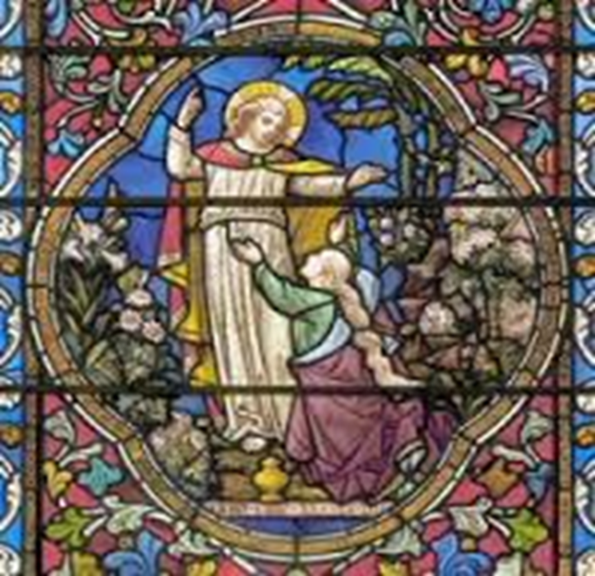
3. The personal appearance of Jesus
But the story about the appearances of Jesus was not only an explanation of the Scriptures
Mary Magdalene.
The first appearance.
A woman.
Recognition by the human voice of Jesus.
Mary answered: ‘Rabuni’ (= Master)

Slide 6
4. Jesus acts as God:
The forgiveness of sins
Luke 24: 36-48 On the road to Emmaus.
Jesus opened their minds to understand the Scriptures: “The Christ will suffer and rise from the dead on the third day, and repentance and forgiveness of sins will be preached in his name to all nations”.
We cannot negate the presence of sin and evil in the present world.
God created heaven and earth and he said it was good. He created Adam and Eve (man and woman) and he said it was very good.
‘Breaking the bread’ as a sign of Jesus’ sacrifice for us.

Slide 7
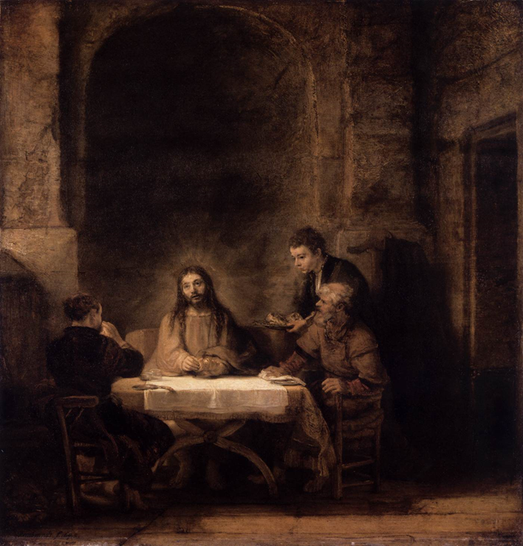
Rembrandt’s Supper at Emmaus, 1648

Slide 8
5.The three ‘trees of life’ in the Bible
The tree of life in the beginning: Genesis 2:9
The tree of life at the side of the river flowing from the throne of God and the Lamb in the middle of the New Jerusalem: Revelation 22.
In the middle, the pivot of biblical history, is the cross, the tree of life.
Through him all things were made; without him nothing was made that has been made (John 1)
Christ’s suffering and death were needed to bring new life. No denial but reconciliation.

Slide 9
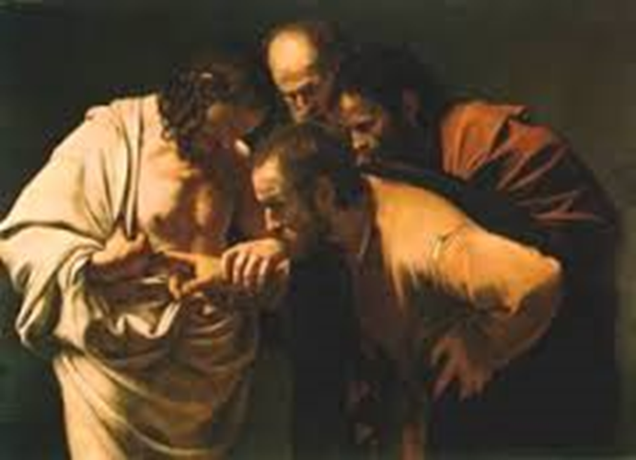
‘The disbelief of Thomas’.
Caravaggio, 1601–1602

Slide 10
6.Jesus giving his life as a ransom for many
Jesus giving his life as a sinless person, only God is without sin.
The new law of the Kingdom of God: Forgiveness of sin
Mark 10:45 “For even the Son of Man did not come to be served, but to serve, and to give his life as a ransom for many.”
Psalm 49:6-8:
  No one can redeem the life of another
or give to God a ransom for them
the ransom for a life is costly,
no payment is ever enough.

Slide 11
7. The risen Christ brings new life
• Isaiah 61:11 “For as the soil makes the sprout come up and a garden causes seeds to grow, so the Sovereign Lord will make righteousness and praise spring up before all nations”.
• Romans 14:9 “For this very reason, Christ died and returned to life so that he might be the Lord of both the dead and the living”.
God the Father and God the Son and God the Holy Spirit are three in one.
Restauration is in Christ Jesus, our Savior.
He shares his live with those who believe in him

