Slide 1
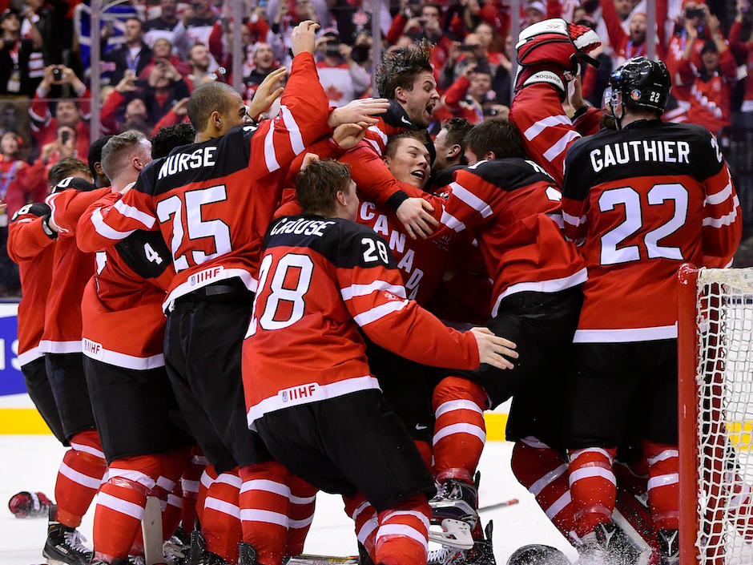
Life Before the Final Horn Mark 1:14-20; 1 Corinthians 7:26-31

Slide 2
Goalie Zach Fucale Come Up Big!

Slide 3
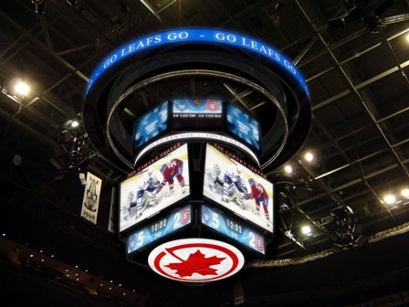
Is the Time REALLY Short?

Slide 4
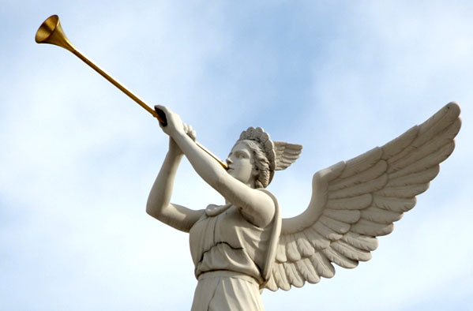
After John was put in prison, Jesus went into Galilee, proclaiming the good news of God. “The time has come,” he said. “The kingdom of God has come near. Mark 1:14-15a

Slide 5
Life is TOUGH… There Must Be PRIORITIES !

Slide 6
Because of the present crisis… those who marry will face many troubles in this life… 1 Corinthians 7:26a, 28b

Slide 7
Time is WINDING Up… There Must Be URGENCY !

Slide 8
What I mean, brothers and sisters, is that the time is short. 1 Corinthians 7:29a

Slide 9
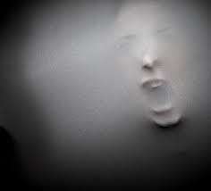
The World SYSTEM is Fading… There Must Be RELEASE…

Slide 10
…those who use the things of the world, [should live] as if not engrossed in them. For this world in its present form is passing away. 1 Corinthians 7:31

Slide 11
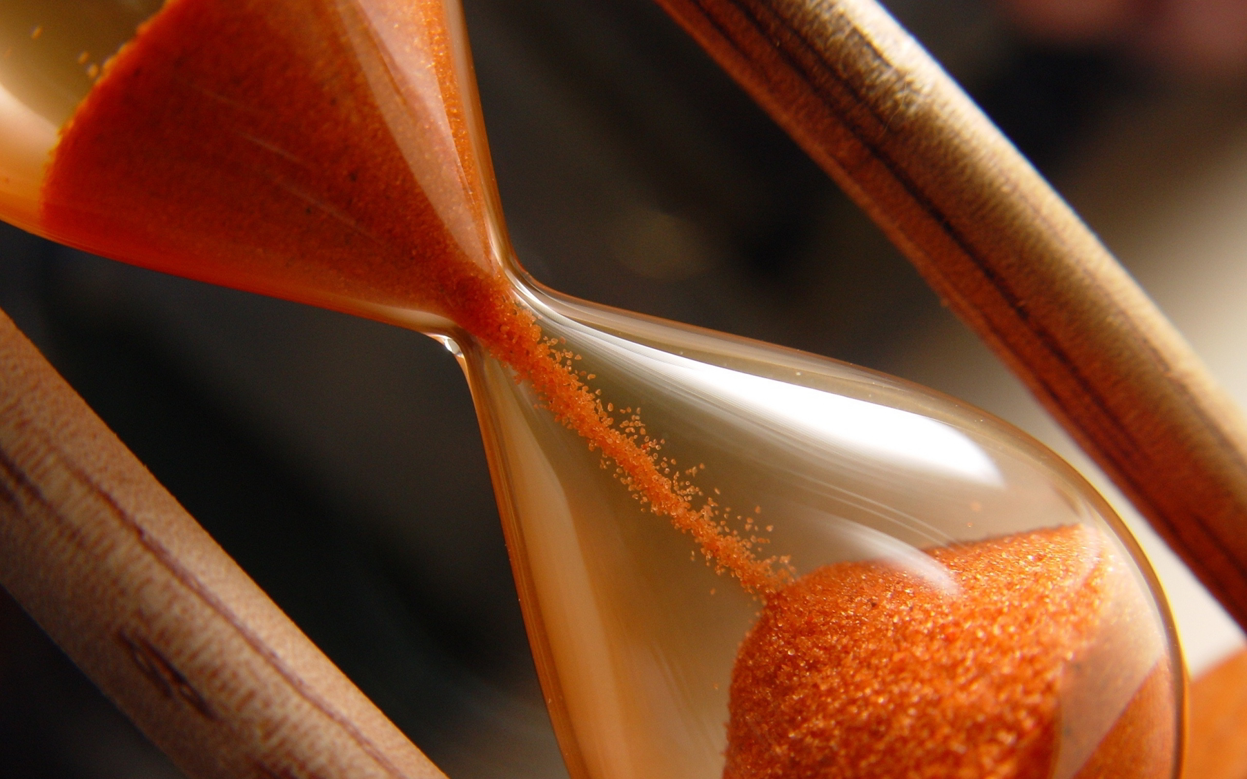
What Does it Mean to Live in the LAST Times?

Slide 12
“… Repent and believe the good news!” As Jesus walked beside the Sea of Galilee, he saw Simon and his brother Andrew casting a net into the lake, for they were fishermen. “Come, follow me,” Jesus said, “and I will send you out to fish for people.”

Slide 13
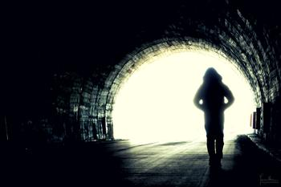
Key Words: As if NOT !

Slide 14
At once they left their nets and followed him. When he had gone a little farther, he saw James son of Zebedee and his brother John in a boat, preparing their nets. Without delay he called them, and they left their father Zebedee in the boat with the hired men and followed him. Mark 1:15b-20

Slide 15
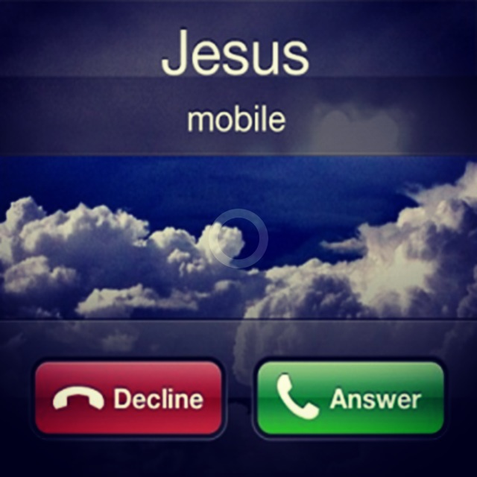
An Urgent CALL Demands a VITAL Response

Slide 16
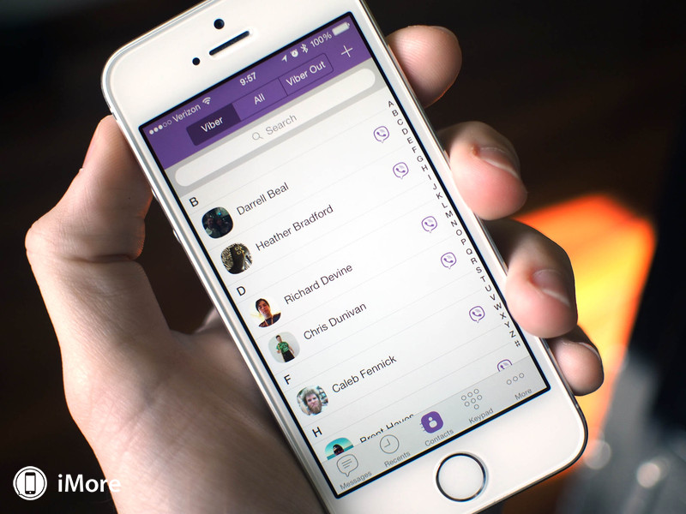
The Last Times Reorient Our Core RELATIONSHIPS !

Slide 17
From now on those who have wives should live as if they do not; those who mourn, as if they did not… 1 Corinthians 7:29-30a

Slide 18
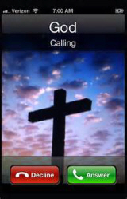
The Last Times Re-establish Our MOTIVES…

Slide 19
…[T]hose who are happy [should live] as if they were not… 1 Corinthians 7:30b

Slide 20
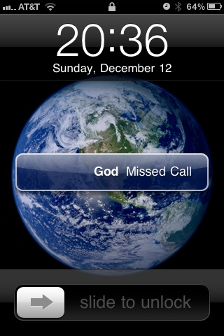
The Last Times Rework Our MATERIAL Goals…

Slide 21
…[T]hose who buy something, [should live] as if it were not theirs to keep; those who use the things of the world, as if not engrossed in them. 1 Corinthians 7:30c

