Slide 1
Lamb of God, who takes away the sin of the World
Brian Gentle
Good Friday 2015
ICEL

Slide 2
God who made the earth,
The air, the sky, the sea,
Who gave the light its birth,
Careth for me
ICEL

Slide 3
the LORD
Yahweh
The Ark of the Covenant
Philistines
Israelites
The Ark was a symbol of God’s presence
ICEL

Slide 4
The Ark in the time of Jesus
in the Holy of Holies
only the High Priest could enter, and that only on certain days and after much preparation
ICEL

Slide 5
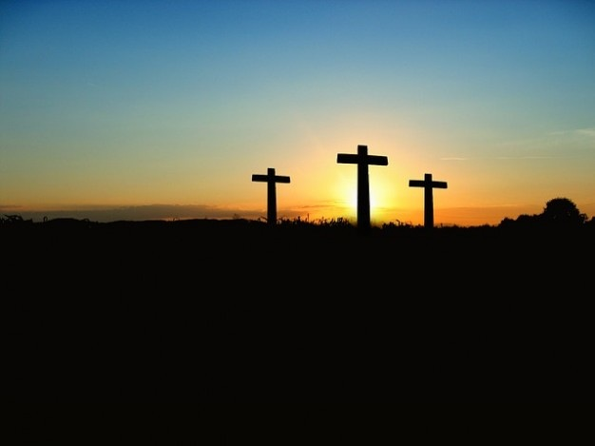
ICEL

Slide 6
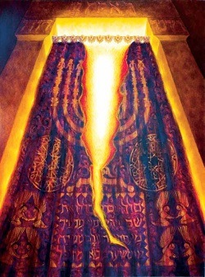
Jesus died
God acted
ICEL

Slide 7
We have direct access to God
No go-between needed
But How?
Reverence
We can bring anything to Him
But we should watch what we say
God is our friend, but He is Holy
In our service to Him, we should give the best we can
ICEL

Slide 8
Thank you, Lord!
Let the peace of Christ rule in your hearts, since as members of one body you were called to peace. And be thankful. Let the message of Christ dwell among you richly as you teach and admonish one another with all wisdom through psalms, hymns, and songs from the Spirit, singing to God with gratitude in your hearts. And whatever you do, whether in word or deed, do it all in the name of the Lord Jesus, giving thanks to God the Father through him.
Colossians 3, 15-17
ICEL

