Slide 1
The 2nd Sunday of Lent
‘By grace alone’
ICEL Leuven
March 12th 2017
Pieter Boersema

Slide 2
Introduction
Second Sunday of Lent.
Part of the 40 days before Easter: the Church remembers the life and ministry of Jesus and renews its commitment to him in Christian discipleship.
A period of fasting but as well a period of teaching in the Early Church for the preparation of the Baptismal service.
Teaching the Bible is also teaching the stories.
The Bible as God’s revelation shown in people.

Slide 3
The Bible stories about salvation
The lectionary for today:
First reading: Gen. 12:1-4a The calling of Abraham
Second reading: Rom 4:1-5, 13-17
  Paul (apostle of the Gentiles) Only by faith alone
Third reading, Gospel reading: John 3:1-17
  Jesus and Nicodemus (Teaching the Gospel)
The Gospel in a nutshell:
  All three stories (OT, Gospel, NT) related to salvation.
The year 2017: The remembrance of the Reformation, 500 years ago.

Slide 4
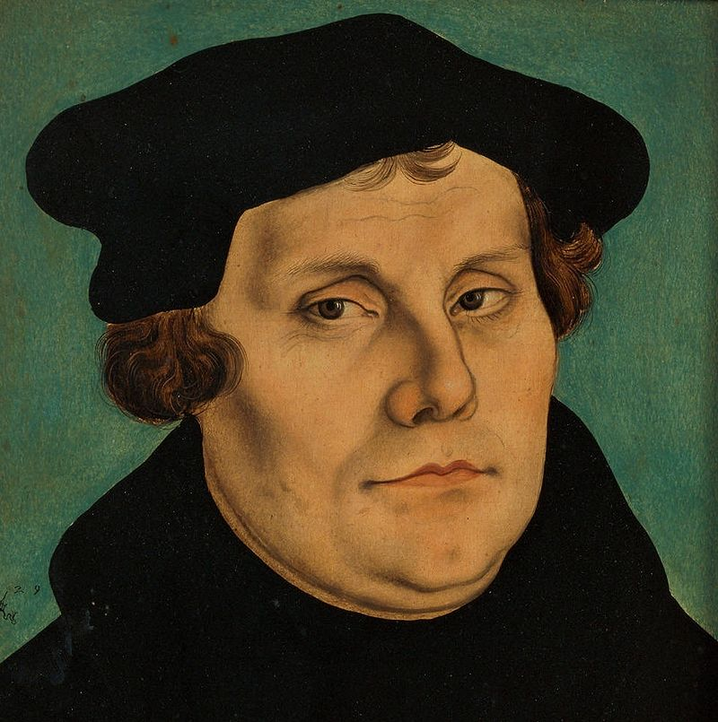
Luther his key phrase:
‘By grace alone’ ‘Sola Gratia’.
Born 10 November 1483
Eisleben, Saxony
Died 18 February 1546 (aged 62)
Eisleben, Saxony,
Holy Roman Empire
Source: Wikipedia

Slide 5
Genesis 12:1-4 The calling of Abram
The Lord had said to Abram, “Go from your country, your people and your father’s household to the land I will show you.
2 “I will make you into a great nation, and I will bless you; I will make your name great, and you will be a blessing.
3 I will bless those who bless you, and whoever curses you I will curse; and all peoples on earth
will be blessed through you.”
4 So Abram went, as the Lord had told him; and Lot went with him. Abram was seventy-five years old when he set out from Harran.

Slide 6
Part 1: The calling of Abram
Gen. 12: a new chapter: God chose Abr(ah)am.
God’s blessing: “I make you into a great nation”. But he has no child and is 75 years old.
“….and all peoples on earth will be blessed through you”. The structure of salvation.
• Gen. 15:6 (God’s Covenant with Abram) “Abram believed the Lord, and he credited it to him as righteousness”.
• Abram left his country, his people and his father’s household (this was his basis of security).

Slide 7
Gen. 12: From Ur to Egypt

Slide 8
Part 2: Romans 4: ‘By faith alone’.
Abraham is justified by faith. Abraham believed God, and it was credited to him as righteousness (without blame).
This was even before the Law was given to the Israelites by Moses at mount Sinai.
Rom. 4: 16. “Therefore, the promise comes by faith, so that it may be by grace and may be guaranteed to all Abraham’s offspring—not only to those who are of the law but also to those who have the faith of Abraham. He is the father of us all “.

Slide 9
What is the meaning of the words ‘faith’ and ‘belief’?
Is faith a product of rational reasoning?
Faith is a way of life: To chose for God and not the other gods.
To trust YHWH: the covenant with God.
The same meaning as ‘amen’.
Law (to live) and faith (to trust) are very close to each other when it comes to live a life with God.
The Kingdom of God is present and yet to come
See the stories in the Bible, OT and NT.

Slide 10
Galatians 5: Freedom in Christ
22. But the fruit of the Spirit is love, joy, peace, forbearance, kindness, goodness, faithfulness, gentleness and self-control. Against such things there is no law.
24. Those who belong to Christ Jesus have crucified the flesh with its passions and desires.
25. Since we live by the Spirit, let us keep in step with the Spirit.
26. Let us not become conceited (self-important), provoking (irritating) and envying (jealous) each other.

Slide 11
Part 3: Jesus teaching the Gospel
John 3:1 Now there was a Pharisee, a man named Nicodemus who was a member of the Jewish ruling council.
2 He came to Jesus at night and said, “Rabbi, we know that you are a teacher who has come from God. For no one could perform the signs you are doing if God were not with him.”
3 Jesus replied, “Very truly I tell you, no one can see the kingdom of God unless they are born again.”
Verse 16: For God so loved the world that he gave His one and only Son.

Slide 12
‘saved from the world’ and
‘to save the world’
40 days of Lent: 40 days desert (could have been 1 year: The sin in human mankind),
After 40 years: Joshua brought them through the river Jordan into the promised land.
40 days Jesus in the wilderness (Matthew 4).
Grace as the love of God for the faithful/believers
God’s grace as the witness to the world.
Mark 12: 30,31. God’s great commandment: “Love God …. and thy neighbor as thou self”.

