Slide 1
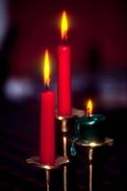
Sermon 1st Advent
‘Light in the darkness’
ICEL Leuven
Dec. 3rd 2017
Pieter Boersema

Slide 2
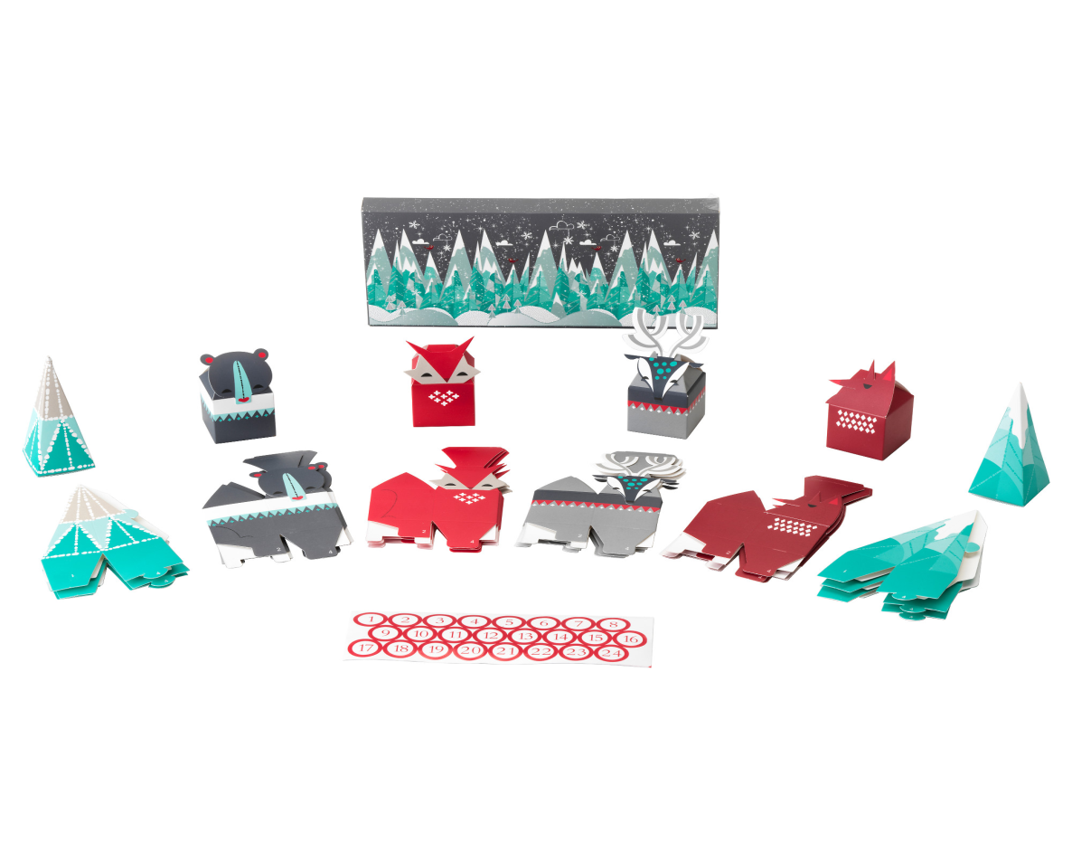
Advent as preparation for Christmas

Slide 3
The division of a day between night and daylight is natural but can be depressive when nights are long and cold as in wintertime.
Darkness in spiritual meaning is seen in many places around the world, but also in ‘modern culture’ as here in Belgium.
The feeling of darkness can be part of our personal life and surroundings.
Many passages from the Bible readings during Advent time have a strong confrontation between ‘dark’ and ‘light’.
Advent is de Christian expectation to see light in the darkness.

Slide 4
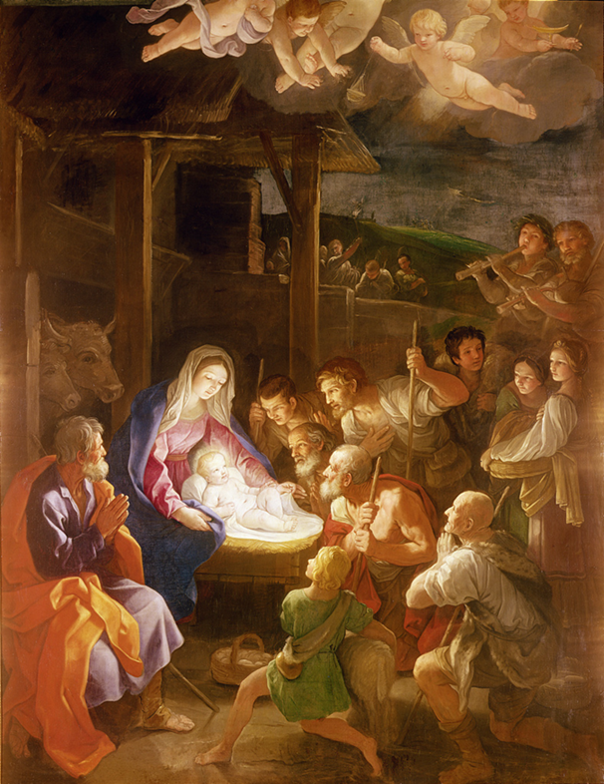
Jesus born in a manger
Adventus = Latin for ‘visit of the King’. ‘The King is coming’.
But not a Champion enters but a small child in the manger.
This is not a ‘weak part’ of Christianity, but God’s chosen way of salvation.
Often we have a wrong (i.e. a human) perception based on power.

Slide 5
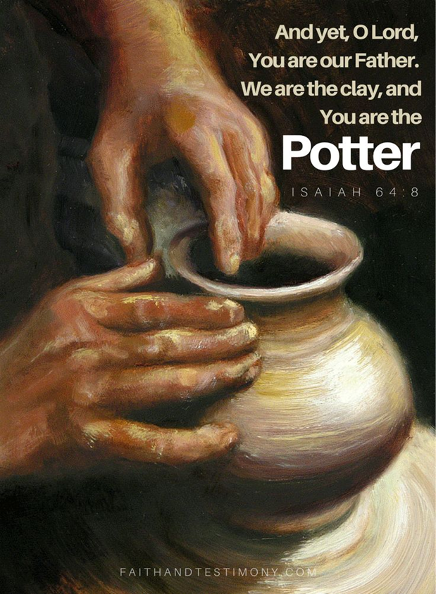
God is the creator and we are His creation
The world has fallen in sin by human desiring to be like God (Gen. 3).
Salvation is from the Lord. This is not a struggle in the sense of ‘human strength’.
In the Bible there is often a reverse situation: The weak become strong.
E.g. read the Beatitudes at the ‘Sermon on the mount’; Matthew 5.
But also the stories in the Tenah, the O.T.

Slide 6
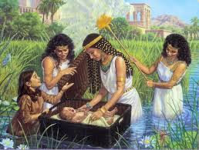
Moses in the papyrus basket

Slide 7
Parallels between the birth of Jesus and Moses
Moses (Exodus 2)
Born in a crib
Born under Egypt rule
The Pharaoh seen as God
The name of his sister is Miriam (water / to elevate)
He became a prince, to set free the people of Israel.
‘The name ‘Moses’ means ‘Son of …(a god)’
Passover: The Lord brought the Israelites out of Egypt.
A tradition in the church in the middle East during Easter night:
Jesus born in Bethlehem
Born in a manger
Born under Roman rule
Cesar August seen as God
The name of the mother is Mary (Greek for Miriam).
The expected Messiah to save the world.
The name ‘Jesus ‘ (Joshua) means ‘rescue, deliver’.
Passover: Jesus himself was the Passover lamb.
Let there be light !

Slide 8
The 1st reading passage for this first Advent: Psalm 80
Verse 1: God as the Shepherd King, Israel as God’s flock.
Verse 1 b. But God is also enthroned between the cherubim on top of the Ark of the Covenant.
Verses 3-7: God, how long will your anger smolder against the prayers of your people. Their enemies has been allowed to overpower them.
Verse 3: restore us, O God, make your face shine upon us, that we may be saved (repeated in verses 7 and 8).

Slide 9
The 2nd reading passage for this first Advent: Isaiah 64:1-9
7 b. for you have hidden your face from us
and have given us over to our sins.
8 Yet you, Lord, are our Father.
We are the clay, you are the potter;
we are all the work of your hand.
9 Do not be angry beyond measure, Lord;
do not remember our sins forever.
Oh, look on us, we pray,
for we are all your people.

Slide 10
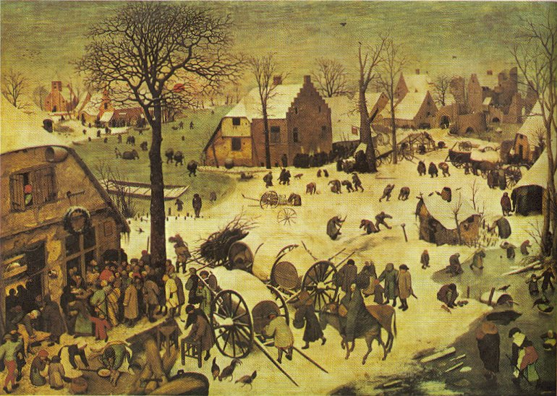
Painting of Pieter Bruegel the Elder
The census at Bethlehem, 1566

Slide 11
The confrontation between darkness and light
In the beginning God created the heavens and the earth. …….. And God said, let there be light: and there was light ………God called the light ‘day’, and the darkness he called ‘night’. (Genesis 1: 1, 3 and 5).
Salvation on earth is not the disappearance of the night, but light to see a part of God’s love.
This light is not his physical power, this appearance of God will blinds us. But his mercy is His Son Jesus, as a baby born in Bethlehem.
This child is the light for revelation (Luke 2:32).

Slide 12
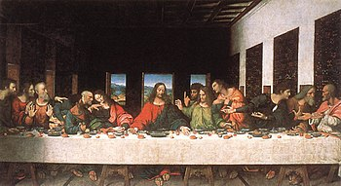
Leonardo da Vinci, The Last Supper (1520)
John 3:21 “I tell you the truth, one of you is going to betray me”

Slide 13
The Holy Supper as support of our faith
Isaiah 64: 9 “Do not be angry beyond measure, Lord; do not remember our sins forever. Oh, look on us, we pray, for we are all your people”.
God’s mercy is based on His love for us.
This love brings us together around the table.
To Remember Christ given his life at the cross as the Passover lamb is to see his resurrection from the death and his ascension to heaven.
It is also the believe that we expect His second coming when we shall see Him in all his glory.
And there will be no more night (Rev. 22:5).

