Slide 1
Familie Brandes– Patrick, Mariëtte, Joëlle, Manouk and Yoran

Slide 2
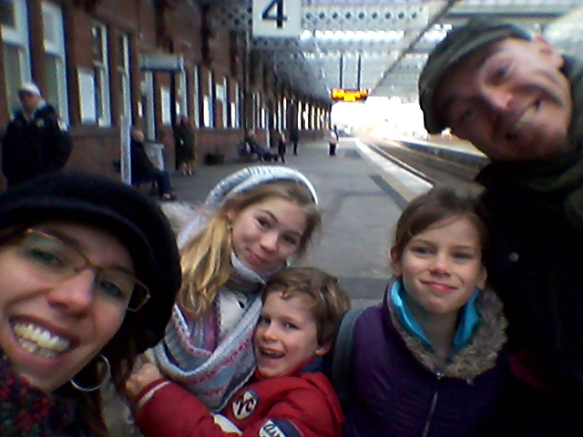
Familie Brandes On our way to Paisley, Scotland

Slide 3
Since 2001 we work for Youth with a Mission.
Half July we move to Scotland.

Slide 4
Seeking to please God and do His will
“But without faith it is impossible to please Him, for he who comes to God must believe that He is and that He is a rewarder of those who diligently seek Him” (Hebrews 11:6).

Slide 5
Psalm 139
“You have searched me, Lord,
and you know me.
2 You know when I sit and when I rise;
you perceive my thoughts from afar.
3 You discern my going out and my lying down;
you are familiar with all my ways.
4 Before a word is on my tongue
you, Lord, know it completely.”

Slide 6
“You will show me the path of life; in Your presence is fullness of joy; at Your right hand are pleasures forevermore” (Psalm 16:11)

Slide 7
Psalm 104:
1Bless the LORD, O my soul!
O LORD my God, You are very great;
You are clothed with splendor and majesty,
2Covering Yourself with light as with a cloak,
Stretching out heaven like a tent curtain.
3He lays the beams of His upper chambers in the waters;
He makes the clouds His chariot;
He walks upon the wings of the wind;

Slide 8
Psalm 147: 3 Describes God as the One who “heals the brokenhearted and binds up their wounds”

Slide 9
The way I am
I was a product of my time
I didn't know what was right or wrong
I was to ashamed to shine
I didn't know who's side I was on
What difference does it make
to be good Samaritan
to have heaven on my mind
I follow just the way I am
It was just a matter of time
I developed more and more a open mind
all my preconceived ideas
they were so shallow but I thought I'll be fine
Oh I had so much to learn
look and listen to the Universe
the song of prodigals return
the constant train of rain and rain reverse

Slide 10
The way I am
Oh I follow I will follow just the way I am
I will follow I will follow just the way I am
I met a Man with of many words
He had a heart for healing hidden hurts
I was insecure but he assured
You follow me, you 'll be free like a bird
Oh what difference does it make
to be good Samaritan
to have heaven on my mind
now I follow You the way I am

Slide 11
The way I am
Oh the way He comes to me like water
the way He comes to me like waterfalls
Oh the way...
the way He comforts my soul
He said something very small
something small but jet so beautiful
Only for you I give it all,
only for you I will endure it all

Slide 13
Galatians 1:3,4 “Grace and peace to you from God our Father and the Lord Jesus Christ, who gave Himself for our sins to rescue us from the present evil age, according to the will of our God and Father.”

Slide 14
Meditation:
Give in Gods hand what keeps you busy at the moment. Your main work and ministry.
Invite Him to give you a fresh word.

Slide 15
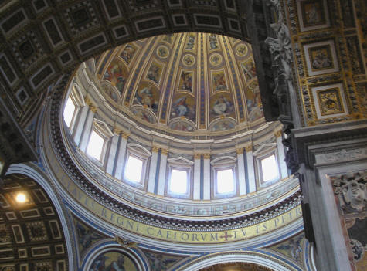
Meditation:
Make Jesus the King of your Heart.
Ask God to reveal what is ruling over you and give it up, so there is a free room, a free dome, freedom to follow Jesus and become His disciple.

Slide 16
“But seek first His Kingdom and his righteousness, and all these things will be given to you as well.” Matthew 6:32
Matthew 6:19 “Do not store up for yourselves treasures on earth, where moth and rust destroy, and where thieves break in and steal. 20But store up for yourselves treasures in heaven, where moth and rust do not destroy, and where thieves do not break in and steal. 21For where your treasure is, there your heart will be also.”

Slide 17
The Kingdom of God is putting Jesus on the throne of your heart

Slide 18
Jesus said He always did “those things that please Him (Father God)” (John 8:29)
That’s why God entrusted Jesus to be Ruler over all, to be the King of Kings and the Lord of Lords.
We cannot worship Jesus without making him the King over our lives

Slide 19
Seeking to please God and do His will

Slide 20
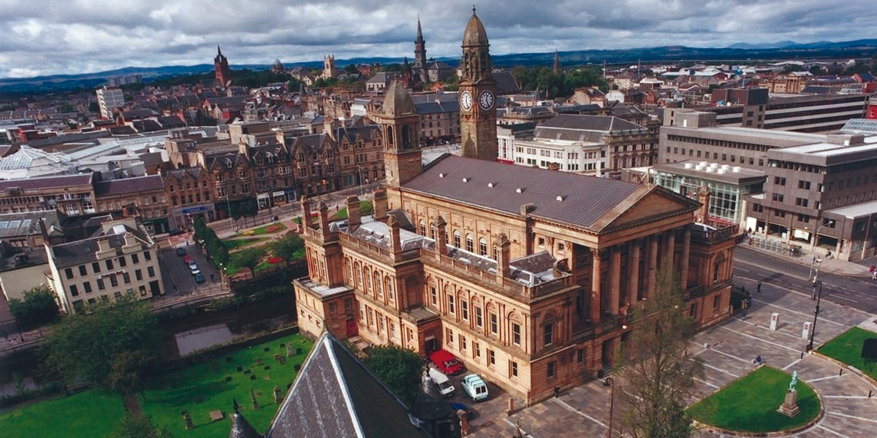
Paisley – vlakbij Glasgow

Slide 21
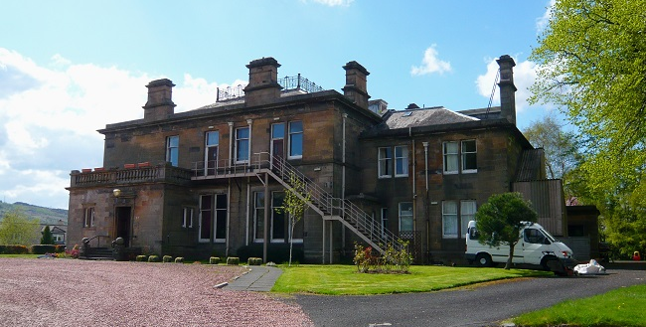
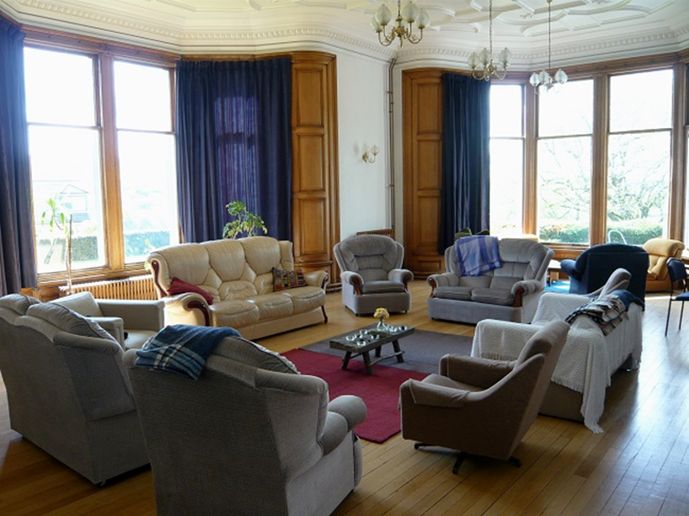

Slide 22
Revival & Worship DTS

Slide 23
Discipelschaps Trainings School
An initiative for building a dynamic, active, outward focussed community of missionaries
From Sept 24 2016 till May 20 2017 Fulltime;
Lecture/Training phase as well as Mission Trips
9 people on the staff team to organize and coach.
We have space for 30 students;
A strong focus on worship and outreaches, locally, nationally and internationally among refugees.

Slide 24
Interested? Come and see us!

Slide 25
Invitation to partner with us
Do you want to become a partner of ‘Beautiful Feet’ and help us on our way to Scotland?
You can sign up for our newsletter (4x year)
Info@brandesfeet.nl

Slide 26
The challenge is to raise €1200 per month
We have now raised €515
Would YOU want to invest in our project ‘Beautiful Feet’?

Slide 27
info@brandesfeet.nl

