Slide 1
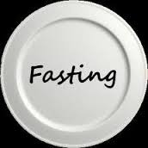
“Fasting that makes sense”
Isaiah 58, 1-12
ICEL
05 February 2017

Slide 2
Fasting: deliberate abstinence from something habitual for a determined period of time.
Traditionally from food, drink and/or sexual relations
Can be partial or total
Now expanded to cover other habits or practices

Slide 3
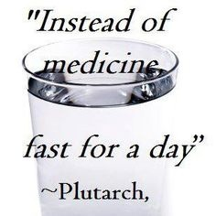
Different types of fasts

Slide 4
The fast in Isaiah is religious and short
¹"Shout it aloud, do not hold back. Raise your voice like a trumpet. Declare to my people their rebellion and to the descendants of Jacob their sins.
² For day after day they seek me out; they seem eager to know my ways, as if they were a nation that does what is right and has not forsaken the commands of its God. They ask me for just decisions and seem eager for God to come near them.
³ 'Why have we fasted,' they say, 'and you have not seen it? Why have we humbled ourselves, and you have not noticed?'" Yet on the day of your fasting, you do as you please and exploit all your workers.
⁴ Your fasting ends in quarreling and strife, and in striking each other with wicked fists. You cannot fast as you do today and expect your voice to be heard on high.
⁵ Is this the kind of fast I have chosen, only a day for people to humble themselves? Is it only for bowing one's head like a reed and for lying in sackcloth and ashes?

Slide 5
What went wrong with their fast?
³ 'Why have we fasted,' they say, 'and you have not seen it? Why have we humbled ourselves, and you have not noticed?'" Yet on the day of your fasting, you do as you please and exploit all your workers.
⁴ Your fasting ends in quarreling and strife, and in striking each other with wicked fists. You cannot fast as you do today and expect your voice to be heard on high.
⁵ Is this the kind of fast I have chosen, only a day for people to humble themselves? Is it only for bowing one's head like a reed and for lying in sackcloth and ashes? Is that what you call a fast, a day acceptable to the LORD?

Slide 6
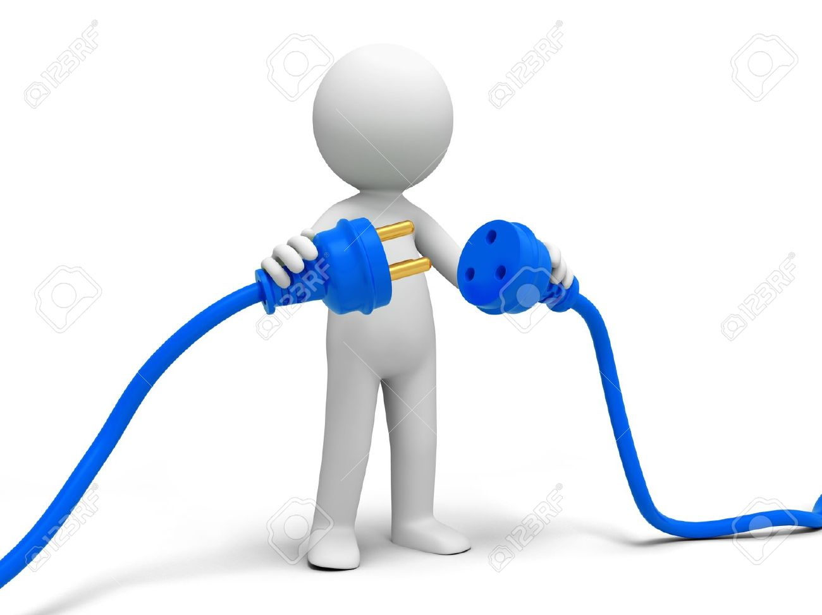
Major disconnect between ritual and ethics
BEFORE:
Do as they please
Exploit their workers
AFTER:
Quarrelling and strife
Coming to blows with each other

Slide 7
Solution: Different kind of fast
⁶ "Is not this the kind of fasting I have chosen: to loose the chains of injustice and untie the cords of the yoke, to set the oppressed free and break every yoke?
⁷ Is it not to share your food with the hungry and to provide the poor wanderer with shelter-- when you see the naked, to clothe them, and not to turn away from your own flesh and blood?

Slide 8
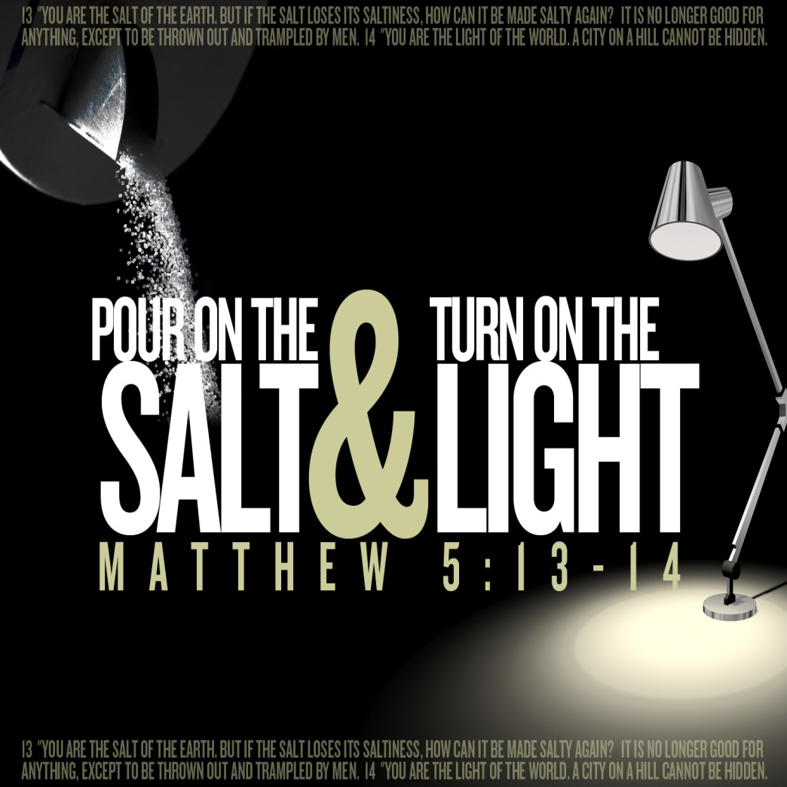
In other words…fasting makes sense when it actively engages with others to meet their needs.

Slide 9
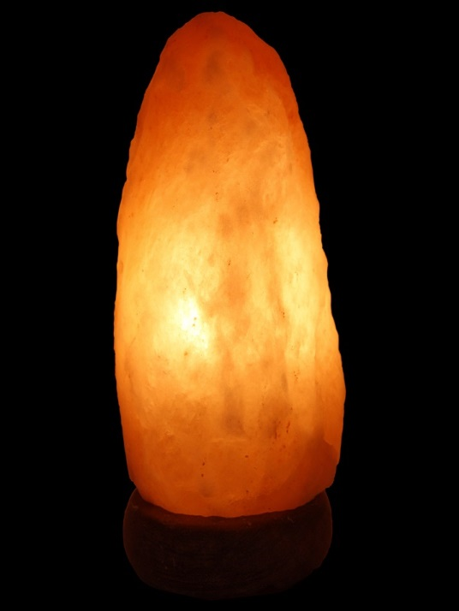
Fasting as only doing without or for individual self-improvement is not enough. Focus is on the needs of others is what counts. But it does not have to be a “grande œuvre” or big project.

Slide 10
“Thus there exists, alongside the terrible greater good, human goodness in everyday life. It is the goodness of an elderly woman who on the side of the road gives a piece of bread to a convict passing by, the goodness of a soldier who offers his water canteen to a wounded enemy, the goodness of youth which takes pity on old age, the goodness of a farmer who hides an old Jew in his barn. It is the goodness of prison guards who, risking their own freedom, transmit letters from detainees to their wives and mothers. This private goodness of one individual on behalf of another is a goodness without witnesses, without ideology. One could even call it goodness without thinking.”
(Vassili Grossman, Vie et Destin, 1980)

Slide 11
Promised result, also for us?
⁸ Then your light will break forth like the dawn, and your healing will quickly appear; then your righteousness will go before you, and the glory of the LORD will be your rear guard.
⁹ Then you will call, and the LORD will answer; you will cry for help, and he will say: Here am I.”

Slide 12
