Slide 1
(Sm)all things count
Small things count…Small people count…
The widow of Nain and her deceased son Luke 7:11
The poor widow offering two coppers Mark 12: 43-44
Children and Sheep, both count. Matthew 18:10-14
My lost son was dead, but now he is alive!
Joy in Heaven! Luke15:11-32

Slide 2
The rich fool and the bulging barn (Luke 12)
¹⁶ And he told them this parable: “The ground of a certain rich man yielded an abundant harvest. ¹⁷ He thought to himself, ‘What shall I do? I have no place to store my crops.’¹⁸ “Then he said, ‘This is what I’ll do. I will tear down my barns and build bigger ones, and there I will store my surplus grain. ¹⁹ And I’ll say to myself, “You have plenty of grain laid up for many years. Take life easy; eat, drink and be merry.”’
²⁰ “But God said to him, ‘You fool! This very night your life will be demanded from you. Then who will get what you have prepared for yourself?’
²¹ “This is how it will be with whoever stores up things for themselves but is not rich toward God.”

Slide 3
The lamp on a stand
Luke 11:33 – The light within you
Mat 5:14-15 – You are the light of the world.
Matt 5:16 – Let our light shine before men
Luke 8:16 – Do not hide the light within you!
No one lights a lamp and hides it in a clay jar or puts it under a bed. Instead, they put it on a stand, so that those who come in can see the light. (v16)

Slide 4
Love for the lost…one by one
Parable of the Lost sheep Luke 15:4-7
⁴ “Suppose one of you has a hundred sheep and loses one of them. Doesn’t he leave the ninety-nine in the open country and go after the lost sheep until he finds it?
⁵ And when he finds it, he joyfully puts it on his shoulders ⁶ and goes home. Then he calls his friends and neighbors together and says, ‘Rejoice with me; I have found my lost sheep…

Slide 5
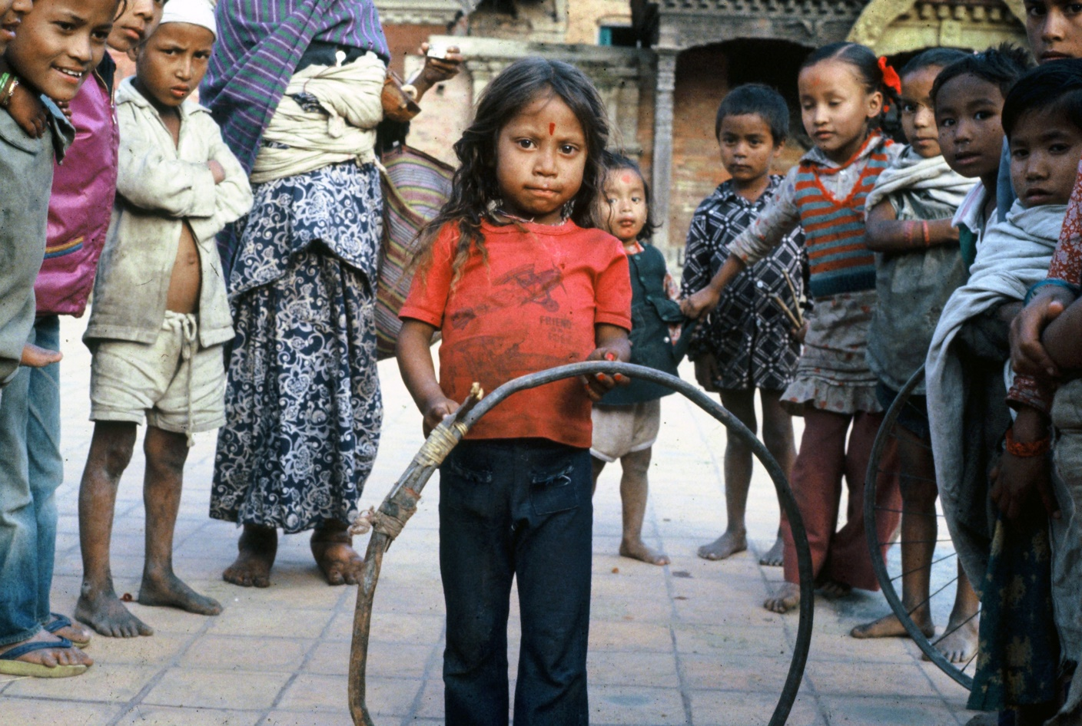
Plentishare.org
A tiny gift each month
will bring you close to people
with real needs

Slide 6
Join us in Plentishare!
A tiny gift each month
For small projects
With great results

