Slide 1
Call on the Lord
Psalm 116

Slide 2
¹ I love the Lord
…
¹⁹ Praise the Lord.

Slide 3
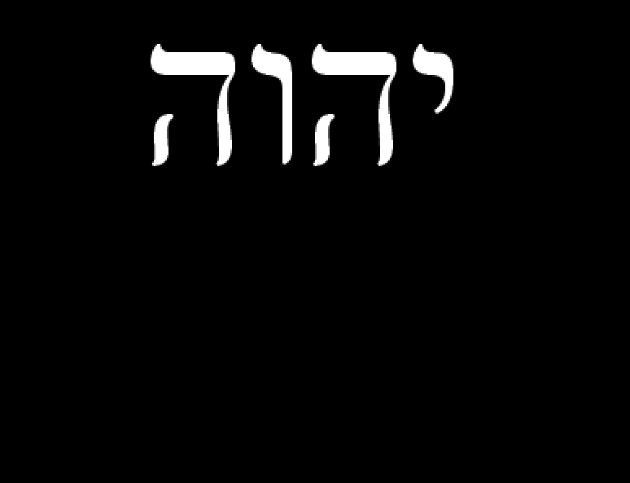

Slide 4
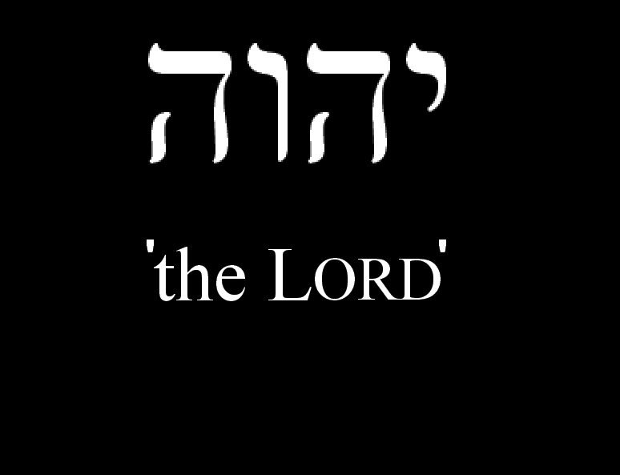

Slide 6
He is a person.

Slide 7
¹ I love the Lord, for he heard my voice; he heard my cry for mercy.
² Because he turned his ear to me, I will call on him as long as I live.

Slide 8
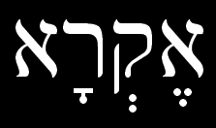
¹ I love the Lord, for he heard my voice; he heard my cry for mercy.
² Because he turned his ear to me, I will call on him as long as I live.
eqra

Slide 9
He is listening.

Slide 10
³ The cords of death entangled me, the anguish of the grave came over me;
I was overcome by distress and sorrow.
⁴ Then I called on the name of the Lord: “Lord, save me!”

Slide 11
We need Him.

Slide 12
³ The cords of death entangled me, the anguish of the grave came over me;
I was overcome by distress and sorrow.
⁴ Then I called on the name of the Lord: “Lord, save me!”
b’shem adonai eqra

Slide 13
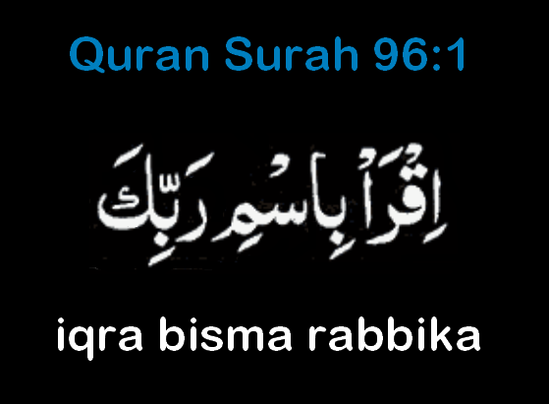
Notes:
Iqra bismi rabbika

Slide 15
He wants us to approach Him.

Slide 16
⁵ The Lord is gracious and righteous; our God is full of compassion.
⁶ The Lord protects the unwary; when I was brought low, he saved me.

Slide 17
⁷ Return to your rest, my soul, for the Lord has been good to you.
⁸ For you, [Lord,] have delivered me from death, my eyes from tears, my feet from stumbling,
⁹ that I may walk before the Lord in the land of the living.

Slide 18
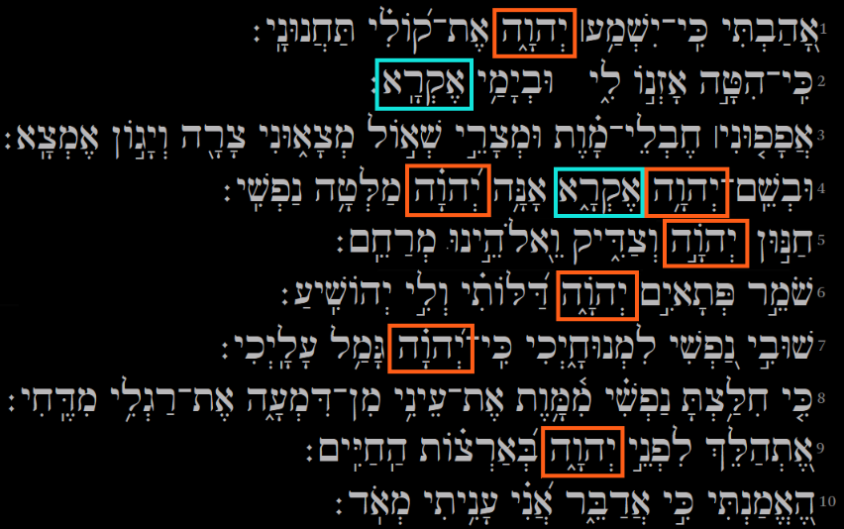

Slide 19
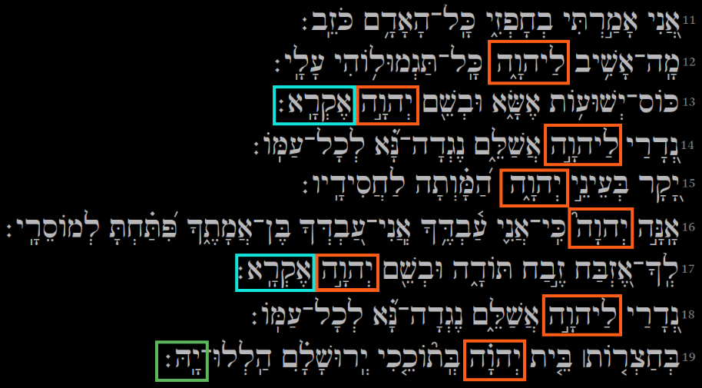

Slide 20
⁷ Return to your rest, my soul, for the Lord has been good to you.
⁸ For you, [Lord,] have delivered me from death, my eyes from tears, my feet from stumbling,
⁹ that I may walk before the Lord in the land of the living.

Slide 21
We must address Him, not just ourselves.

Slide 22
…
¹² What shall I return to the Lord for all his goodness to me?
¹³ I will lift up the cup of salvation and call on the name of the Lord.

Slide 23
We owe Him.

Slide 24
…
¹⁶ Truly I am your servant, Lord; I serve you just as my mother did; you have freed me from my chains.
¹⁷ I will sacrifice a thank offering to you and call on the name of the Lord.

Slide 25
We should serve Him.

Slide 26
¹⁸ I will fulfill my vows to the Lord in the presence of all his people,
¹⁹ in the courts of the house of the Lord -- in your midst, Jerusalem.
Praise the Lord.

Slide 27
Let us share.

Slide 28
^{1.} He is a person. ^{2.} He is listening. ^{3.} We need Him. ^{4.} He welcomes us as we approach Him. ^{5.} We must address Him, not just ourselves. ^{6.} We owe Him. ^{7.} We should serve Him. ^{8.} We should share with others.

