Slide 1
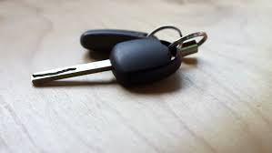
Losing the Gospel
Micah 6:1-8

Slide 2
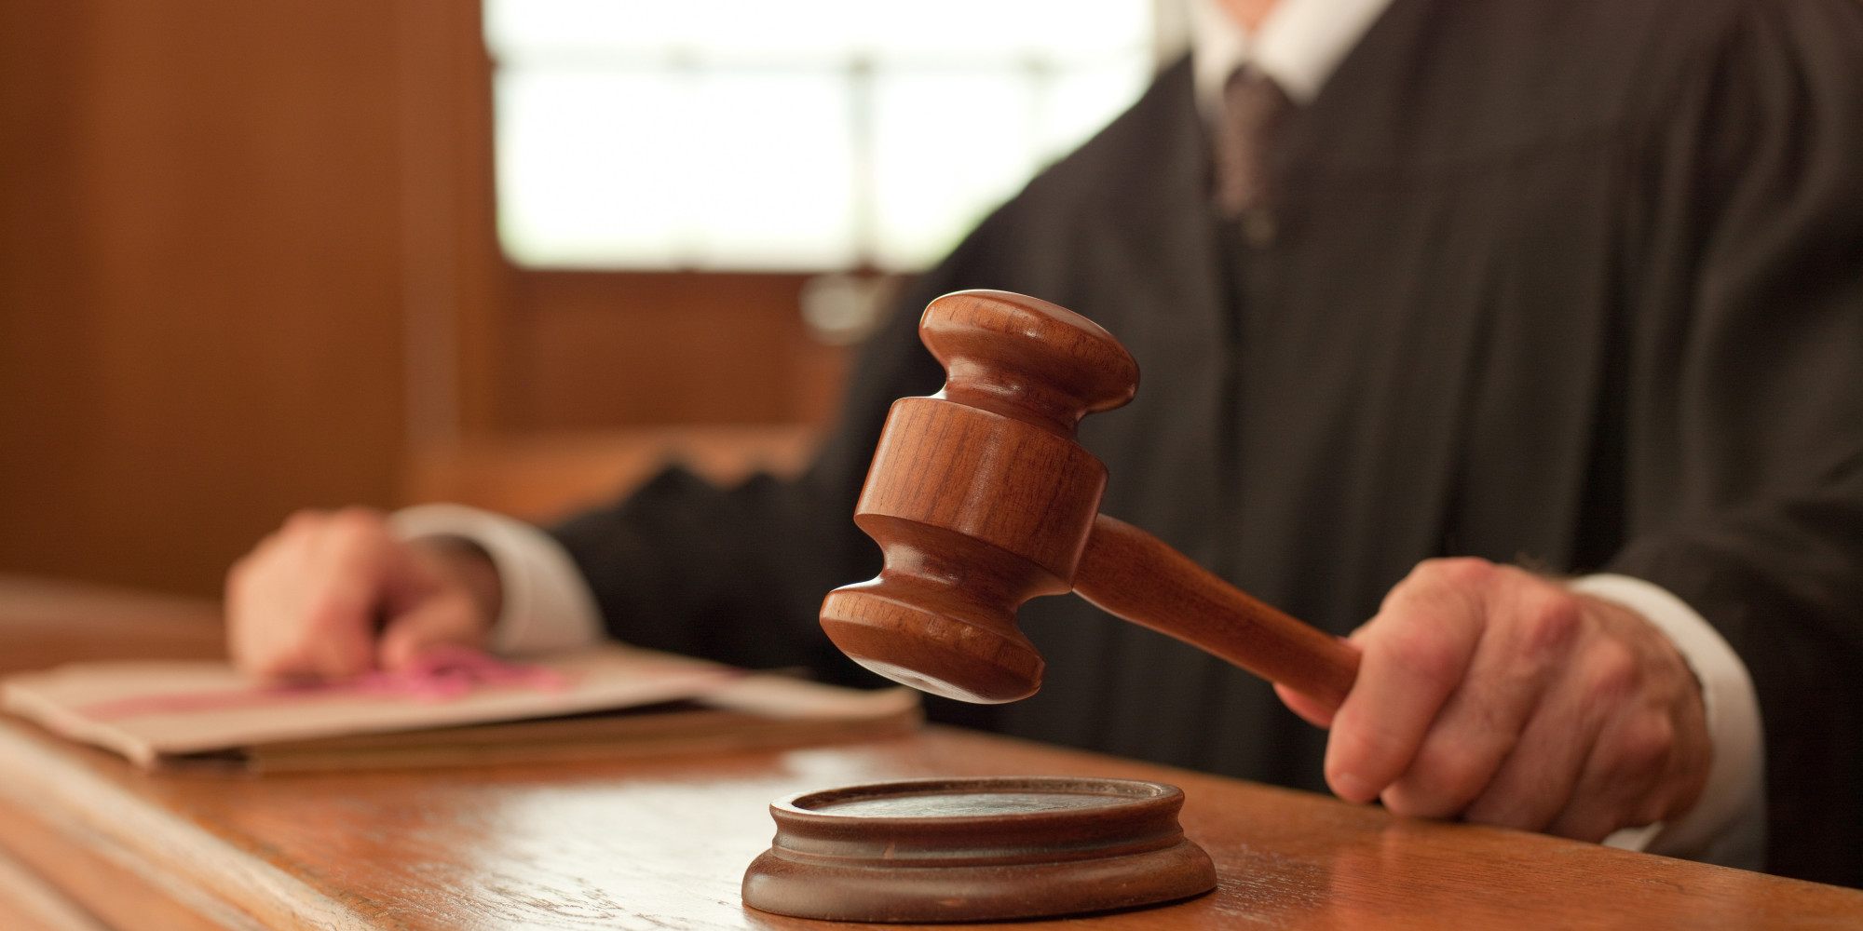
For the Lord has a case against his people; he is lodging a charge against Israel. “My people, what have I done to you? How have I burdened you? Answer me. I brought you up out of Egypt and redeemed you from the land of slavery…” Micah 6:2b-4

Slide 3
How to Know You’ve LOST the Gospel:
Is It Still GOOD News?

Slide 4
1st
Is It Good News for INDIVIDUALS...?

Slide 5
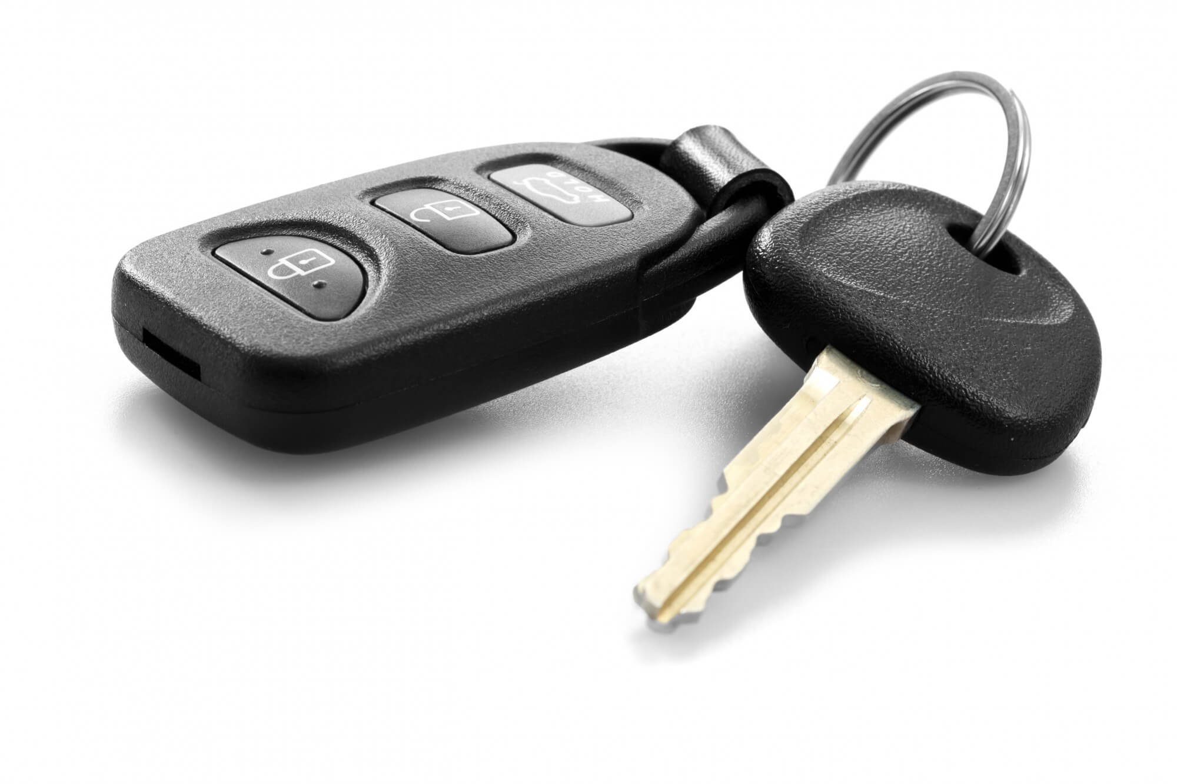
Now, brothers and sisters, I want to remind you of the gospel I preached to you, which you received and on which you have taken your stand. By this gospel you are saved, if you hold firmly to the word I preached to you. Otherwise, you have believed in vain. For what I received I passed on to you as of first importance: that Christ died for our sins
according to the
Scriptures, that he
was buried, that he was
raised on the third day according to the Scriptures, and that he appeared to Cephas, and then to the Twelve. 1 Corinthians 15:1-5

Slide 6
• Jesus DIED and ROSE...

Slide 7
• Jesus DIED and ROSE...
• He Did It to Take Away SIN

Slide 8
• Jesus DIED and ROSE...
• He Did It to Take Away SIN
• We Are Saved by BELIEVING

Slide 9
2nd
Is It Good News for the MARGINAL...?

Slide 10
The Spirit of the Lord is on me, because he has anointed me to proclaim good news to the poor. He has sent me to proclaim freedom for the prisoners and recovery of sight for the blind, to set the oppressed free, to proclaim the year of the Lord’s favour. Luke 4:18-19

Slide 11
Jubilee:
Setting People FREE!

Slide 12
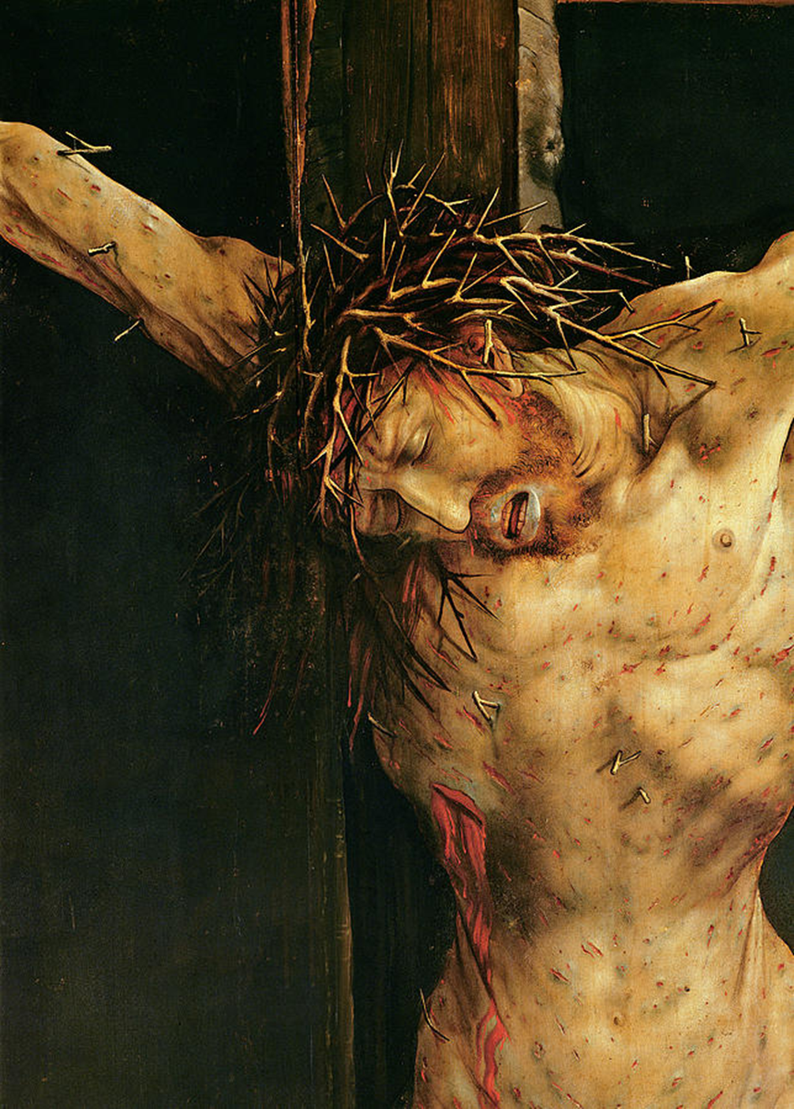
The Gospel is Personal SALVATION: Reconnecting with GOD

Slide 13
The Gospel is Personal SALVATION: Reconnecting with GOD
Resulting in
Social TRANSFORMATION: Reconnecting with God’s Vision of the WORLD

Slide 15
The Gospel Becomes REALLY Good News When We Do BOTH !

Slide 16
Woe to you, teachers of the law and Pharisees, you hypocrites! You give a tenth of your spices—mint, dill and cumin. But you have neglected the more important matters of the law—justice, mercy and faithfulness. You should have practiced the latter, without neglecting the former. Matthew 23:23

Slide 17
He has shown all you people what is good. And what does the LORD require of you?
To act justly and to love mercy and to walk humbly with your God.
Micah 6:8

Slide 18
• The Whole Gospel Includes the SPIRITUAL

Slide 19
...to walk humbly with your God... Micah 6:8
Since we live by the Spirit, let us keep in step with the Spirit. Galatians 5:25

Slide 20
• The Whole Gospel Includes the PHYSICAL

Slide 21
to love mercy... Micah 6:8
As you go, proclaim this message: ‘The kingdom of heaven has come near.’ Heal the sick, raise the dead, cleanse those who have leprosy, drive out demons. Freely you have received, freely give. Matthew 10:7-8
If any one of you has
material possessions
and sees a brother
or sister in need but
has no pity on them, how can the
love of God be in you? 1 John 3:17

Slide 22
• The Whole Gospel Includes the SOCIAL

Slide 23
To act justly... Micah 6:8
A bruised reed he will not break, and a smoldering wick he will not snuff out, till he leads justice to victory. Matthew 12:20

