Slide 1
How to Know Spiritual Truth
John 5:33-47

Slide 2
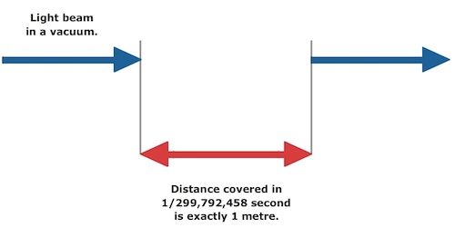

Slide 3
Four Sources of Spiritual Truth

Slide 4
WITNESS:
A Personal
POINTER…
You sent to John, and he has borne witness to the truth… He was a burning and shining lamp, and you were willing to rejoice for a while in his light. John 5:33, 35

Slide 5
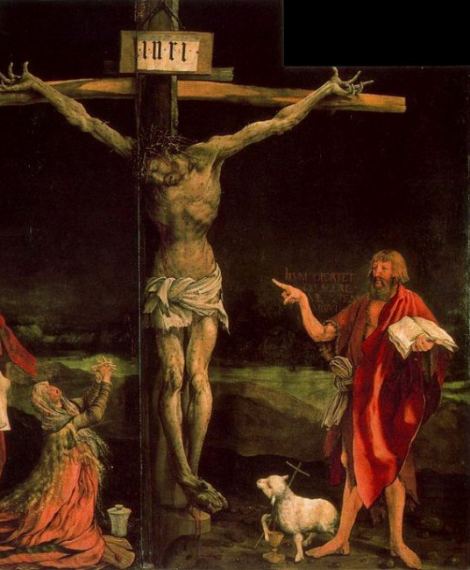

Slide 6
MIRACLES:
Unexplainable EXPERIENCES…
But the testimony that I have is greater than that of John. For the works that the Father has given me to accomplish, the very works that I am doing, bear witness about me that the Father has sent me. John 5:36

Slide 7
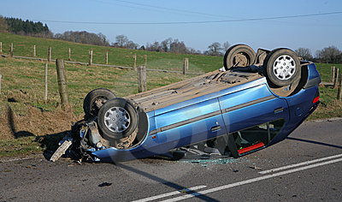

Slide 8
CONVICTION:
Divine ENCOUNTERS…
And the Father who sent me has himself borne witness about me. John 5:37a

Slide 9
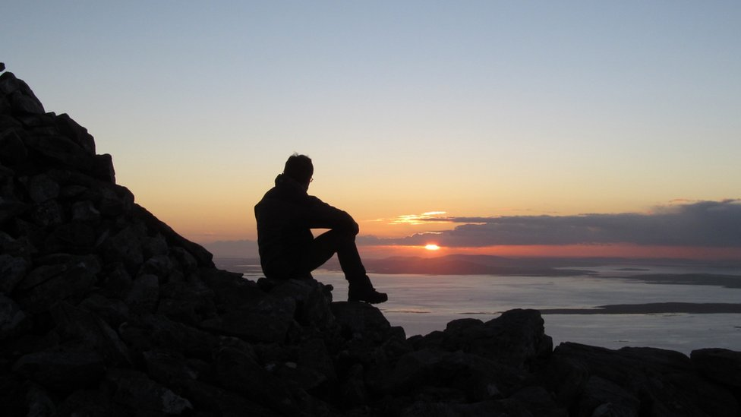

Slide 10
SCRIPTURE:
Biblical LIGHT…
You search the Scriptures because you think that in them you have eternal life; and it is they that bear witness about me… John 5:39

Slide 11
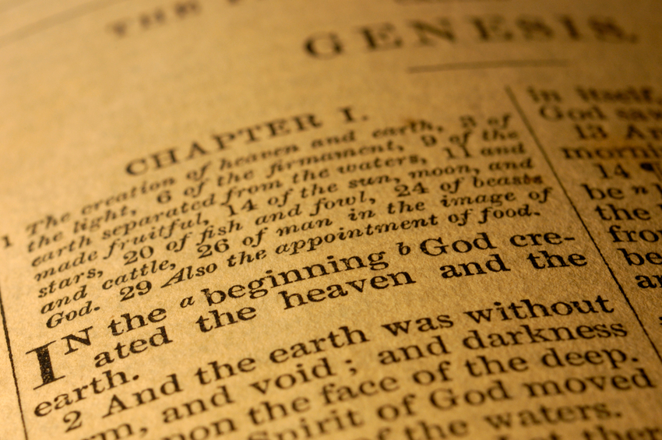

Slide 12
And Yet, In Spite of ALL This…
… yet you refuse to come to me that you may have life. John 5:40

Slide 13
The Dire Consequences of UNBELIEF…

Slide 14
His voice you have never heard, his form you have never seen, and you do not have his word abiding in you, for you do not believe the one whom he has sent. John 5:37b-38
The Incapacity to Experience TRUTH…

Slide 15
But I know that you do not have the love of God within you. I have come in my Father’s name, and you do not receive me. If another comes in his own name, you will receive him. John 5:42-43
The Incapacity to Discern FALSEHOOD…

Slide 16
The DILEMMA of Spiritual Truth

Slide 18
The HUMAN Obstacle
I do not receive glory from
people. But I know that you
do not have the love of God
within you. I have come in
my Father’s name, and you
do not receive me. If another
comes in his own name, you will receive him. How can you believe, when you receive glory from one another and do not seek the glory that comes from the only God? John 5:40-44

Slide 19
The RELIGIOUS Obstacle
Do not think that I will accuse you to the Father. There is one who accuses you: Moses, on whom you have set your hope. For if you believed Moses, you would believe me; for he wrote of me. But if you do not believe his writings, how will you believe my words?” John 5:45-47

Slide 20
Truth Starts Outside of US…
He came to his own, and his own people did not receive him. But to all who did receive him, who believed in his name, he gave the right to become children of God, who were born, not of blood nor of the will of the flesh nor of the will of man, but of God. John 1:11-13

