Slide 1
Just Who Am I?
1 Peter 1:1-2

Slide 2
What do the religions say?

Slide 3
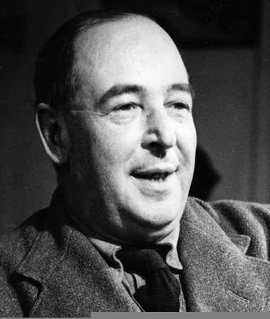
"If I find in myself a desire which no experience in this world can satisfy, the most probable explanation is that I was made for another world."
C.S. Lewis

Slide 4
To God's elect, strangers in the world, scattered throughout Pontus, Galatia, Cappadocia, Asia and Bithynia, 2 who have been chosen according to the foreknowledge of God the Father, through the sanctifying work of the Spirit, for obedience to Jesus Christ and sprinkling by his blood… 1 Peter 1 :1-2

Slide 5
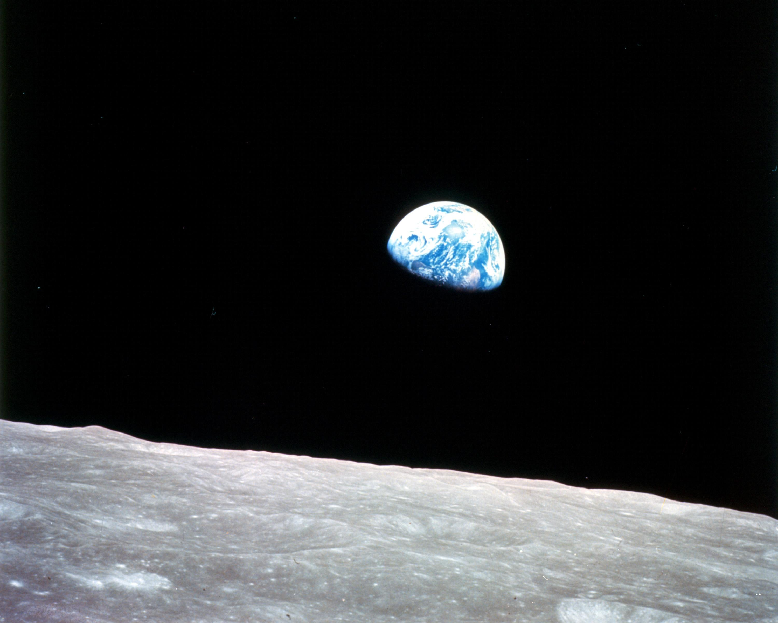
We Are Strangers

Slide 6
To God's elect, strangers in the world … 1 Peter 1 :1
Dear friends, I urge you, as strangers and aliens … 1 Peter 2 :11

Slide 7
This World is Not My HOME…

Slide 8
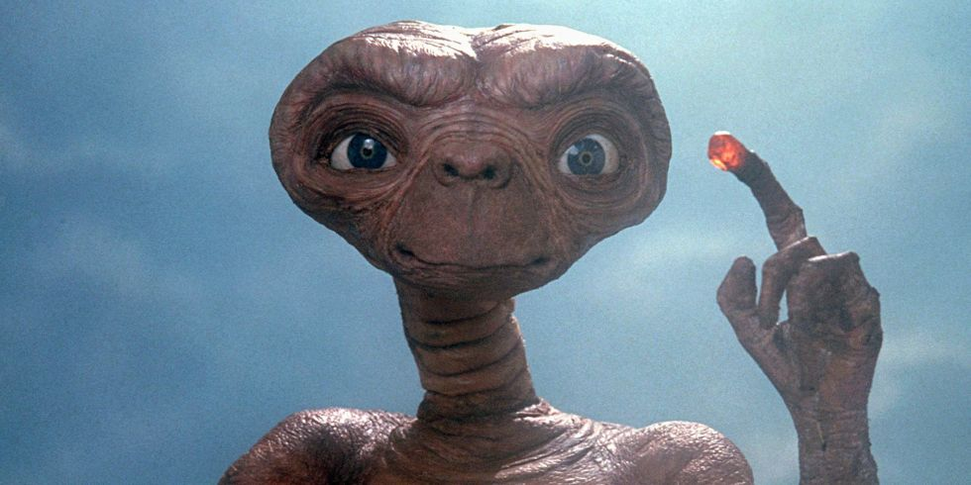

Slide 9
All these people were still living by faith when they died. They did not receive the things promised; they only saw them and welcomed them from a distance, admitting that they were foreigners and strangers on earth. Hebrews 11:13

Slide 10
We Are Resident ALIENS

Slide 11
[They admitted] that they were foreigners and strangers on earth. People who say such things show that they are looking for a country of their own. Hebrews 11:13b-14

Slide 12
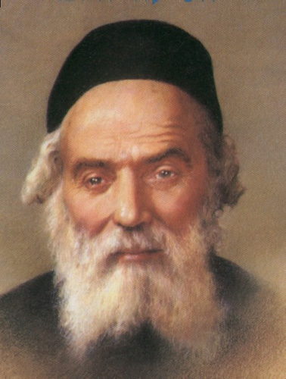
Chofetz Chaim

Slide 13
We Are Citizens of ANOTHER World…

Slide 14
But our citizenship is in heaven, and from it we await a Savior, the Lord Jesus Christ. Philippians 3:20

Slide 15
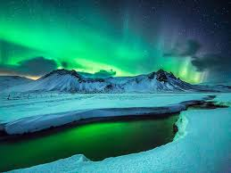

Slide 16
Therefore, we are ambassadors for Christ, God making his appeal through us. 2 Corinthians 5:20

Slide 17
"If I find in myself a desire which no experience in this world can satisfy, the most probable explanation is that I was made for another world."
C.S. Lewis

