Slide 1
Wake Up!!!
1 Corinthians 11:17-34

Slide 2
In the following directives I have no praise for you, for your meetings do more harm than good. 1 Corinthians 11:17

Slide 3
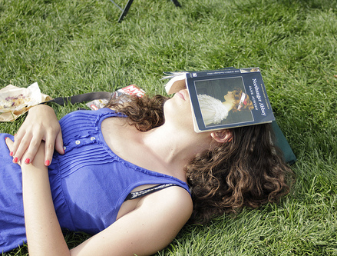
ASLEEP in the Light: The Problem of FORGETTING

Slide 4
When you come together, it is not the Lord’s Supper you eat, for as you eat, each of you goes ahead without waiting for anybody else. One remains hungry, another gets drunk.

Slide 5
Don’t you have homes to eat and drink in? Or do you despise the church of God and humiliate those who have nothing? What shall I say to you? Shall I praise you for this? Certainly not! 1 Corinthians 11:20-22

Slide 6
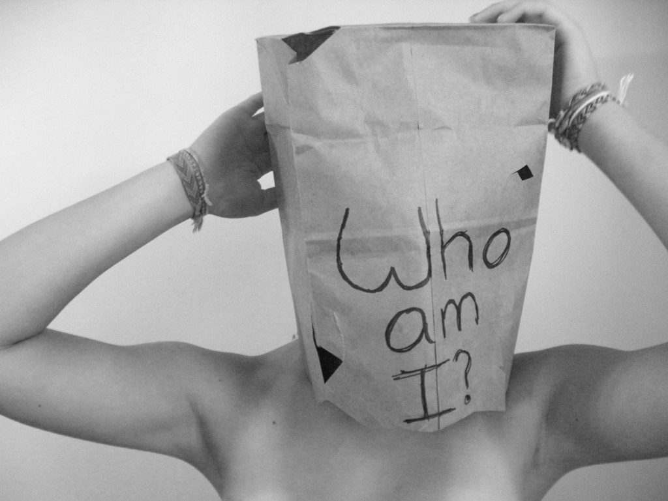
Spiritual AMNESIA: Who Am I?

Slide 7
In the first place, I hear that when you come together as a church, there are divisions among you, and to some extent I believe it. No doubt there have to be differences among you to show which of you have God’s approval.
1 Corinthians 11:18-19

Slide 8
Remedy: Put Yourself Back in the STORY!

Slide 9
For I received from the Lord what I also passed on to you: The Lord Jesus, on the night he was betrayed, took bread, and when he had given thanks, he broke it and said, “This is my body, which is for you; do this in remembrance of me.”

Slide 10
In the same way, after supper he took the cup, saying, “This cup is the new covenant in my blood; do this, whenever you drink it, in remembrance of me.” For whenever you eat this bread and drink this cup, you proclaim the Lord’s death until he comes. 1 Corinthians 11:23-26

Slide 11
The Story Reminds Us Who We ARE!

Slide 12
So then, whoever eats the bread or drinks the cup of the Lord in an unworthy manner will be guilty of sinning against the body and blood of the Lord . . . For those who eat and drink without discerning the body of Christ eat and drink judgment on themselves.
1 Corinthians 11:27, 29

Slide 13
The Story Reminds Us Who We WERE!

Slide 14
This is my body, which is for you… This cup is the new covenant in my blood… 1 Corinthians 11:24, 25

Slide 15
Everyone ought to examine themselves before they eat of the bread and drink from the cup. 1 Corinthians 11:28

Slide 16
The Story Reminds Us Who We Are BECOMING!

Slide 17
For whenever you eat this bread and drink this cup, you proclaim the Lord’s death until he comes. 1 Corinthians 11:26

