Slide 1
Easter: Getting Unstuck

Slide 2
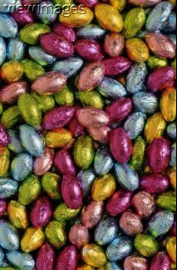
Easter Egg Hunt!!

Slide 3
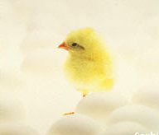

Slide 4
Easter Eggs Are Little Surprises that Remind Us...

Slide 5
… Things Are Not Always as They Appear to Be

Slide 6
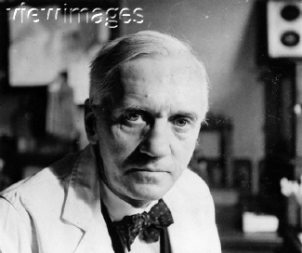
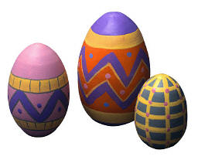
Fleming Discovers Penicillin

Slide 7
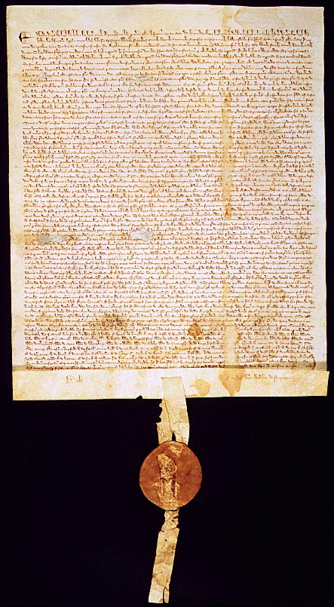
Signing of the Magna Carta

Slide 8
Goodyear Vulcanizes Rubber

Slide 9
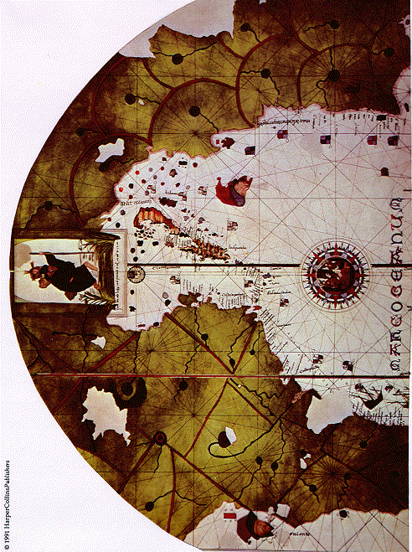
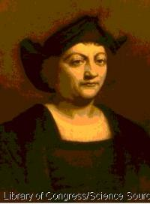
Columbus Discovers the New World

Slide 10
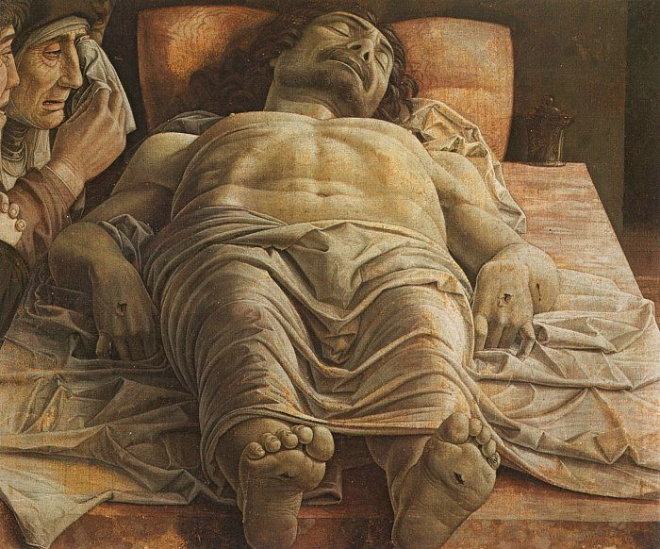
On the first day of the week, very early in the morning, the women took the spices they had prepared and went to the tomb. Luke 24:1

Slide 11
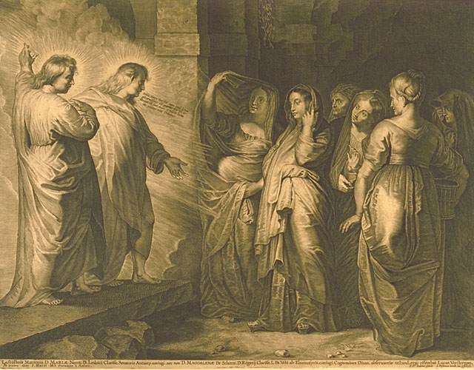
...they did not find the body of the Lord Jesus....

Slide 12
Why do you look for the living among the dead? He is not here; he has risen!

Slide 13
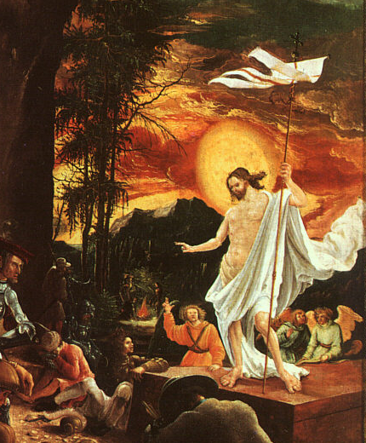
He is Risen!

Slide 14
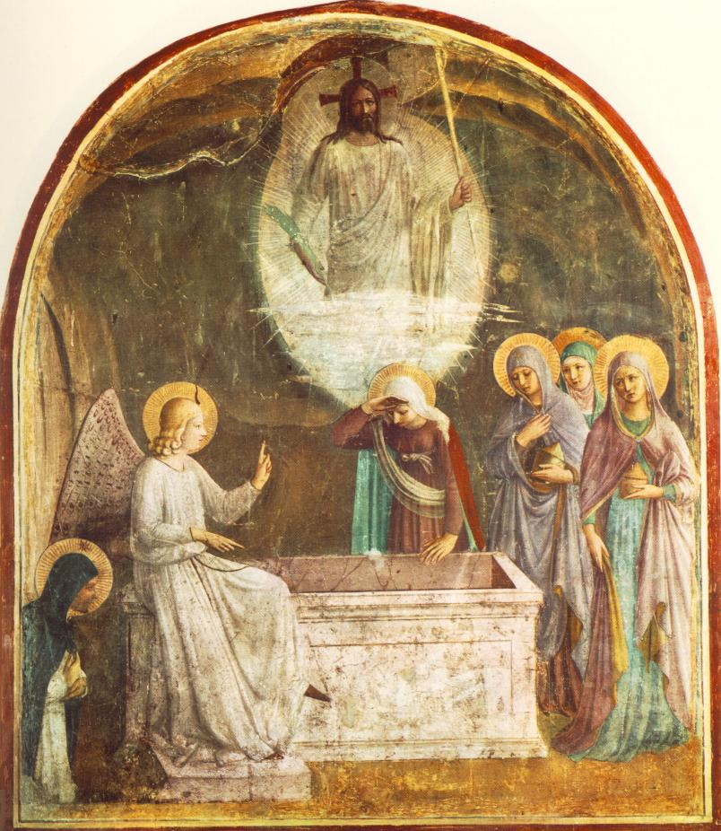
He is Risen!

Slide 15
What Does It Take to Get Unstuck?
First, It Takes an Easter Egg MOMENT...

Slide 16
Peter, however, got up and ran to the tomb. Bending over, he saw the strips of linen lying by themselves, and he went away, wondering to himself what had happened. Luke 24:12

Slide 17
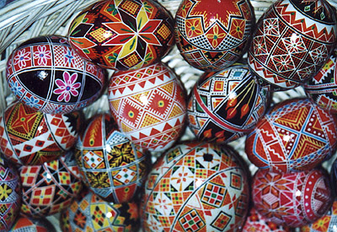
What Does It Take to Get Unstuck?
Then, It Takes an Easter Egg PROCESS...

Slide 18
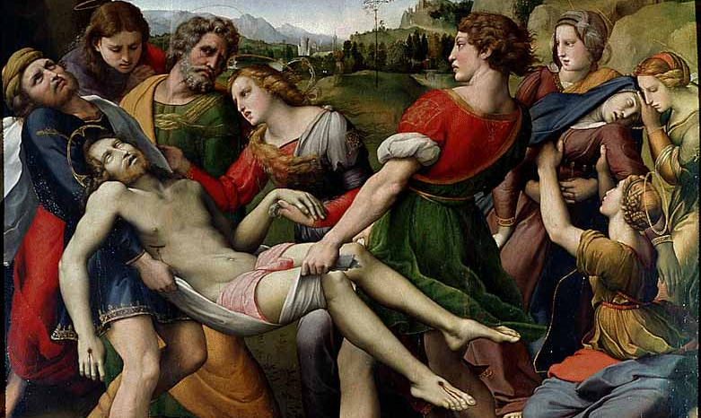
People Change...
When They HURT So Much They Want To CHANGE...

Slide 19
The third time he said to him, "Simon son of John, do you love me?" Peter was hurt because Jesus asked him the third time, "Do you love me?" He said, "Lord, you know all things; you know that I love you." John 21:17

Slide 20
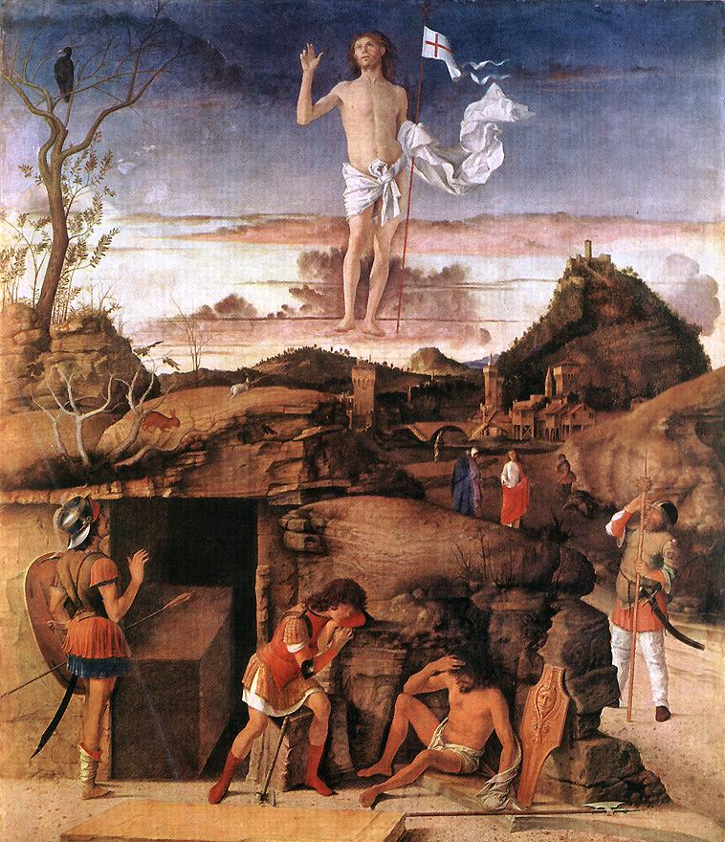
He is Risen

Slide 21
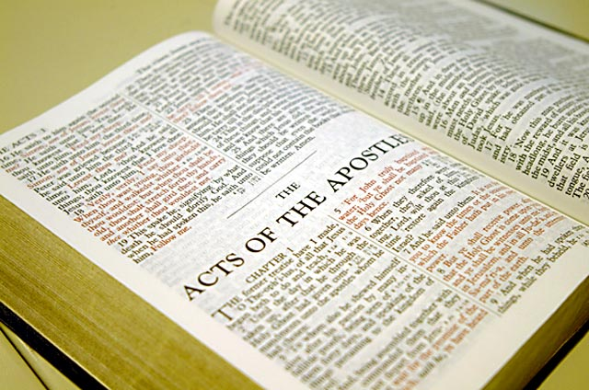
People Change...
When They LEARN So Much They Have To CHANGE...

Slide 22
Why are you troubled, and why do doubts rise in your minds? …This is what I told you while I was still with you: Everything must be fulfilled that is written about me in the Law of Moses, the Prophets and the Psalms. Luke 24:38, 44

Slide 23
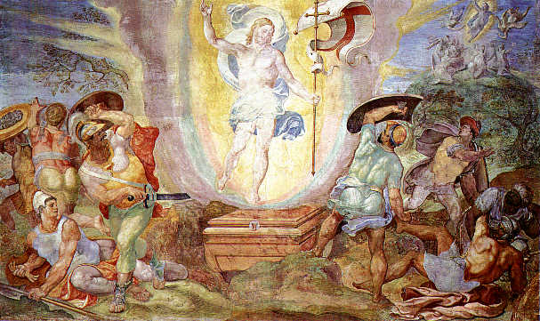
He is Risen

Slide 24
People Change...
When They RECEIVE So Much They Are ABLE To Change...

Slide 25
People Change...
All of them were filled with the Holy Spirit... Acts 2:4

Slide 26
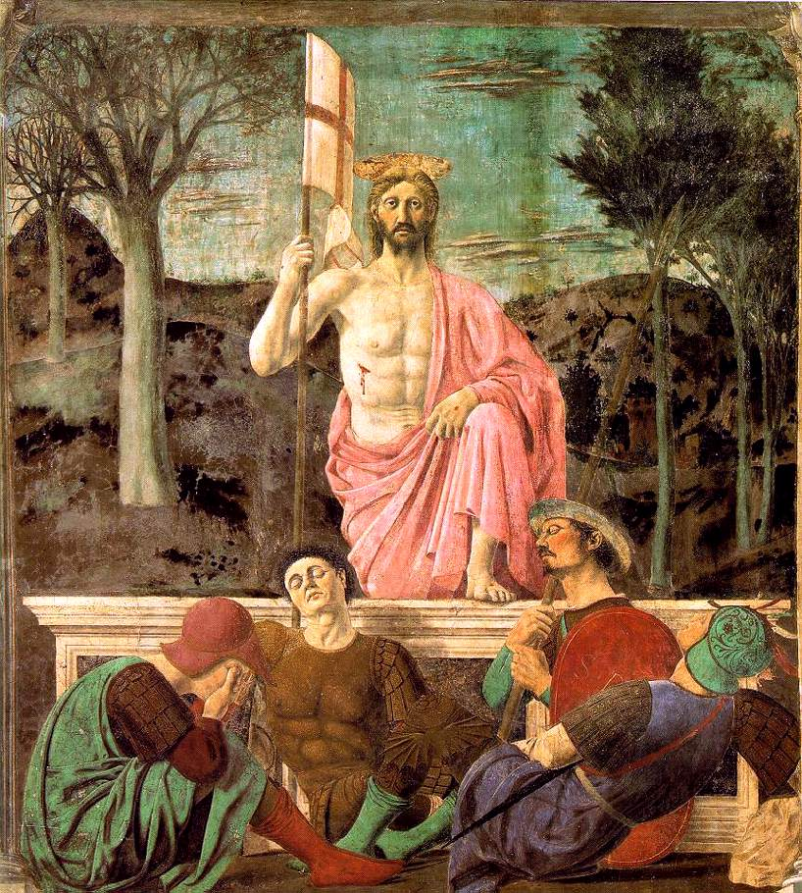
He is Risen

