Slide 1
Who Am I?
The Spirit of Adoption
on the Day of Pentecost
Romans 8:12-17

Slide 2
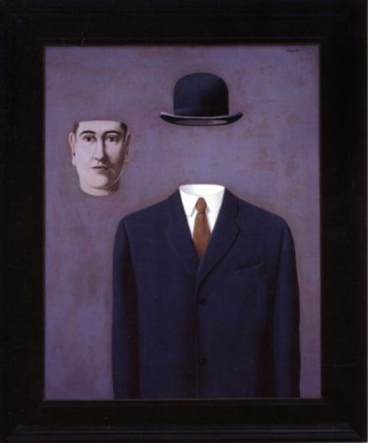
We Are All ORPHANS in Search of an Identity

Slide 3
He came to his own, and his own people did not receive him. But to all who did receive him, who believed in his name, he gave the right to become children of God, who were born, not of blood nor of the will of the flesh nor of the will of man, but of God. John 1:11-13

Slide 4
Adoption: Four Gifts of Knowing Who(SE) You Are

Slide 5
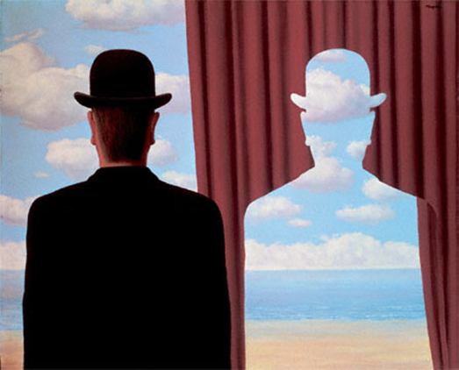
IMITATION: When I Grow Up… I Wanna Be Like DAD!

Slide 6
So then, brothers, we are debtors, not to the flesh, to live according to the flesh. For if you live according to the flesh you will die, but if by the Spirit you put to death the deeds of the body, you will live. For all who are led by the Spirit of God are sons of God. Romans 8:12-14

Slide 7
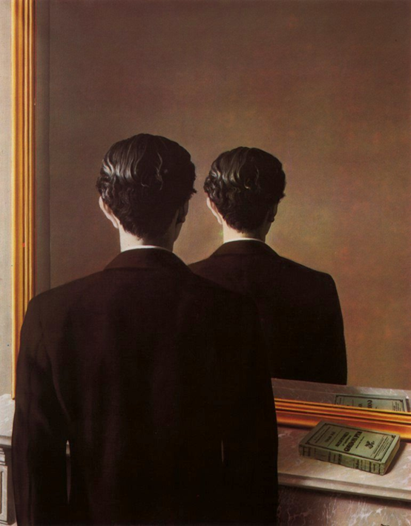
ASSURANCE: Always ACCEPTED

Slide 8
For you did not receive the spirit of slavery to fall back into fear, but you have received the Spirit of adoption as sons, by whom we cry, “Abba! Father!” Romans 8:15

Slide 9
• BELONGING: You Are Not ALONE…

Slide 10
The Spirit himself bears witness with our spirit that we are children of God… Romans 8:16

Slide 11
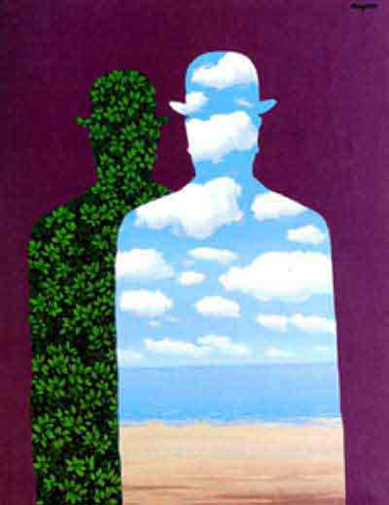
INHERITANCE: The Certain Hope of Something BETTER…

Slide 12
…and if children, then heirs—heirs of God and fellow heirs with Christ, provided we suffer with him in order that we may also be glorified with him. Romans 8:17

