Slide 1
2 Peter 3:3-15

Slide 2
…knowing this first of all, that scoffers will come in the last days with scoffing, following their own sinful desires. They will say, “Where is the promise of his coming? For ever since the fathers fell asleep, all things are continuing as they were from the beginning of creation.”
2 Peter 3:3-4

Slide 3
But do not overlook this one fact, beloved, that with the Lord one day is as a thousand years, and a thousand years as one day. The Lord is not slow to fulfill his promise as some count slowness, but is patient toward you, not wishing that any should perish, but that all should reach repentance.
2 Peter 3:8-9

Slide 4
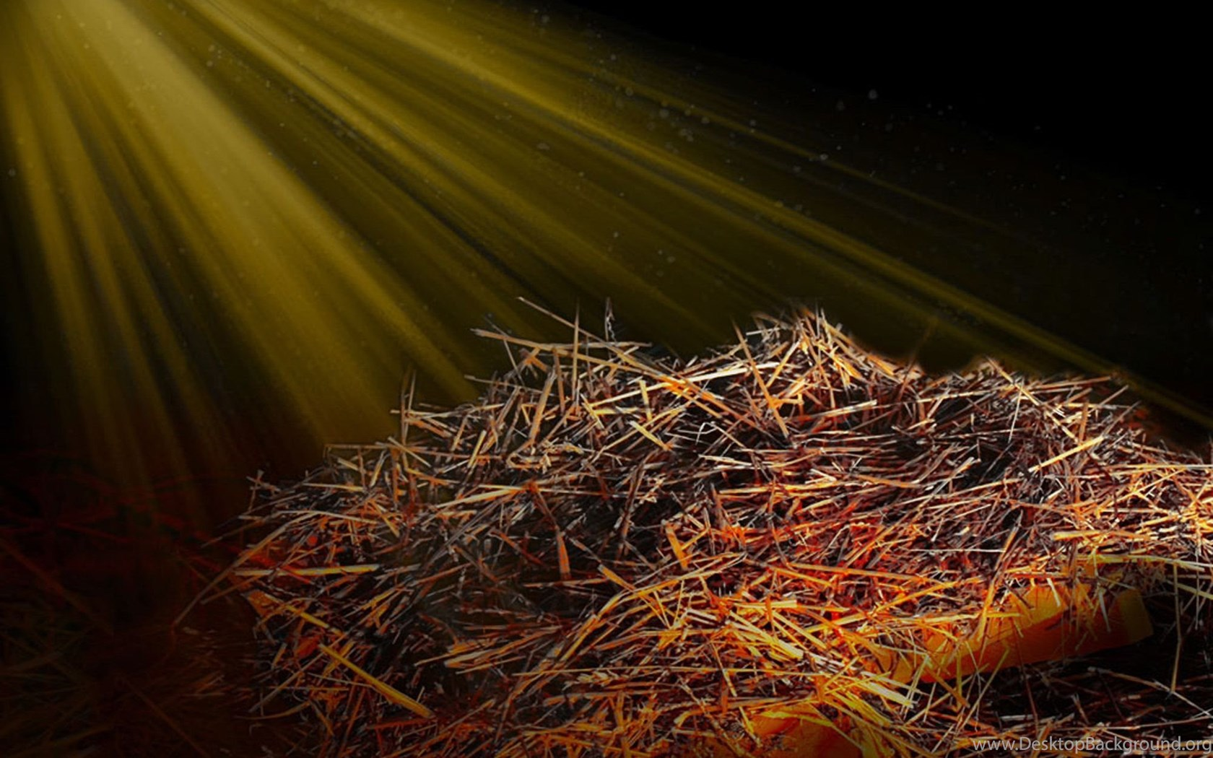
Away FROM the Manger

Slide 5
For to us a child is born, to us a son is given; and the government shall be upon his shoulder, and his name shall be called
Wonderful Counselor, Mighty God, Everlasting Father, Prince of Peace. Of the increase of his government and of peace
there will be no end, on the throne of David and over his kingdom, to establish it and to uphold it with justice and with righteousness from this time forth and forevermore. Isaiah 9:6-7

Slide 6
He was despised and rejected by men, a man of sorrows and acquainted with grief; and as one from whom men hide their faces he was despised, and we esteemed him not. Surely he has borne our griefs and carried our sorrows; yet we esteemed him stricken, smitten by God, and afflicted. But he was pierced for our transgressions; he was crushed for our iniquities; upon him was the chastisement that brought us peace, and with his wounds we are healed. Isaiah 53:3-5

Slide 7
The thief comes only to steal and kill and destroy. I came that they may have life and have it abundantly. I am the good shepherd. The good shepherd lays down his life for the sheep.
John 10:10-11

Slide 8
I saw heaven standing open and there before me was a white horse, whose rider is called Faithful and True. With justice he judges and makes war. His eyes are like blazing fire, and on his head are many crowns. He has a name written on him that no one knows but he himself. He is dressed in a robe dipped in blood, and his name is the Word of God.
Revelation 19:11-13

Slide 9
…the kingdom of God is within you. Luke 17:21

Slide 10
…your kingdom come, your will be done on earth as it is in heaven. Matthew 6:10

Slide 11
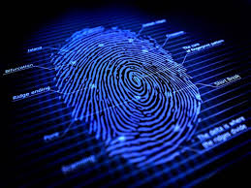
Happily-Ever-After Faith
Looks for FINGERPRINTS…
Prophecy POINTS to God…

Slide 12
But the day of the Lord will come like a thief, and then the heavens will pass away with a roar, and the heavenly bodies will be burned up and dissolved, and the earth and the works that are done on it will be exposed.
2 Peter 3:10

Slide 13
No one knows about that day or hour, not even the angels in heaven, nor the Son, but only the Father. Matthew 24:36

Slide 14
He said to them: "It is not for you to know the times or dates the Father has set by his own authority. Acts 1:7

Slide 15
I am the Alpha and the Omega," says the Lord God, "who is, and who was, and who is to come, the Almighty." Revelation 1:8

Slide 16
Worthy is the Lamb, who was slain, to receive power and wealth and wisdom and strength and honor and glory and praise! Revelation 5:12

Slide 17
Happily-Ever-After Faith
Anticipates TRIALS…
Prophecy PREPARES Us for
Things to Come…

Slide 18
Since all these things are thus to be dissolved, what sort of people ought you to be in lives of holiness and godliness, waiting for and hastening the coming of the day of God, because of which the heavens will be set on fire and dissolved, and the heavenly bodies will melt as they burn! But according to his promise we are waiting for new heavens and a new earth in which righteousness dwells.
2 Peter 3:11-13

Slide 19
Jesus answered: "Watch out that no one deceives you.
For then there will be great distress, unequaled from the beginning of the world until now--and never to be equaled again… See, I have told you ahead of time.
Matthew 24:4, 21, 25

Slide 20
I have told you this, so that when the time comes you will remember that I warned
you.
I have told you these things, so that in me you may have peace. In this world you
will have trouble. But take heart! I have overcome the world. John 16: 4, 33

Slide 21
Happily-Ever-After Faith HANGS ON…
Prophecy PRESERVES Us in Uncertain Times

Slide 22
Therefore, beloved, since you are waiting for these, be diligent to be found by him without spot or blemish, and at peace. And count the patience of our Lord as salvation… 2 Peter 3:14-15

Slide 23
Dear friends, now we are children of God, and what we will be has not yet been made known. But we know that when he appears, we shall be like him, for we shall see him as he is. Everyone who has this hope in him purifies himself, just as he is pure. 1 John 3:2-3

