Slide 1
our Inheritance
Galatians 4; 4-7
31 December 2017
ICEL

Slide 2
Psalm 148 (NIV)
1 Praise the Lord.
Praise the Lord from the heavens;
praise him in the heights above.
2 Praise him, all his angels;
praise him, all his heavenly hosts.
3 Praise him, sun and moon;
praise him, all you shining stars.
4 Praise him, you highest heavens
and you waters above the skies.
ICEL

Slide 3
But, when the time
had finally come…
ICEL

Slide 4
waiting
Then the angel of the Lord said, “Lord Almighty, how long will you withhold mercy from Jerusalem…?”
Zech: 1;12 (NIV)
ICEL

Slide 5
when the time came…
God sent His Son…
to redeem those under the law, that we might receive adoption to sonship
Gal 4;4a & 5 (NIV)
ICEL

Slide 6
Calling God
“Father”
even “Dad”
ICEL

Slide 7
For those who are led by the Spirit of God
are the children of God.
The Spirit you received does not make you
slaves, so that you live in fear again; rather,
the Spirit you received brought about your
adoption to sonship.
And by him we cry, “Abba, Father.”
The Spirit himself testifies
with our spirit that we are God’s children.
Now if we are children, then we are
heirs—heirs of God and co-heirs with Christ,
if indeed we share in his sufferings in order
that we may also share in his glory.
Rom 8; 14-17 (NIV)
ICEL

Slide 8
It is a dreadful thing to fall into the hands of the living God.
Heb 10; 31 (NIV)
Yet, this wrath is NOT directed at His children
ICEL

Slide 9
“Come to me, all you who are weary and burdened, and I will give you rest. Take my yoke upon you and learn from me, for I am gentle and humble in heart, and you will find rest for your souls. For my yoke is easy and my burden is light.”
Matt 11;28-30 (NIV)
to equip his people for works of service, so that the body of Christ may be built up
Eph 4;12 (NIV)
ICEL

Slide 10
Rest assured
of our inheritance
ICEL

Slide 11
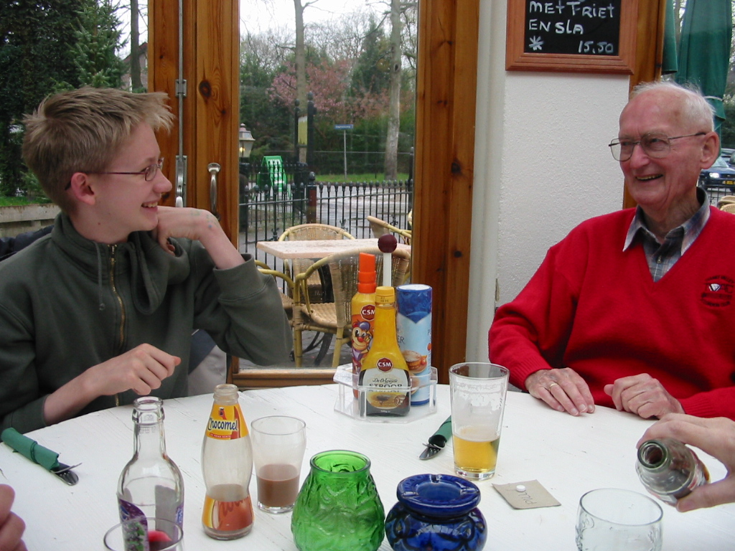
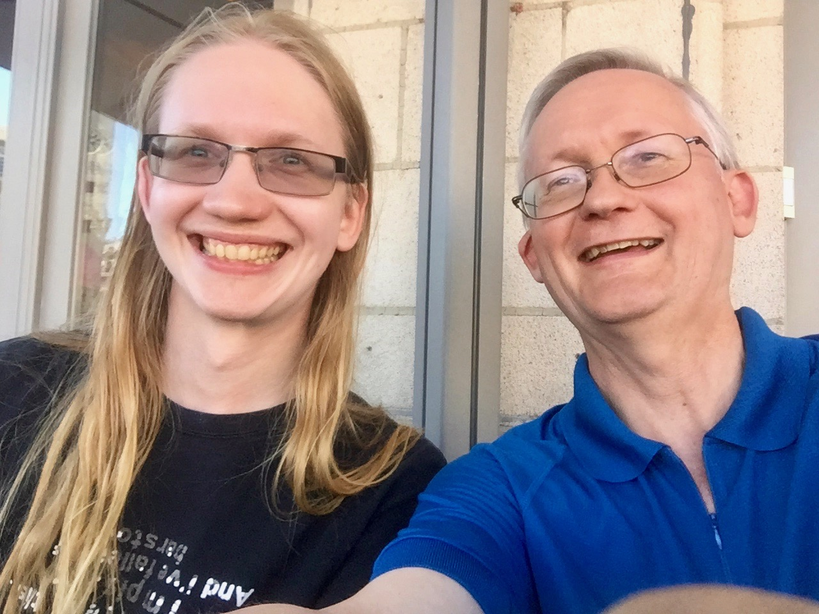
Like father, like son
ICEL

Slide 12
A spiritual inheritance
Now if we are children, then we are heirs—heirs of God and co-heirs with Christ, if indeed we share in his sufferings in order that we may also share in his glory.
Rom 8;17 (NIV)
ICEL

Slide 13
giving joyful thanks to the Father, who has qualified you to share in the inheritance of his holy people in the kingdom of light
Col 1;12 (NIV)
amazing career prospects!
ICEL

Slide 14
the promised Holy Spirit, who is a deposit guaranteeing our inheritance until the redemption of those who are God’s possession—to the praise of his glory.
Eph 1; 13b-14 (NIV)
ICEL

Slide 15
Conclusion
Children of Jesus
the Holy Spirit in our souls
we can call God “Father”
…and God calls us His children
ICEL

Slide 16
His time will come
in the meantime
Happy New Year
ICEL

Slide 17
ICEL

