Slide 1
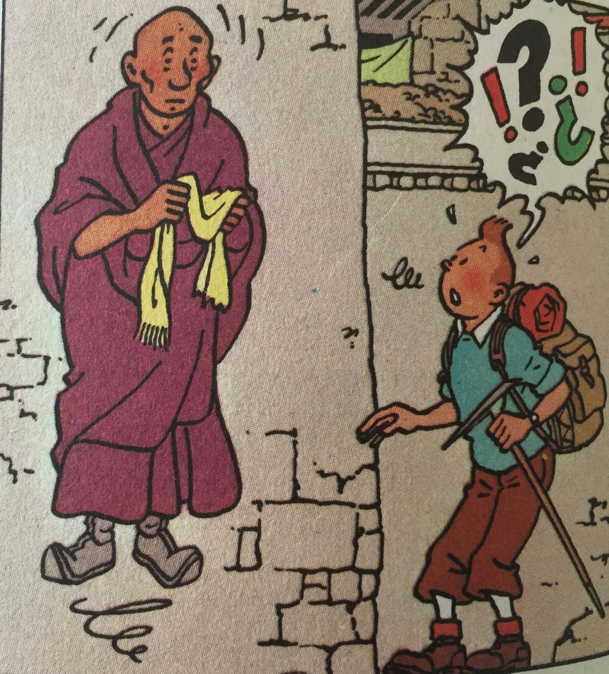
Meditation
ICEL

Slide 2
Psalm 27, v4
4 One thing I ask from the Lord,
this only do I seek: that I may
dwell in the house of the Lord
all the days of my life, to gaze
on the beauty of the Lord
and to seek him in his temple.
ICEL

Slide 3
Dwell in His house
1 Whoever dwells in the shelter
of the Most High will rest in the
shadow of the Almighty.
2 I will say of the Lord,
‘He is my refuge and my fortress,
my God, in whom I trust.’
Psalm 91, vv 1-2
ICEL

Slide 4
“dwell” in New Testament
God will dwell in us
Here I am! I stand at the door
and knock. If anyone hears my
voice and opens the door, I will
come in and eat with that person,
and they with me. Rev 3, 20 (NIV)
ICEL

Slide 5
God wants to live in our hearts
…and to know this love that
surpasses knowledge – that you
may be filled to the measure of
all the fullness of God. Eph 3, 19 (NIV)
ICEL

Slide 6
A holy structure
21 In him the whole building is
joined together and rises to
become a holy temple in the Lord.
22 And in him you too are being
built together to become a dwelling
in which God lives by his Spirit.
Eph 2, vv 21-22 (NIV)
ICEL

Slide 7
ATTITUDE
ICEL

Slide 8
gaze upon His beauty
Turn your eyes upon Jesus,
Look full in His wonderful face,
And the things of Earth will grow
strangely dim
In the light of His glory and grace.
ICEL

Slide 9
…at his sacred tent I will sacrifice
with shouts of joy;
I will sing and make music to
the Lord.
Psalm 27, 6b (NIV)
ICEL

Slide 10
Distractions
I see one of the ceiling lights is
broken again
oooh look, Brian’s had a haircut
did I remember to turn off the
cooker before we came out?…
ICEL

Slide 11
Concentrate
“O how I love your Law.
I meditate on it all day long”
Ps 119, 97 (NIV)
ICEL

Slide 12
ATTITUDE
APPROACH
ICEL

Slide 13
seek Him in his temple
Why?
For in the day of trouble he will
keep me safe in his dwelling;
he will hide me in the shelter of
his sacred tent and set me high
upon a rock.
Ps 27, 5 (NIV)
ICEL

Slide 14
So do not worry, saying,
“What shall we eat?” or
“What shall we drink?” or
“What shall we wear?”
For the pagans run after all these
things, and your heavenly Father
knows that you need them.
But seek first his kingdom and his
righteousness, and all these things
will be given to you as well.
Matt 6, 31-33 (NIV)
ICEL

Slide 15
When?
Seek the Lord while He
may be found Is 55,6 (NIV)
Now!
ICEL

Slide 16
How?
All Scripture is God-breathed
and is useful for teaching,
rebuking, correcting and
training in righteousness,
so that the servant of God may
be thoroughly equipped for every
good work.
2 Tim 3, 16-17
ICEL

Slide 17
ATTITUDE
APPROACH
ACTIVITY
ICEL

Slide 18
I remain confident of this:
I will see the goodness
of the Lord
in the land of the living.
Wait for the Lord;
be strong and take heart
and wait for the Lord.
Ps 27, 13-14 (NIV)
ICEL

