Slide 1
Welcome to ICEL
International Church
of Evangelical
Christians
in Leuven
www.icel.be
Notes:
1

Slide 3
COME AS YOU ARE
Ben Glover, David Crowder, Matt Maher
COME OUT OF SADNESS from wherever you've been
Come, brokenhearted let rescue begin
Come find your mercy, O sinner, come kneel
Earth has no sorrow that
Heaven can't heal
Earth has no sorrow that
Heaven can't heal

Slide 4
Lay down your burdens
Lay down your shame
All who are broken
Lift up your face
O wanderer, come home
You're not too far
So lay down your hurt, lay down your heart
Come as you are

Slide 5
There's hope for the hopeless
And all those who've strayed
Come sit at the table
Come taste the grace
There's rest for the weary
Rest that endures
Earth has no sorrow that
Heaven can't cure

Slide 6
Come as you are
Come as you are
Fall in His arms
Come as you are

Slide 7
There's joy for the morning
O sinner, be still
Earth has no sorrow that Heaven can't heal
Earth has no sorrow that Heaven can't heal

Slide 9
ARISE, MY SOUL, ARISE
Text:Charles Wesley, Music:Kevin Twit
ARISE, MY SOUL, ARISE,
shake off your guilty fears;
The bleeding sacrifice,
in my behalf appears;
Before the throne my Surety stands,
Before the throne my Surety stands,
My name is written on His hands.

Slide 10
Arise (arise), arise (arise), arise
Arise, my soul, arise.
Arise (arise), arise (arise), arise
Arise, my soul, arise.
Shake off your guilty fears and rise

Slide 11
He ever lives above,
for me to intercede;
His all redeeming love,
His precious blood, to plead;
His blood atoned for every race,
His blood atoned for every race,
And sprinkles now the throne of grace.

Slide 12
Arise (arise), arise (arise), arise
Arise, my soul, arise.
Arise (arise), arise (arise), arise
Arise, my soul, arise.
Shake off your guilty fears and rise

Slide 13
Five bleeding wounds He bears;
received on Calvary;
They pour effectual prayers;
they strongly plead for me:
"Forgive him, O forgive," they cry,
"Forgive him, O forgive," they cry,
"Nor let that ransomed sinner die!"

Slide 14
Arise (arise), arise (arise), arise
Arise, my soul, arise.
Arise (arise), arise (arise), arise
Arise, my soul, arise.
Shake off your guilty fears and rise

Slide 15
The Father hears Him pray,
His dear anointed One;
He cannot turn away
the presence of His Son;
The Spirit answers to the blood,
The Spirit answers to the blood
And tells me I am born of God.

Slide 16
Arise (arise), arise (arise), arise
Arise, my soul, arise.
Arise (arise), arise (arise), arise
Arise, my soul, arise.
Shake off your guilty fears and rise

Slide 17
My God is reconciled;
His pardoning voice I hear;
He owns me for His child;
I can no longer fear
With confidence I now draw nigh,
With confidence I now draw nigh,
And "Father, Abba, Father," cry.

Slide 18
Arise (arise), arise (arise), arise
Arise, my soul, arise.
Arise (arise), arise (arise), arise
Arise, my soul, arise.
Shake off your guilty fears and rise
©1996 Kevin Twit Music (ASCAP).Used by permission. All rights reserved.

Slide 20
THIS LITTLE LIGHT OF MINE
This little light of mine, I'm gonna let it shine.
This little light of mine, I'm gonna let it shine.
This little light of mine, I'm gonna let it shine,
Let it shine, let it shine, let it shine.
Hide it under a bushel, NO! I'm gonna let it shine
Hide it under a bushel, NO! I'm gonna let it shine
Hide it under a bushel, NO! I'm gonna let it shine
Let it shine, let it shine, let it shine.

Slide 21
Won't let Satan blow it out, I'm gonna let it shine
Won't let Satan blow it out, I'm gonna let it shine
Won't let Satan blow it out, I'm gonna let it shine
Let it shine, let it shine, let it shine.
Let it shine 'till Jesus comes, I'm gonna let it shine
Let it shine 'till Jesus comes, I'm gonna let it shine
Let it shine 'till Jesus comes, I'm gonna let it shine
Let it shine, let it shine, let it shine.
Copyright

Slide 23
780 HOW DEEP THE FATHER’S LOVE
Stuart Townend
HOW DEEP THE FATHER’S LOVE FOR US,
How vast beyond all measure,
That He should give His only Son
To make a wretch His treasure.
How great the pain of searing loss –
The Father turns His face away,
As wounds which mar the Chosen One
Bring many sons to glory.

Slide 24
Behold the man upon a cross,
My sin upon His shoulders;
Ashamed, I hear my mocking voice
Call out among the scoffers.
It was my sin that held Him there
Until it was accomplished;
His dying breath has brought me life –
I know that it is finished.

Slide 25
I will not boast in anything,
No gifts, no power, no wisdom;
But I will boast in Jesus Christ,
His death and resurrection.
Why should I gain from His reward?
I cannot give an answer;
But this I know with all my heart –
His wounds have paid my ransom.
Copyright © 1995 Kingsway’s Thankyou Music.

Slide 27
1827 HERE I AM
Martin Smith & Stuart Garrard
HERE I AM,
Humbled by Your majesty,
Covered by Your grace so free.
Here I am,
Knowing I’m a sinful man,
Covered by the blood of the Lamb.
Now I’ve found
The greatest love of all is mine,
Since You laid down Your life,
The greatest sacrifice.

Slide 28
Majesty, majesty.
Your grace has found me just as I am,
Empty-handed but alive in Your hands.
Majesty, majesty.
Forever I am changed by Your love
In the presence of Your majesty.

Slide 29
Here I am,
Humbled by the love that You give,
Forgiven so that I can forgive.
Here I stand,
Knowing that I’m Your desire,
Sanctified by glory and fire.
Copyright © 2003 Curious? Music UK/Bucks Music Ltd

Slide 31
FATHER ME
Paul Oackly
You have loved me with such perfect love
Fathered me with such a tender touch
Your faithfulness surrounds my soul
Your mercy lifts my head
How could I repay all you have done?

Slide 32
Father me, faithful Father
Father me, no-one else could ever be
The perfect Father God to me

Slide 33
You now clothe me with your righteousness
Hide me in the shadow of your wings
And even in my darkest days
Your light will guide my way
Hallelujah to the King of grace

Slide 34
Father me, faithful Father
Father me, no-one else could ever be
The perfect Father God to me
Copyright (c) 2005 Thankyou music

Slide 36
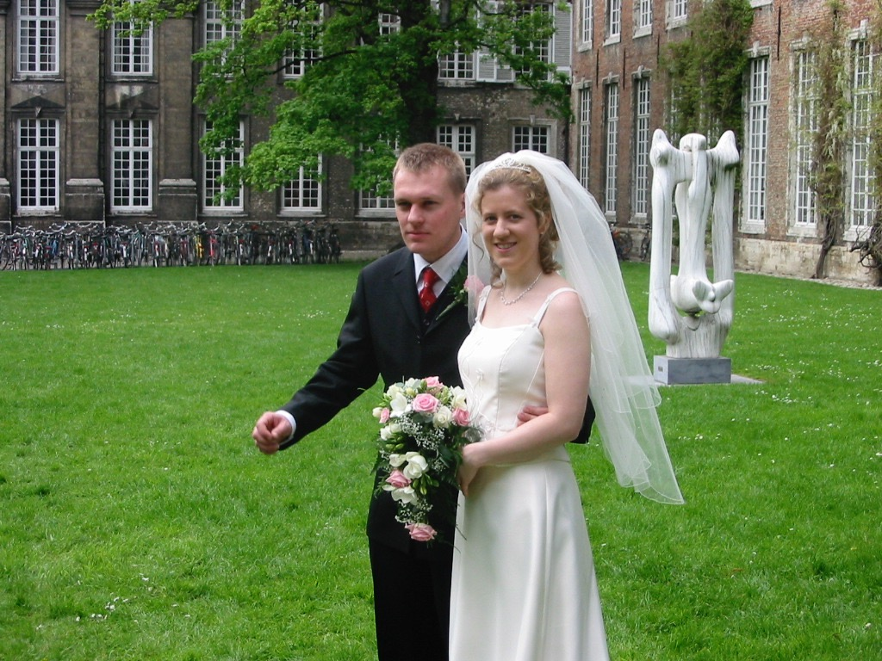
Weddings!
ICEL

Slide 37
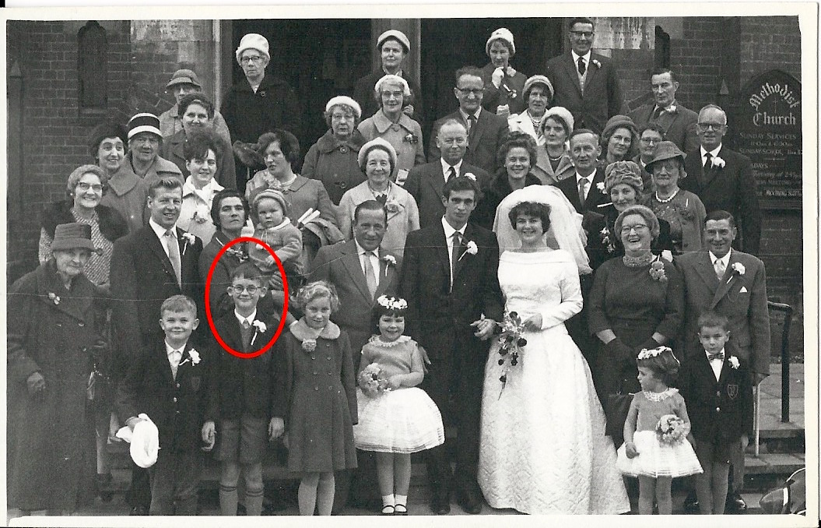
1960s
ICEL

Slide 38
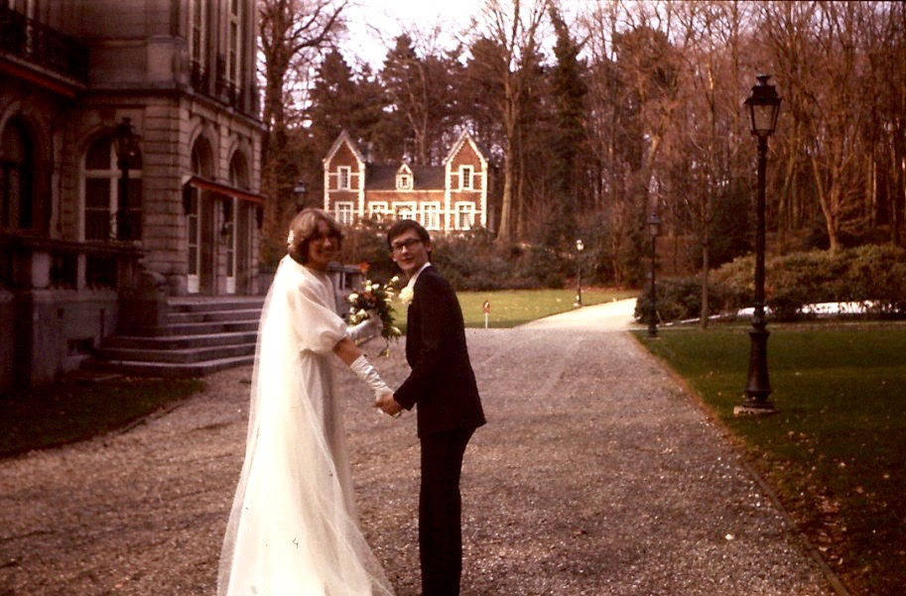
1979
ICEL

Slide 39
In Jesus’ time
weddings went on for days
ran out of wine
ICEL

Slide 40
nothing but the best was good enough
ICEL

Slide 41
Jesus offers us gifts
We know them as ‘gifts of the Spirit’
ICEL

Slide 42
1 Corinthians 12:1-11 (New International Version)
¹ Now about the gifts of the Spirit, brothers and sisters, I do not want you to be uninformed.
² You know that when you were pagans, somehow or other you were influenced and led astray to dumb idols.
³ Therefore I want you to know that no one who is speaking by the Spirit of God says, ‘Jesus be cursed,’ and no one can say, ‘Jesus is Lord,’ except by the Holy Spirit.

Slide 43
1 Corinthians 12:1-11 (New International Version)
⁴ There are different kinds of gifts, but the same Spirit distributes them.
⁵ There are different kinds of service, but the same Lord.
⁶ There are different kinds of working, but in all of them and in everyone it is the same God at work.
⁷ Now to each one the manifestation of the Spirit is given for the common good.

Slide 44
1 Corinthians 12:1-11 (New International Version)
⁸ To one there is given through the Spirit a message of wisdom, to another a message of knowledge by means of the same Spirit, ⁹ to another faith by the same Spirit, to another gifts of healing by that one Spirit, ¹⁰ to another miraculous powers, to another prophecy, to another distinguishing between spirits, to another speaking in different kinds of tongues, and to still another the interpretation of tongues.
¹¹ All these are the work of one and the same Spirit, and he distributes them to each one, just as he determines.

Slide 45
message of wisdom
message of knowledge
faith
healing
miracles
distinguishing spirits
tongues
interpretation of tongues
ICEL

Slide 46
Controversy
a gift is “given”
not a mandatory sign of being a Christian
‘no-one can say “Jesus is Lord” except by the Holy Spirit.’
1 Cor 12, 3b
ICEL

Slide 47
gifts are for a purpose
to build up the church
to draw others to faith
…not for self gratification
ICEL

Slide 48
Communicators
those who preach or teach
they encourage the people and help to build them up
ICEL

Slide 49
Faith
God gives us all a measure of faith
some receive a special faith
hard times
Daniel in the lions’ den
Jesus shows his trust in the Father
ICEL

Slide 50
Healing and Miracles
much disagreement
God does choose to heal miraculously
…but that’s not the norm
ICEL

Slide 51
source of these gifts
The Lord decides what gift to give you
not based on what you desire necessarily
but on His plan for your life
ICEL

Slide 52
our challenge
what is our gift?
how can we know?
ask God
exercise our prayer muscle
listen to the ‘still small voice’
listen to advice from other Christians
ICEL

Slide 53
ICEL is a great place to stretch your ‘spiritual muscles’
ICEL

Slide 55
1168 AMAZING GRACE
John Newton (1725-1807), adapt. Nathan Fellingham
AMAZING GRACE, how sweet the sound
That saved a wretch like me;
I once was lost, but now am found,
Was blind, but now I see.

Slide 56
Amazing love has come to me.
I lift up my voice to the heavens,
Lift up my hands to the King,
And I cry 'hosanna, hosanna in the highest.'
Jesus my Lord is exalted
Far above every name,
And I cry ‘hosanna, hosanna in the highest.’

Slide 57
'Twas grace that taught my heart to fear,
And grace my fears relieved;
How precious did that grace appear,
The hour I first believed!

Slide 58
Amazing love has come to me.
I lift up my voice to the heavens,
Lift up my hands to the King,
And I cry 'hosanna, hosanna in the highest.'
Jesus my Lord is exalted
Far above every name,
And I cry ‘hosanna, hosanna in the highest.’

Slide 59
The Lord has promised good to me,
His word my hope secures;
He will my shield and portion be
As long as life endures.
Copyright © 2000 Thankyou Music

Slide 61
Announcements
SUNDAY | Choir practice | 12.00PM | Chapel
 | Restaurant Lunch | 12.00PM | See Sven-Erik
 | Worship Fellowship | 7.00 PM | St-Michielscentrum
TUESDAY | Women’s Prayer Meeting | 8.00 PM | See Elizabeth Obi
WEDNESDAY | Bible Study | 7.30 PM | St-Michielscentrum
THURSDAY | Prayer Meeting | 8.00 PM | Lin’s home
FRIDAY | Chinese Fellowship | 7.00 PM | St-Michielscentrum
SATURDAY | Nepalese Fellowship | 6.00 PM | Min & Srijana’s home
Home groups: please contact HUGO
Prayer requests can be made via the RED BOX or via www.icel.be
Questions ? Look for the person wearing the ICEL CONTACT badge!
Notes:
61

Slide 64
865 JESUS CHRIST
Matt Redman
JESUS CHRIST, I think upon Your sacrifice,
You became nothing, poured out to death.
Many times I’ve wondered at Your gift of life,
And I’m in that place once again.
And I’m in that place once again.

Slide 65
And once again I look upon
The cross where You died,
I’m humbled by Your mercy
And I’m broken inside.
Once again I thank You,
Once again I pour out my life.

Slide 66
Now You are exalted to the highest place,
King of the heavens, where one day I’ll bow.
But for now, I marvel at this saving grace,
And I’m full of praise once again.
I’m full of praise once again.

Slide 67
And once again I look upon
The cross where You died,
I’m humbled by Your mercy
And I’m broken inside.
Once again I thank You,
Once again I pour out my life.

Slide 68
Thank You for the cross,
Thank You for the cross,
Thank You for the cross, my Friend.
(Repeat)
Copyright © 1995 Kingsway’s Thankyou Music.

